Slide 1
Likes and Loves from the Literary Lists 2022 Edition Picture Books
February 11, 2022
www.mhaloin.com

Slide 2
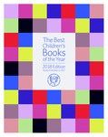
Book Review Sources
Likes and Loves from the Literary Lists 2022 Edition- Resources Bibliography
Get electronic version of it plus this bibliography and powerpoint at
Links to individual reading lists 2021 edition (includes mostly books copyright 2020)
The Best Children's Picture Books of the Year in Spanish 2022 edition
Under Five (pdf) Five to Nine (pdf) Nine to Twelve (pdf) Twelve to Fourteen (pdf) Fourteen and Up (pdf)
http://www.mhaloin.com/
Notes:
My bib is much more current, but not searchable as it is links to many of the blogs (etc) I read all year in prep for this presentation
Bank Street electronic version is searchable electronically 2022 version is now out and is in Spanish.
Selected by committee of adult teachers & librarians.

Slide 3
Review Sources for Librarians (Numbers 0-6 indicate how many have issued starred review)
Booklist with Book Links from ALA
Bulletin of the Center for Children’s Books
The Horn Book Magazine
Kirkus Reviews
School Library Journal
Publishers Weekly
2022 ALA Noteable
Younger Readers – Preschool-grade 2 (age 7), including easy-to-read books; Middle Readers – Grades 3-5, ages 8-10; Older Readers – Grades 6-8, ages 11-14; All Ages – Has appeal and interest for children in all of the above age ranges
Notes:
Booklist is from ALA (They also have Book Links which is a quartly publication for teachers, people in publishing interest and children’s librarians)
The Bulletin of the Center for Children’s Book is at University of Illinois
Horn Book is out of Boston – Only publishes positive reviews by professional reviewers

Slide 4
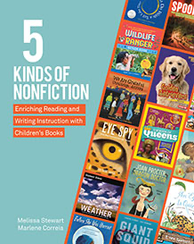
Professional Resource
Melissa Stewart Website
classifying nonfiction into five categories—active nonfiction, browseable nonfiction, traditional nonfiction, expository literature, and narrative nonfiction.

Slide 5
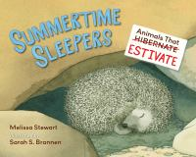
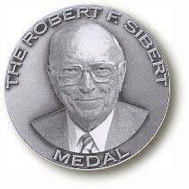
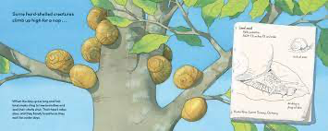
Melissa Stewart-Nonfiction
2022 ALA Notable Younger
2022 Seibert Honor Book
30 min. zoom panel from Charlebridge where 5 nonfiction authors talk about new books.
Notes:
Summertime Sleepers: Animals That Estivate – April 27, 2021, 1*, Animals that sleep in summer Int Lvl: K-3; Rd Lvl: 4.3 My personal thought is that this could pair with some of the amazing Steve Jenkins books we have – Steve Jenkins (1952-12/26/21) Studio in Boulder CO with his wife Robin Page ALA notable - Feathers Not Just for Flying, Seashells More Than a Home,
“Using comparisons and contrasts, this engaging nonfiction title introduces young readers to estivation, the summertime equivalent of hibernation.”ALA

Slide 6
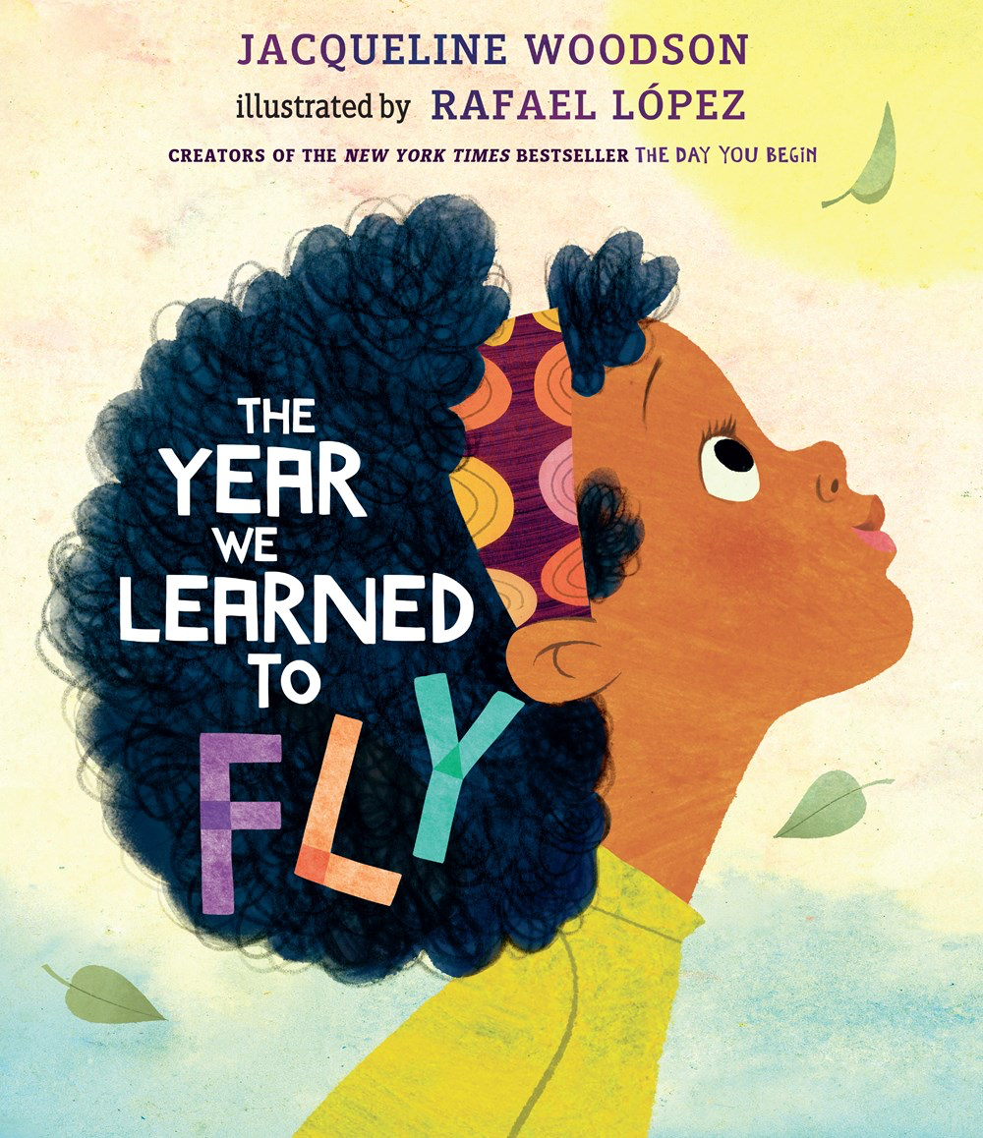
Tributes to Books Imagination and Reading
Jan. 4, 2022
Abrams Books
Julie Falatko author website
Penguin website with peek inside
Notes:
The Year We Learned to Fly- 3* January 4, 2022, 5-8years, - companion to The Day You Begin Using imagination to be the power to lift themselves up (Covid and historical time for American’s of color). Pair with Tar Beach – Tribute to the People Could Fly – power of books, imagination, and story.
Yours in Books 2*, September 21, 2021
A story told in letters between an owl who just wants some peace and quiet from the neighborhood children so he can read, and the squirrel bookshop owner who helps him realize the value of companionship and community. A warmly cheerful homage to how books can kindle bonds, open minds, and unite community.

Slide 7
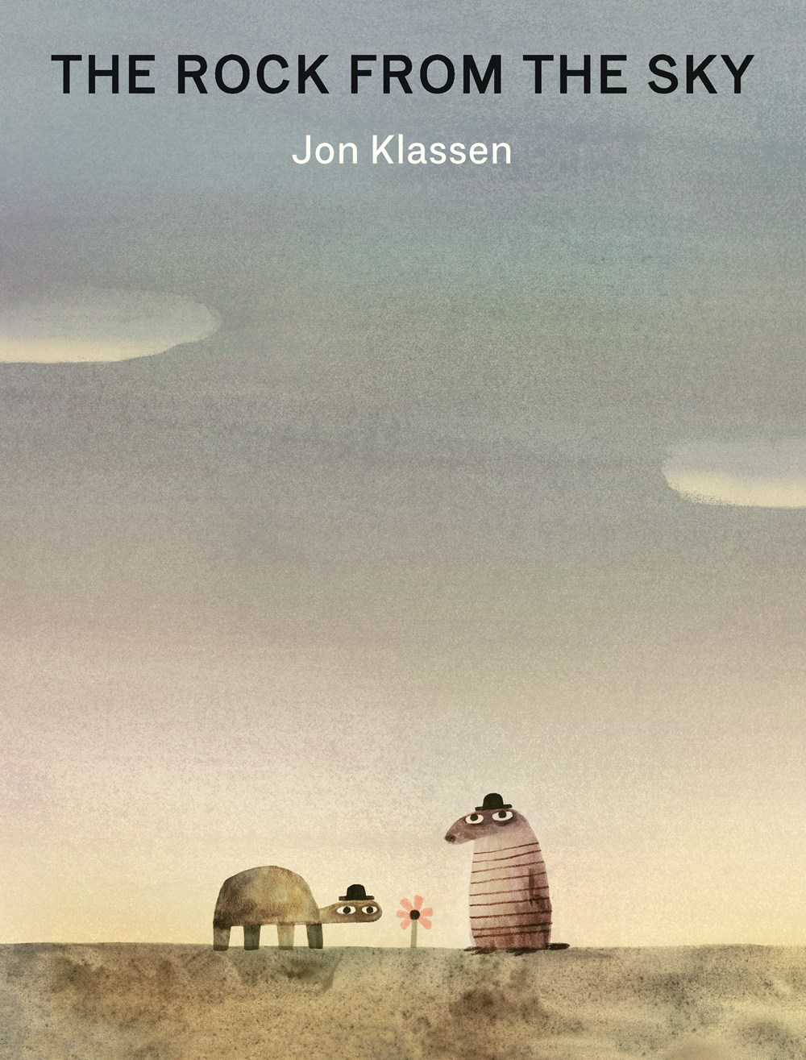
Favorite Authors – Jon Klassen
Activity Kit from Candlewick Press
How would you describe The Rock from the Sky?
It’s a book of five short, connected stories about three characters in which they don’t go anywhere or do almost anything, but also it involves a meteor, time travel, aliens, jealousy, betrayal, and death.
—Jon Klassen
5 minute read aloud on YouTube by teacher Andy Williams
Notes:
IL: K-3; RL: 1.5 3* April 13, 2021 Jonker/Schu #14, Makes me laugh. For those with a bizarre sense of humor this will be hilarious.
Storytime Standouts – Better if you already have read the first 3 Hat stories, but can be a stand alone.
CCB Blue Ribbok

Slide 8
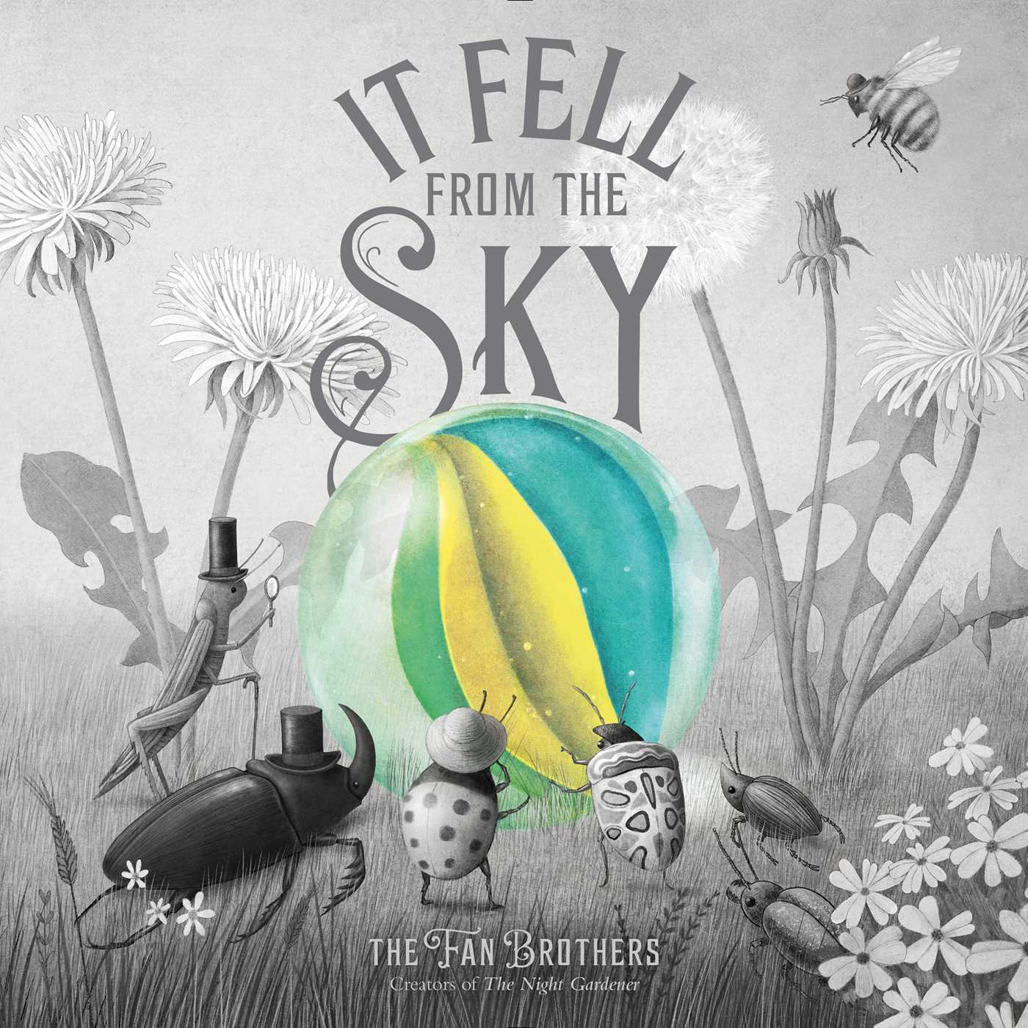
Fan Brothers
NYTimes Best Illustrated
Article in New York Times Best Illustrated Children's Books of 2021
activity booklet
6 min read aloud by Authors Terry Fan and Eric Fan
Notes:
It Fell From the Sky, 2*, IL: K-3; RL: 2.0.
Love this to pair with other insect books, the use of color is amazing.
5th graders loved this

Slide 9
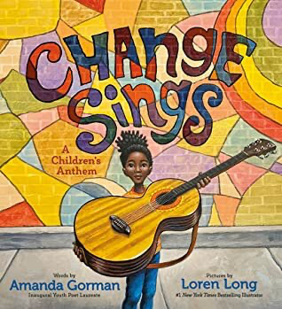
Peace Anthems
Dec. 7,
2021
Link to Teacher's Guide and $5.00 audio download at Penguin/Random House
Bryan Colier introduces his book
Notes:
Dec, 7 2021, Bryan Collier’s reimagined illustration with this Peace Anthem text. Lexile: 360 adult directed
Illustrations and end matter melds the most emblematic moments of the twentieth-century Civil Rights movement with the present day,
Change Sings – Amanda Gorman and Loren Long – September 21, 2021, Sharp’s Awesome, To bring young children social change, activism, and restoration. Guide produced by #disrupttexts
Conference speaker Julia Torres

Slide 10
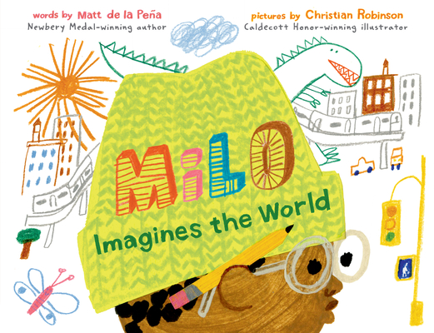
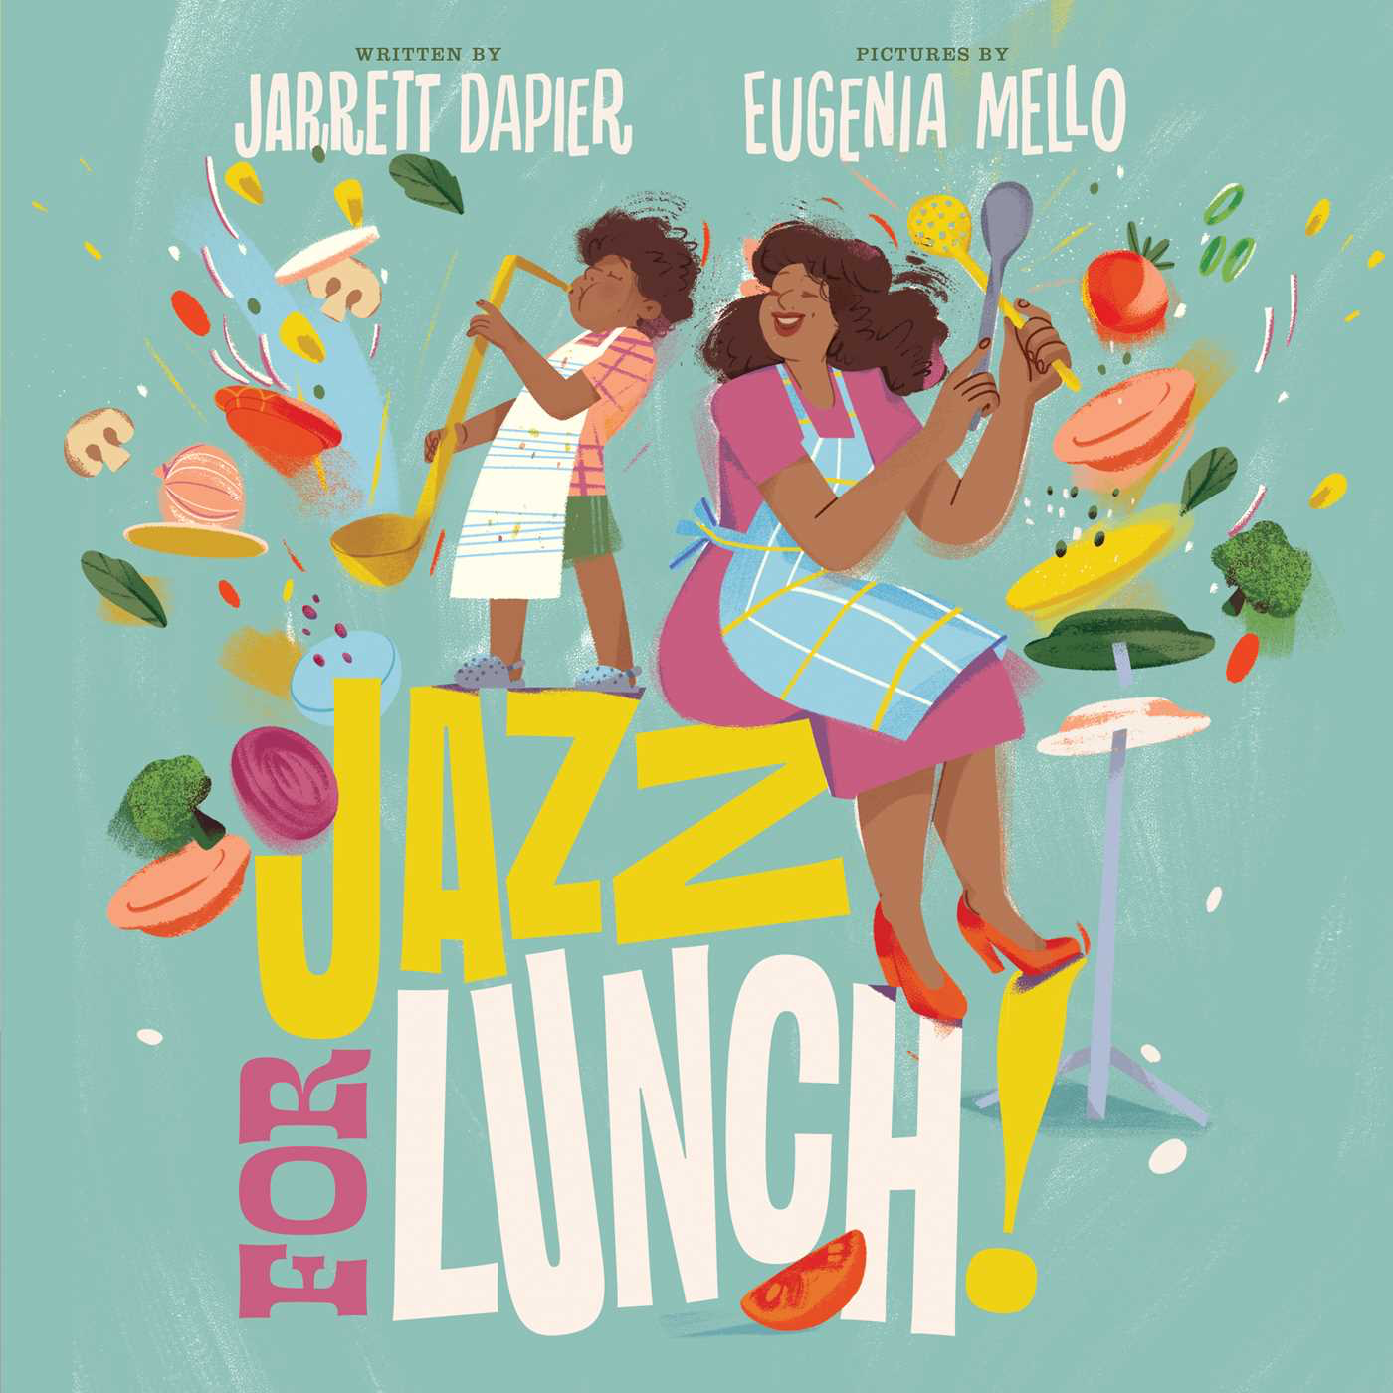
CCOLORADO LIBRARIES
FOR
EARLY LITERACY
2022 ALA Notable Younger
Guide to Last Stop on Market Street, Carmela's Wish, and Milo Imagines the World
Write
2022 shortlists
READ
WRITE
SING
TALK
PLAY
Sing
Milo trailer 1 min.
Notes:
Milo Imagines the World - Int Lvl: K-3; Rd Lvl: 4.4 Milo is on a long subway ride with his older sister. To pass the time, he studies the faces around him and makes pictures of their lives. CCB Blue Ribbon. “Milo sketches what he imagines to be the lives of his fellow subway passengers, only to reassess his drawings after he discovers one boy shares Milo’s destination: visiting day at a correctional facility.”ALA
Jazz for Lunch – 1* celebration of music, food, and family. – use with older kids to research musicians

Slide 11
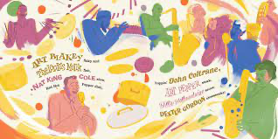
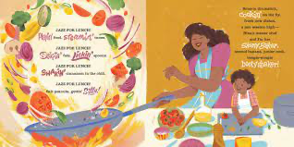
Notes:
Fun to find clips of music by all the amazing musicians described.

Slide 12
CCBA – Colorado Children’s Book Award
1 minute official trailer at Mackids
2022 ALA Notable Younger
Teaching bundle created by The Author Village (TAV)
Please encourage your students to read and vote for 2022 CCBA. Votes must be submitted by March 1st . Each school or library can submit up to 20 titles for 2023 CCBA.
Teaching Books.net Audio Name Pronunciation
Link to submit your votes for 2022 and nomiations for 2023
Notes:
A beautiful book that describes the impact of COVID-19 on communities and why some essential workers could not quarantine.
“A girl and a cat observe how the world changed during the first wave of the COVID-19 pandemic.”ALA
Read aloud guides are available.

Slide 13
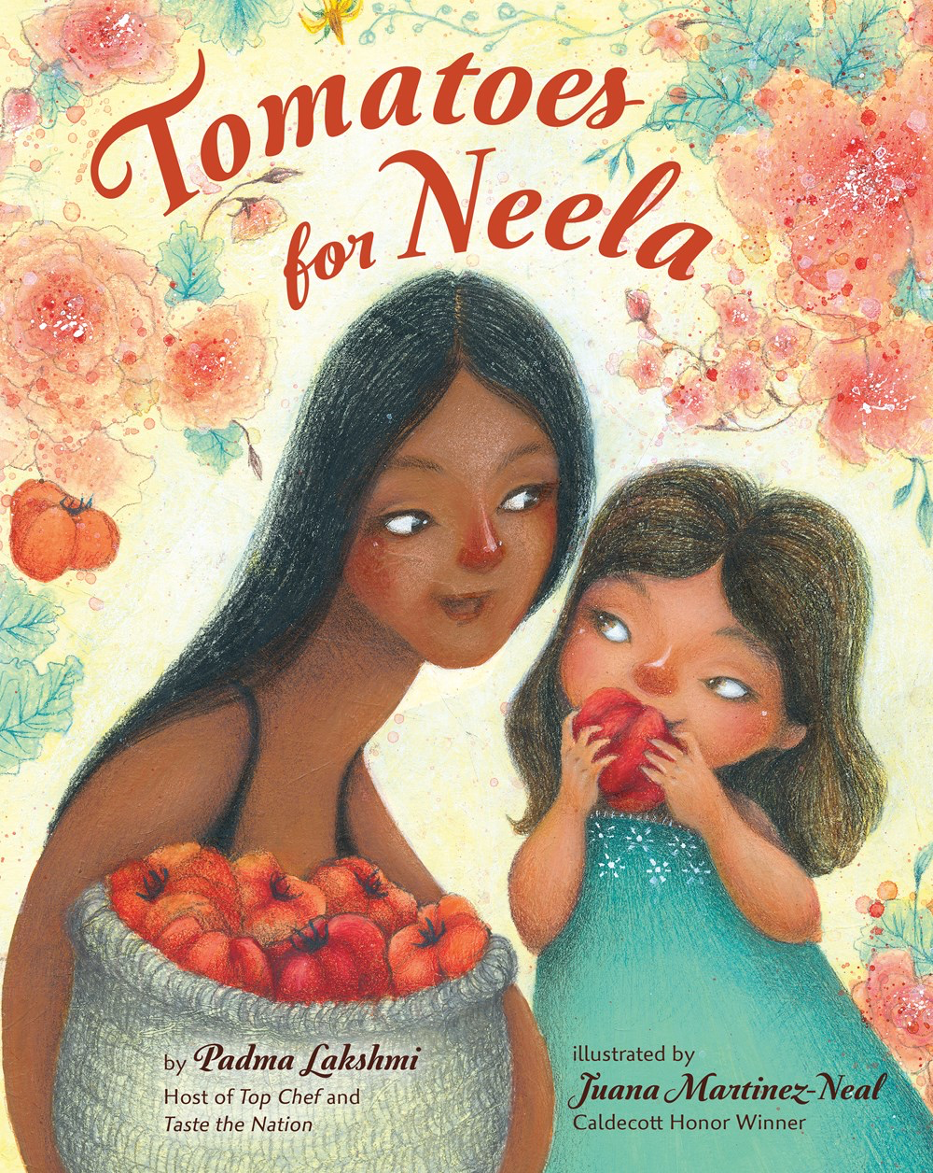
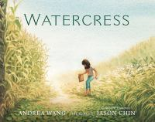
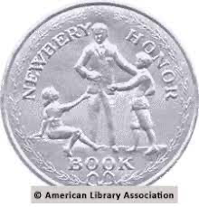
Cultures and foods
2022 ALA Notable Younger
5 min. read aloud at Cincinnati Museum Center
Educator's Guide at Holiday House
Juana Martinez Neal website
2022 Caldecott Medal and 2022
Newbery Honor
Peek inside at Penguin Random House
Notes:
Tomatoes for Neela – 0*, intergenerational love and the importance of food written by Padma Lakshmi, bestselling author and host of Bravo’s Top Chef and Hulu’s Taste the Nation.
Watercress -7* March 30, 2021 Jonker/Schu #13, Embarrassed about gathering watercress from a roadside ditch, a girl learns to appreciate her Chinese heritage after learning why the plant is so important to her parents. Colorado Author, 2022 Newbery Honor, 2022 Caldecott Medal I found the author’s note effective with 5th graders to encourage them to write their memories.
“A Chinese American girl, too embarrassed to eat the watercress her family picked from the roadside, learns of her mother's childhood experience with famine in China”ALA

Slide 14
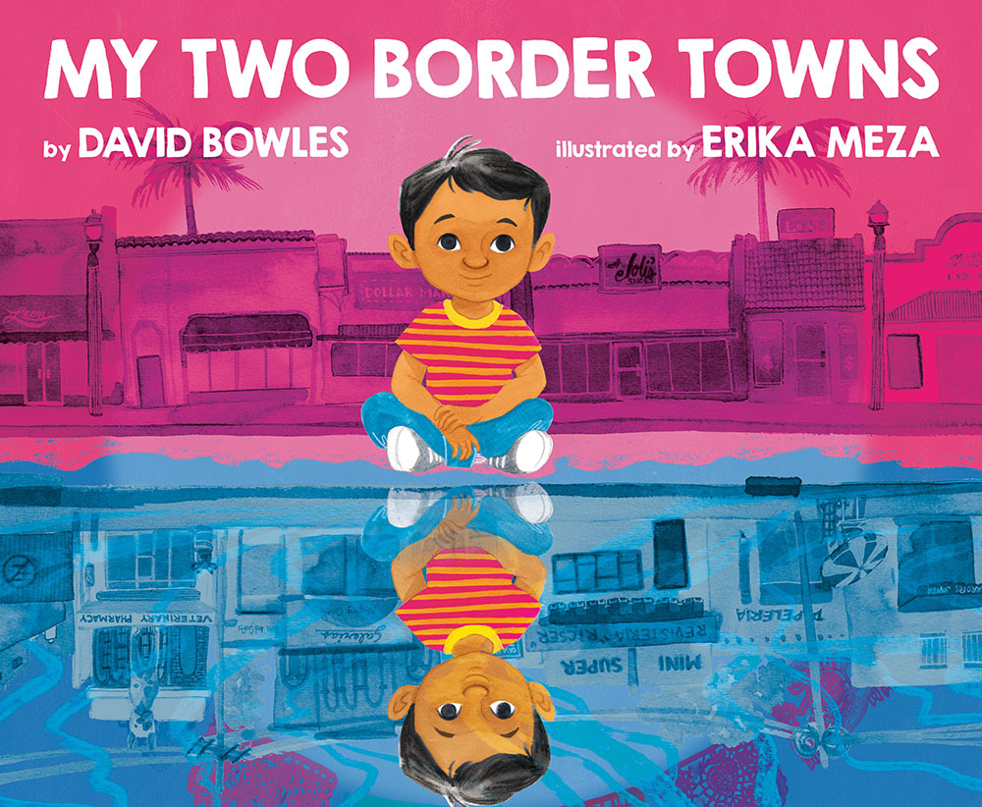
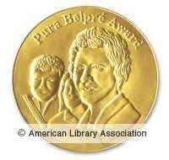
Life at the Border
2022 ALA Notable Younger
2022 ALA
Notable
Younger
Suggested uses at NEA for Read Across America
Teacher's guide at Random House
2022 Pura Belpre Youth Illustration Honor Book
Yuyi Morales explains this allegory tribute to border lands and courage to adults
Notes:
My Two Border Towns, 4*,September 14, 2021 SLJ Best, DPL Staff Favorites - A boy and his father cross the United States-Mexico border every other Saturday, visiting their favorite places, spending time with family and friends, and sharing in the responsibility of community care.
“Crossing the U.S.-Mexico border, a boy and his father buy gifts and necessities for refugee friends who temporarily live between the two countries. Simultaneously published in Spanish and English.” ALA
Bright Star – 6*, Jonker/Schu#17, NPR Best, September 7, 2021 Told with a combination of powerful, spare language and sumptuous and complex imagery that is typical of Yuyi Morales's work, this is the story of a fawn making her way through a border landscape teaming with flora and fauna native to the region. A gentle but empowering voice encourages her to face her fears when she comes across an obstacle in the form of an insurmountable barrier. Yuyi Morales' first book since her bestseller Dreamers is a book for very young children looking for their place in a world full of uncertainty. It is a book with resonance for all children, especially those whose safety is threatened due to the immigration crisis in the US.
“An allegorical look at the migrant experience as told through the story of a young fawn looking for safety after being separated from her mother. Simultaneously published in Spanish and English.”ALA

Slide 15
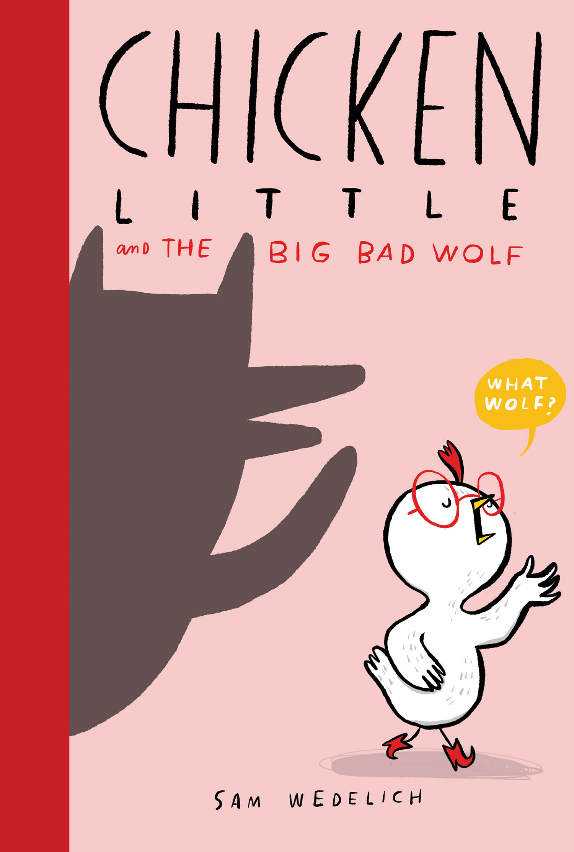
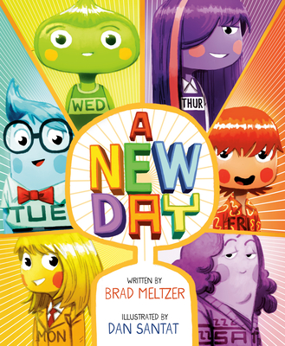
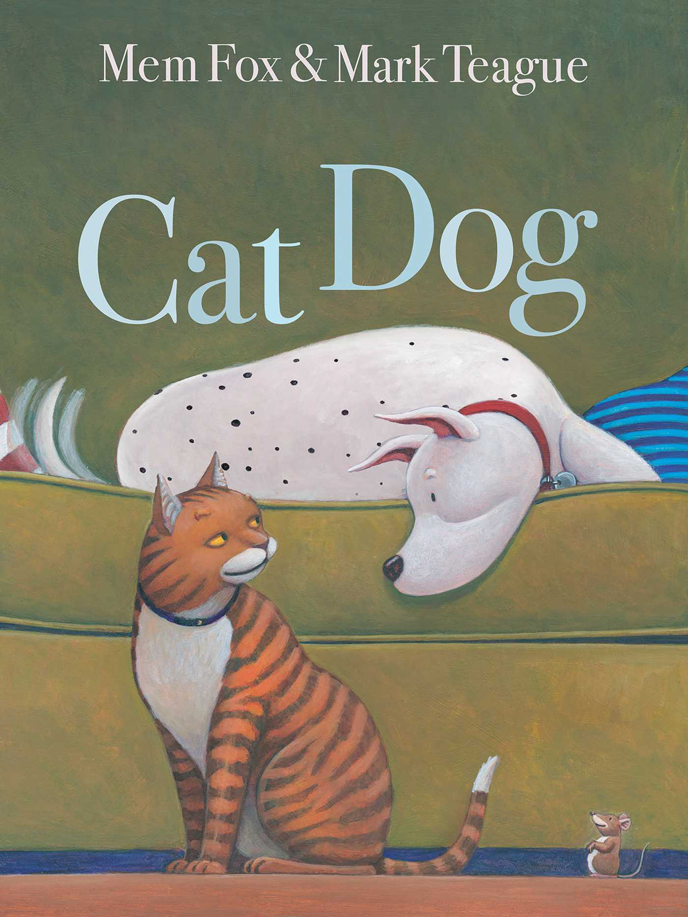
Humor
March 2, 2021
1 min introduction for teachers from Scholastic
5 min. read aloud by Greenville Public Library
12 min. read aloud by author Brad Meltzer at Barnes & Noble
Mem Fox website
Notes:
A New Day – IL 3rd-5th 550L March 2, 2021 Humorous could pair with Drew Daywalt Books - After Sunday quits being a day of the week, the other days of the week try out all sorts of candidates, until an act of kindness reminds them all that a little appreciation can go a long way.
Cat Dog – 2*, September 28, 2021 Cat, Dog, and Mouse story that could benefit from repeated readings and almost be used as a beginning reader.
Chicken Little and the Big Bad Wolf March 2, 2021 RL- 530L IL- PS-3
Graphic sequel to Chicken Little the real and totally true tale Learning to be less fearful and trust. Pair with the True Story of the Big Bad Wolf

Slide 16
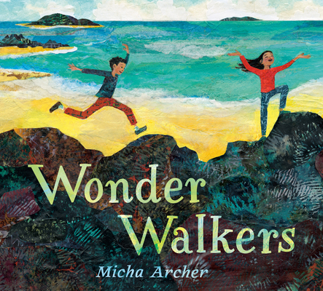
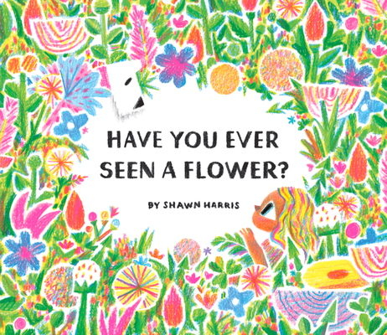
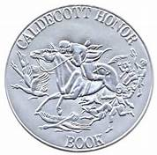
2022 Caldecott Honors Tributes to Nature
2 min. intro by Shawn Harris
2022 ALA Notable
Younger
3 min. Storytime at Midstate Education District
May 4, 2021
2022 ALA Notable Younger
Notes:
Wonder Walkers – 2*s, March 30, 2021, Preschool connections as kids take a walk in nature.
“Two children explore and contemplate nature through a series of imaginative questions” ALA
Have You Ever Seen a Flower? – 2*, 490L – May 4, 2021, Preschool-K read aloud that begs a crayon/colored pencil art lesson
“A young child leaves the drab city for a multi-sensory experience among effervescent flowers in this electric celebration of our connection to, and place within, the natural world”ALA

Slide 17
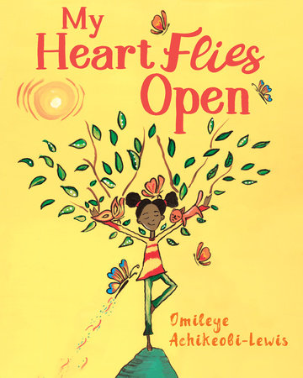
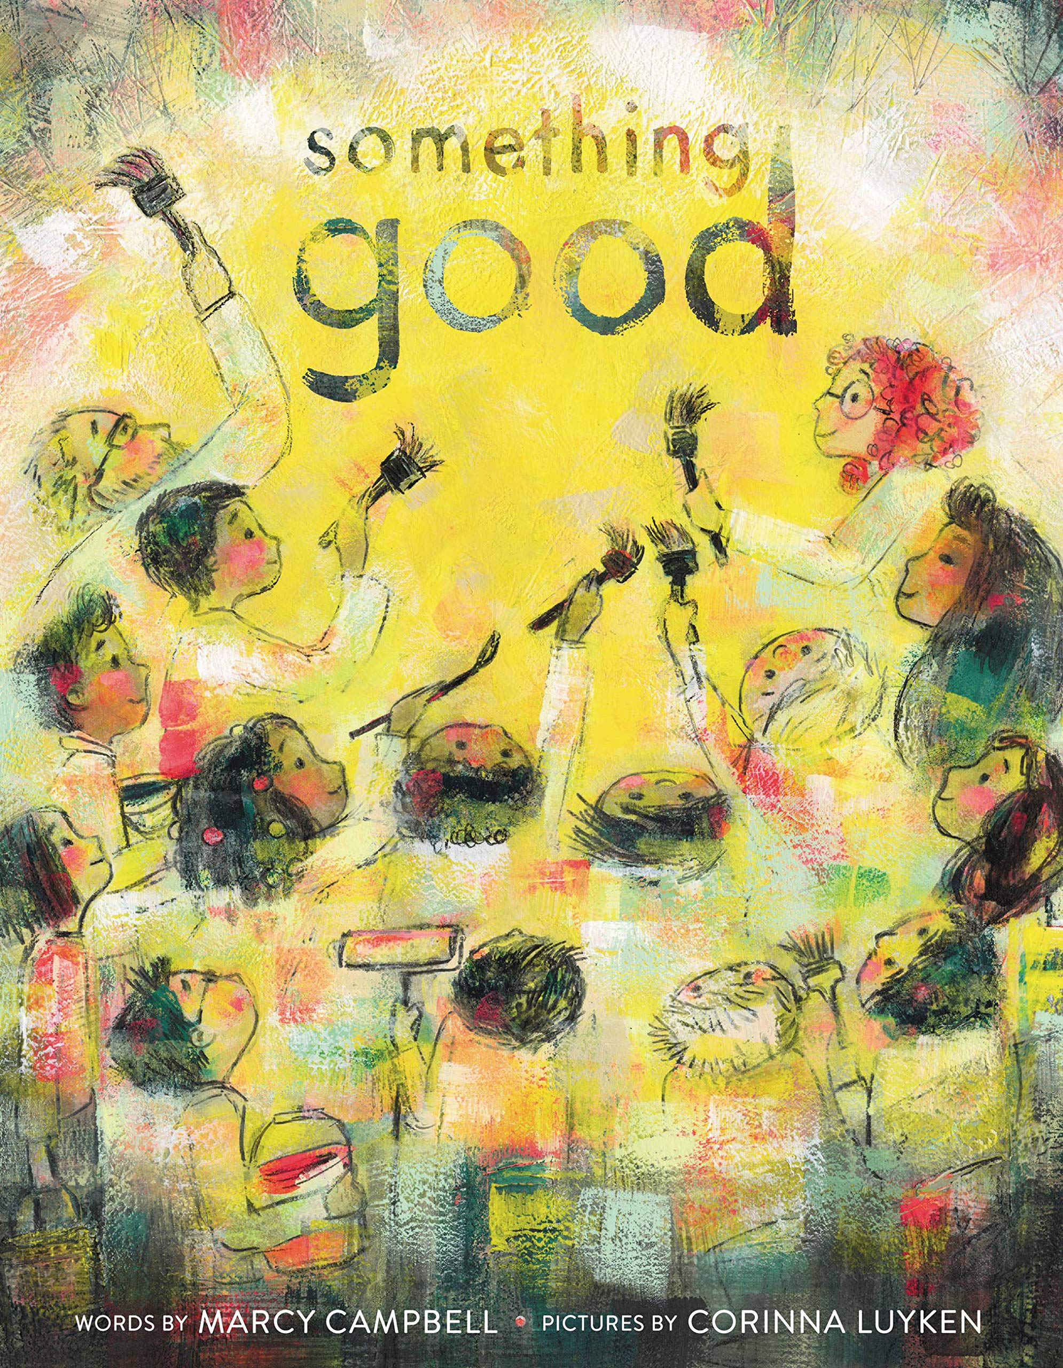
Picture Books to promote peace and mindfulness
10 min, Book Chat with illustrator Corinna Luyken and teacher’s guide at Little Brown Books.
10 min. read aloud by Sankofa Read Aloud
Notes:
My Heart Flies Open- 1*, September 7, 2021 - More than just yoga poses it really is a journey of mindfulness meant to appeal to all children, but particularly girls of color.
Something Good - October 29, 2021 – How a school deals with when “something bad” is discovered written on the wall. Based upon the school where the author volunteers. Covers the topic of hate speech appropriately for elementary students.

Slide 18
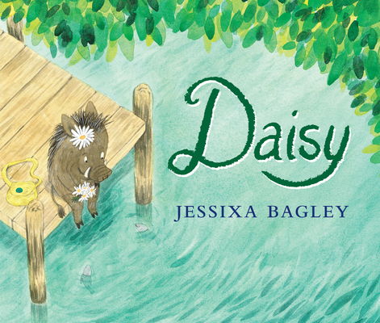
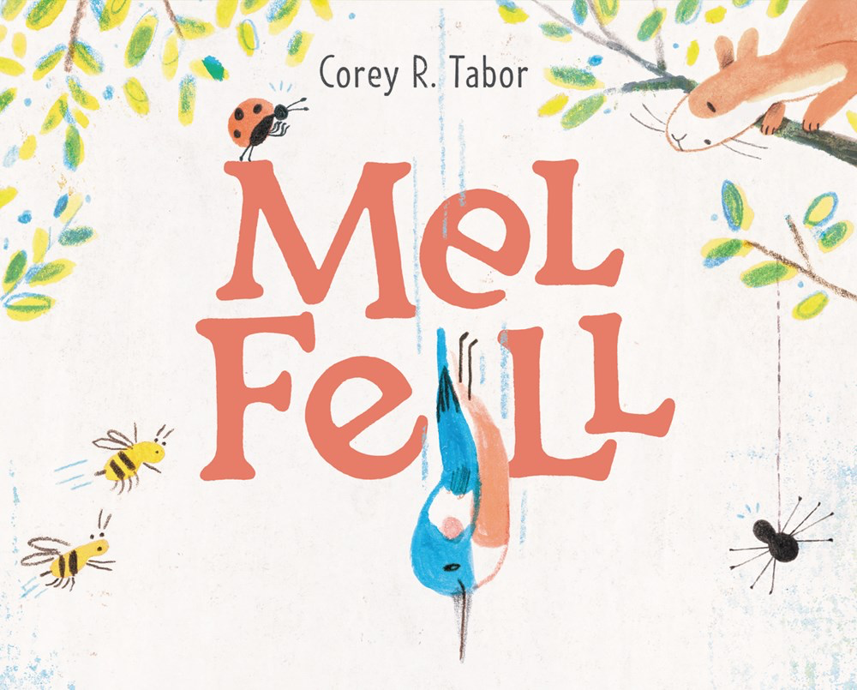
Beginning of school picture book read alouds
2022 ALA Notable Younger
3 min. read aloud at BN storytime by Corey Tabor
7 min. Story Time at OldTownPublic Library
activity guide Mel Fell
March 2, 2021
Notes:
Daisy – March 2, 2021 – 1*, When Daisy the warthog’s classmates tease her, she finds comfort collecting lost and forgotten things. She knows they’re special – and soon she meets a friend who knows it too.
Mel Fell –3* - February 2, 2021 – Caldecott Honor - Nice job Balzer + Bray. I can see this being one of the beginning of the school year reads as kids are just trying new things in preschool or kindergarten. The design is lovely and would be fun to pair with other books with unique page turns, such as Round Trip. For older kids I can see even art teachers using it as lessons in book design. – Jonker/Schu #6
“As Mel the kingfisher plunges from a treetop on her first flight, readers are invited to turn the book sideways and upside-down as they follow her journey.”ALA

Slide 19
Raul the Third
Article in New York Times Best Illustrated Children's Books of 2021
2022 ALA Notabe Younger
2022 Pura Belpre Youth Illustration Award
2022 ALA Notable Younger
World of Vamos Website
Notes:
Vamos! Let’s Cross the Bridge
IL: K-3; RL: 2.1, 2*, 2022 Pura Belpre Youth Illustration Award – NYT Best Illustrated Award, Little Lobo and his dog Bernabe cross the bridge in their red truck to take party supplies across the bridge between the two countries.
"Pals Little Lobo, Bernabé, La Oink Oink, and El Toro get stuck on a bridge between sister cities in two different countries and make a party out of a difficult situation.” ALA
Training Day 3*, moves into a beginning chapter book graphic novel with the same characters.

Slide 20
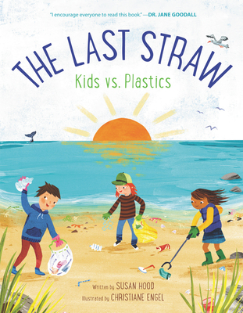
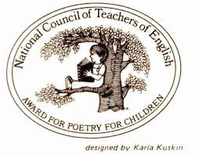
Poetry – Non-fiction
Harper Collins website with teacher's guide
6 min. Susan Hood reads from and discusses her book
2022 NCTE
Notable Poetry Book
Notes:
The Last Straw - 1*, NCTE 2022 Notable Poetry Book - linked to thorough discussion of plastic (both the good and the bad). Interest age level 5+

Slide 21
NYTimes Best Illustrated
2022 Coretta Scott King (Author and Illustrator) Awards
2022 Caldecott Honor Book
2022 Seibert Honor Book
Teacher's Guide at Lerner
Floyd Cooper, who passed away in July, reads from and shares his family connection
2022 ALA Notable Middle
Notes:
Unspeakable, 6 for 3rd-8th*, 1100L, February 1, 2021, NPR Best, Jonker/Schu #16, Caldecott Honor, Coretta Scott King (Author and Ill), 2022 Seibert Honor, - Truth and impact of white supremacy and racism, accessible to 3rd to 8th graders.

Slide 22
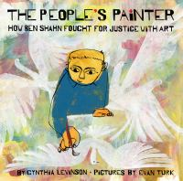
Informational Picture Books
2022 ALA Notable Younger
2022 Amercian Indian Youth Literature Award Honor
2022 ALA Notable Middle
2922 Sydney Taylor Book Award
Cynthia Levinson Resources for Teachers
2022 Sibert Informational
Honor Book
10 minutest Beyond the Book at Abrams Books
2022 Robert F. Sibert Informational Book Award
Notes:
The People’s Painter: How Ben Shahn Fought for Justice with Art 5*, Horn Book Fanfare Jonker/Schu #11 April 20, 2021, 5*, A lyrically told, exquisitely illustrated biography of influential Jewish artist and activist Ben Shahn who immigrated from Lithuania to US.
“Jewish immigrant Ben Shahn used his art to portray the lives of working-class people and others who had been mistreated to bring to light injustices in the United States.”ALA
We Are Still Here 5*, SLJ Best Non-fiction 2022 Tracy Sorell Twelve Kids write reports on topics: assimilation, allotment, termination, language revival, and more; although these are dense and complex areas, Sorell makes them comprehensible for readers through the book’s unique format. Each “presentation” makes this a possible read aloud for multiple dates and

Slide 23
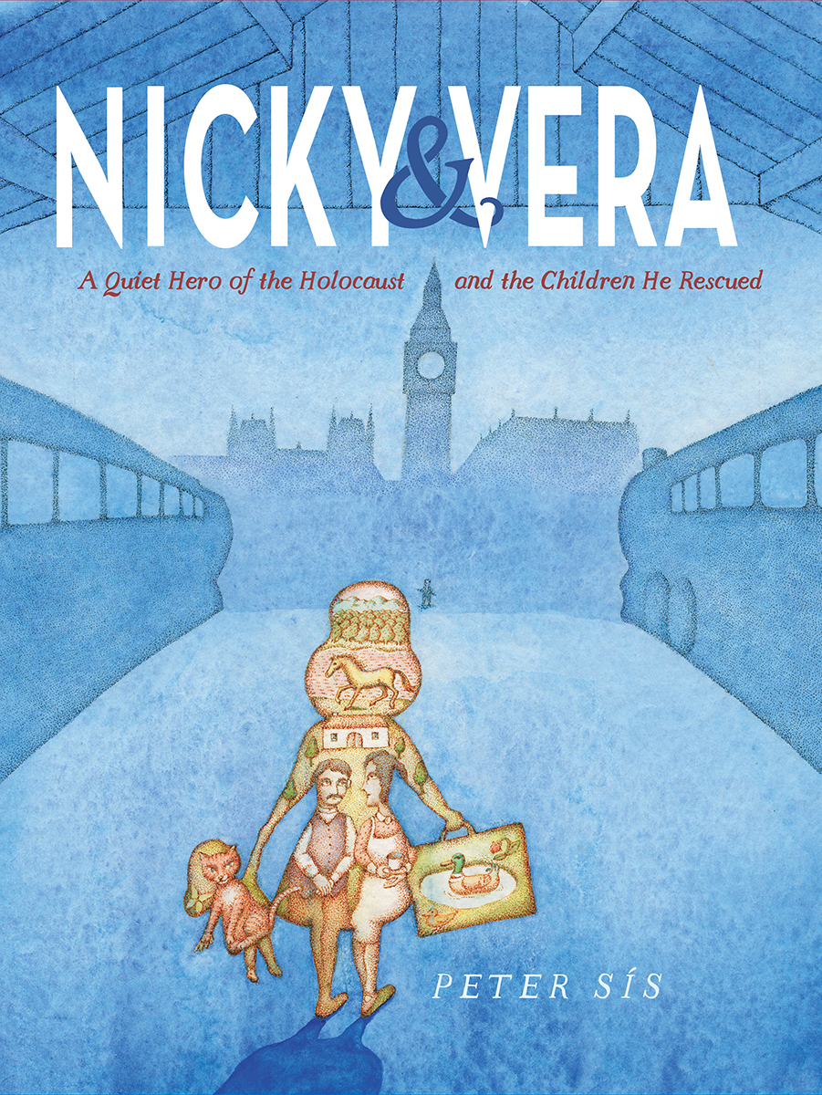
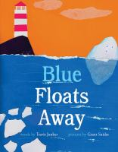
Picture Books Informational
2 min. introduction by Travis Jonker
2022 Sydney Taylor Picture Book Award
Publisher webpage
Notes:
Blue Floats Away 2*, John Schu Watch Read Connect, Colby Sharp 2021 Awesome, RL: 1.4 IL: K-3 March 23, 2021
Story of the water cycle done with cut paper illustrations (also about dealing with change)
Nicky & Vera: A Quiet Hero of the Holocaust – 5*NPR Best of 2021, 2022 Jane Addams Children’s Book Award, Horn Book Fanfare, Illustrated story of Nicholas Winton’s rescue of children during World War II.

Slide 24
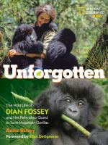
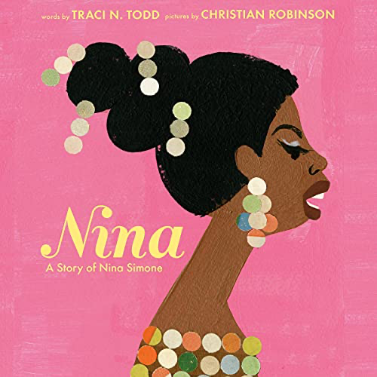
Picture Book Biography
1 min. trailer from Penguin Books
National Geographic Kids Publisher Website
June 29, 2021
2022 ALA Notable
Younger
Notes:
Nina: A Story of Nina Simone Traci N. Todd–Horn Book Fanfare - September 28, 2021 – 7*, NPR Best - RL 5.2, IL K-1 Amazing Christian Robinson Illustrations
“A well-rounded biography of Nina Simone, whose music was influenced by her civil rights activism.”ALA
Anita Silvey – Unforgotten: The Wild Life of Dian Fossey and Her Relentless Quest to Save Mountain Gorillas– Largely told through pictures, but does include all the difficult parts - – June 29, 2021 - Explore the fascinating life and legacy of groundbreaking primatologist and conservationist Dian Fossey, who made it her life's mission to study and protect mountain gorillas, in this powerful biography from award-winning author Anita Silvey This dramatic conclusion to Leakey's "Trimates" will inspire the next generation of scientists and conservationists as they meet Dian Fossey, who studied and protected her beloved gorillas from poachers and other threats until her murder in 1985

Slide 25
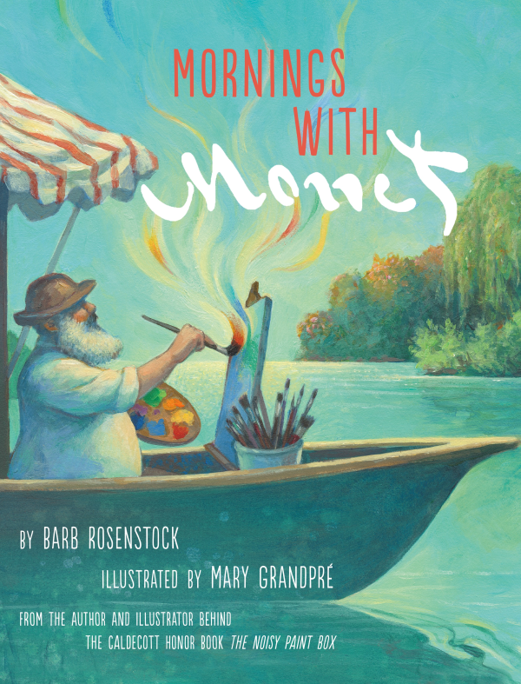
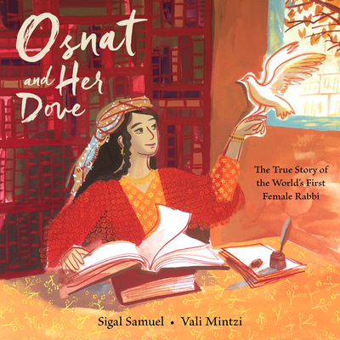
Picture Book Biography
2022 ALA Notable
Younger
2022 ALA Notable Younger
Publisher Website with preview & author introduction
Two Minute Book Trailer
Peek inside at penguinrandomhouse
Notes:
Osnat and Her Dove –SLJ Best 2021 – April 2, 20021, 2*, Picture Book made from a movie, In language reminiscent of a fairy tale, this loose biography relates the little-known story of the first female rabbi, Osnat Barzani, a Kurdish Jew whose knowledge of the Torah and leadership of a yeshiva in ancient Iraq broke gender barriers
“Lore surrounding the life of Osnat Barzani enhances this picture-book biography of the first female rabbi, who lived in seventeenth-century Iraq.”ALA
Morning With Monet –2*, DPL Staff Favorites – Mary Granpre illustrations! – From team that did Noisy Paintbox
“As the morning sun moves, Monet shifts from painting to painting, capturing what will become a famous series of images of the Seine. ”ALA

Slide 26
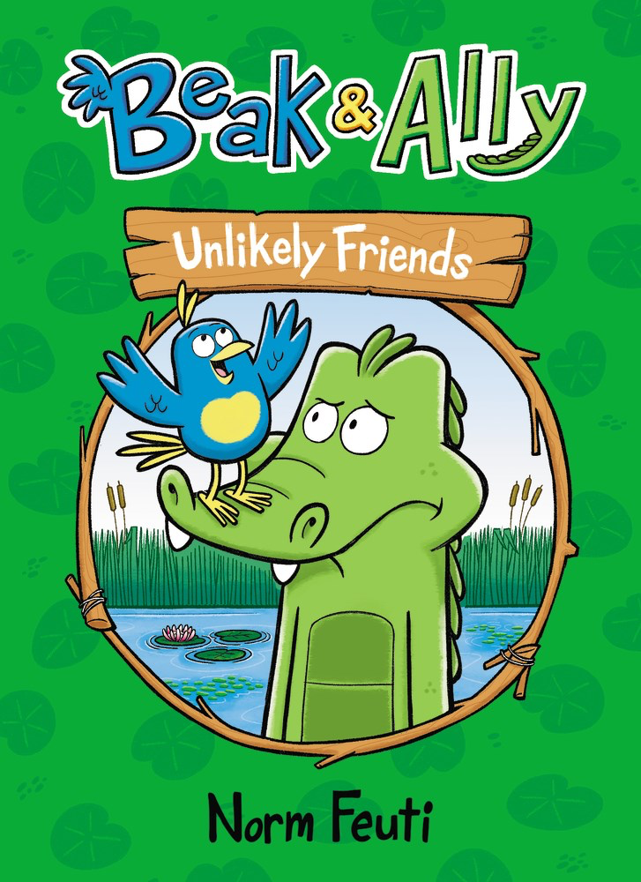
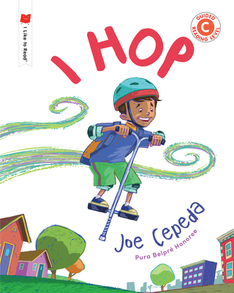
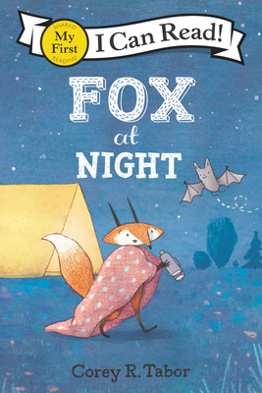
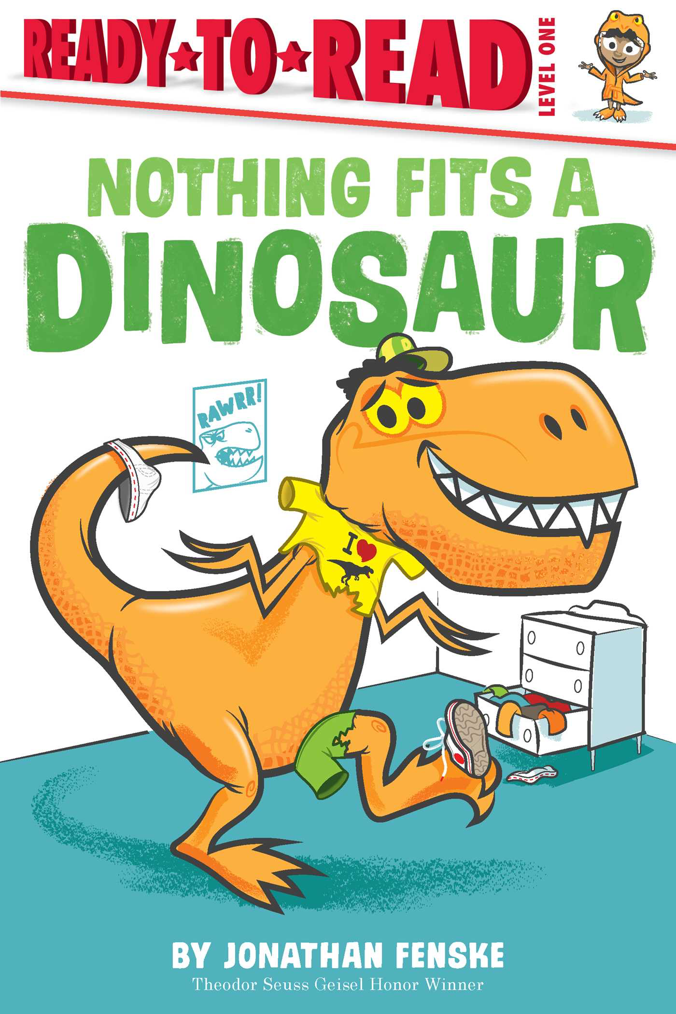
2022 Geisel Award
2022 ALA Notable Younger
2022 ALA Notable Younger
4 min. Fox at Night Read Aloud by Arturo Brillembourg
Aug. 31, 2021
Simon & Schuster Look Insiden Nothing Fits a Dinosaur
2022 ALA Notable Younger
Notes:
Fox at Night – March 2, 2021 – Nocturnal Animal characters – My First I Can Read – Fun with Arden “Equipped with a pair of binoculars, Fox encounters nocturnal forest creatures who offer to help Fox realize the night is full of friends, not monsters—but are they correct?”ALA
Beak & Ally: Unlikely Friends - January 4, 2021 outgoing bird is determined to befriend a reluctant alligator. Another in the ___ & ____ books. – 2 Bedtime jitters 3 Big Storm - Graphic
“Despite Beak the bird's bubbly attempts to befriend Ally, the alligator is content to be alone, until a party invitation and a chance encounter with a Long-Billed Party Pooper remind her of what's important”ALA
I Hop – November 30, 2021 – Guided Reading Level C I Like to Read Series– 1* SLJ
Nothing Fits a Dinosaur – August 31 2021 - Reading Age 4-6 – Level 1 Ready-to-Read – Chicago Public Library Best of the Best – Dinosaur gets ready for bed but, of course, pj’s don’t fit.

Slide 27
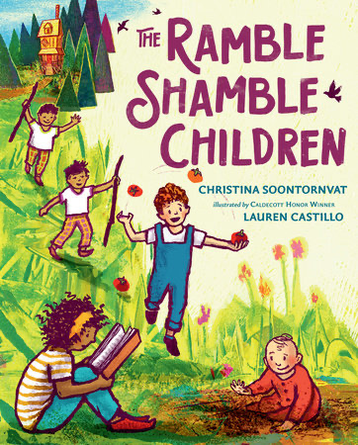
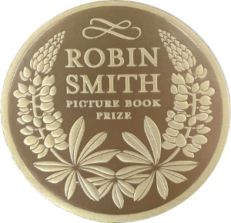
Favorite Author/Illustrator Christine Soontornvat/Lauren Castillo
Peek inside at Penguin/Random House
Notes:
Ramble Shamble Children – March 9, 2021 3*, Story about 5 diverse children living in a ramble shamble house – Fix it up but find it’s better the way it was. Reminiscent of Pippi Longstocking. Children living independent of adults.
Robin Smith Picture Book Award – created 5 years ago to honor Robin’s love of books and teaching.

Slide 28
Likes and Loves from the Literary Lists 2022 Marcie Haloin Session # 408 Friday, Feb. 11 1:30-2:30

