Slide 1
Likes and Loves: Books to Empower Colorado Children 2023 Picture Books
CCIRA session #159
February 9, 2023, 1:30-2:30
www.mhaloin.com
Notes:
Hopefully all the links etc. will work.

Slide 2
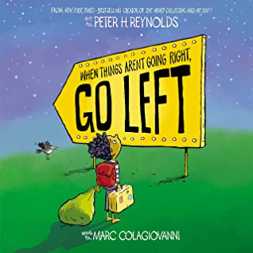
2023 is going to be great
Tameka Fryer Brown's website
2 min. introduction by Peter H. Reynolds
Notes:
When Things Aren’t Going Right, Go Left. Technically does not come out until March 7th, 2023 but Scholastic had it early in bookfairs. That’s how the Jason Reynolds book got nominated last year for CCBA.
That Flag, Jan. 31, 2023. 1*, Two Southern friends reactions to the Confederate Flag. My reaction – Let the children lead us. I feel like I felt the year my principal read at a faculty meeting Jaqueline Woodson and EB Lewis’s The Other Side.
that challenges the meaning behind the still-waving Confederate flag through the friendship of two young girls who live across the street from each other.

Slide 3
Book Review Sources
http://www.mhaloin.com/
The Best Children's Picture Books of the Year in Spanish 2022 edition
Goodreads- social media of choice for me
CYBILS: Children's and Young Adult Book Lovers Awards
2022 Blue Ribbons from The Bulletin
Notes:
My bib is much more current, but not searchable as it is links to many of the blogs (etc) I read all year in prep for this presentation
Bank Street does different electronic bests now.

Slide 4
Review Sources for Librarians (Numbers 0-6 indicate how many have issued starred review)
Booklist with Book Links from ALA
Bulletin of the Center for Children’s Books
The Horn Book Magazine
Kirkus Reviews
School Library Journal
Publishers Weekly
2023 ALA Notable Children's Books
Younger Readers – Preschool-grade 2 (age 7), including easy-to-read books; Middle Readers – Grades 3-5, ages 8-10; Older Readers – Grades 6-8, ages 11-14; All Ages – Has appeal and interest for children in all of the above age ranges
Notes:
Booklist is from ALA (They also have Book Links which is a quartly publication for teachers, people in publishing interest and children’s librarians)
The Bulletin of the Center for Children’s Book is at University of Illinois
Horn Book is out of Boston – Only publishes positive reviews by professional reviewers

Slide 5
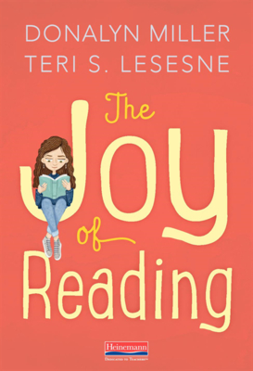
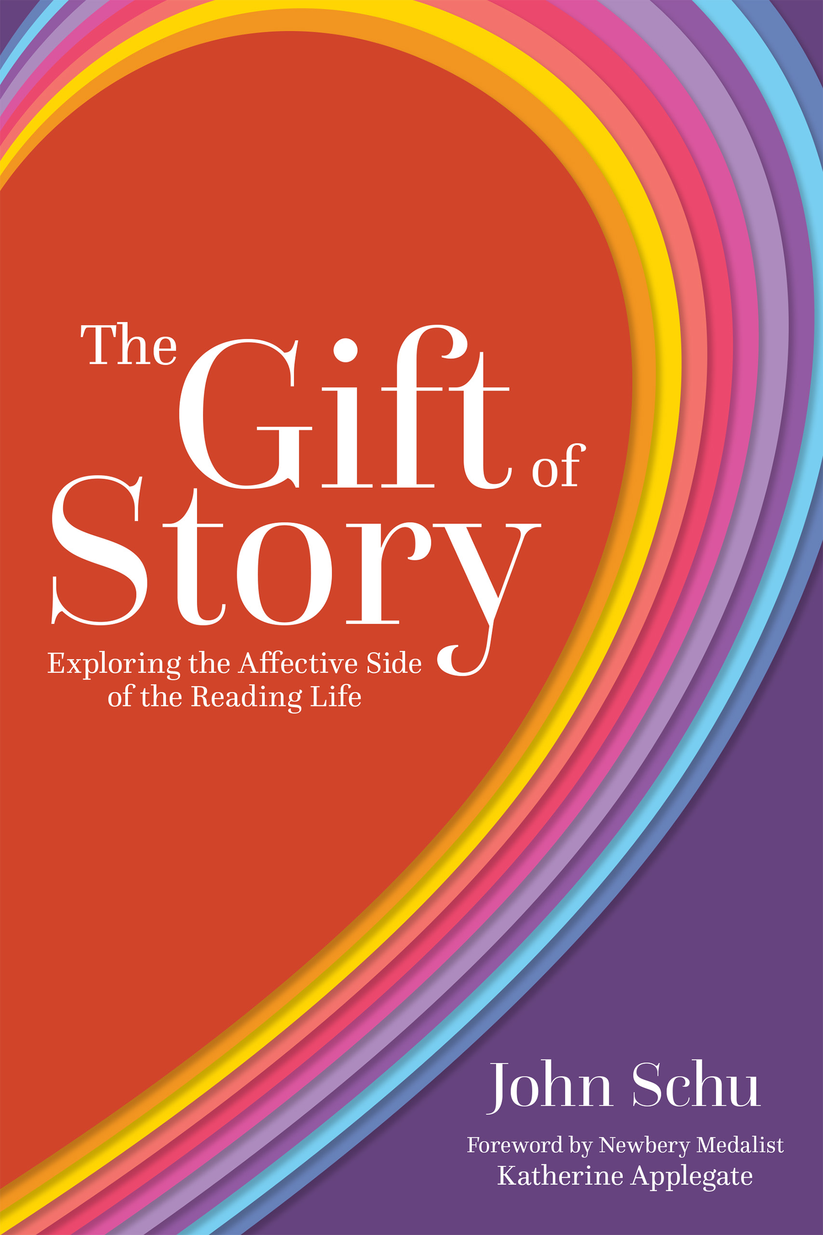
Professional Books – All Authors plan to be here on Saturday
Notes:
I don’t mind spending money of professional books that act as guides to my purchase and use of children’s books.
These are all copyright 2022.

Slide 6
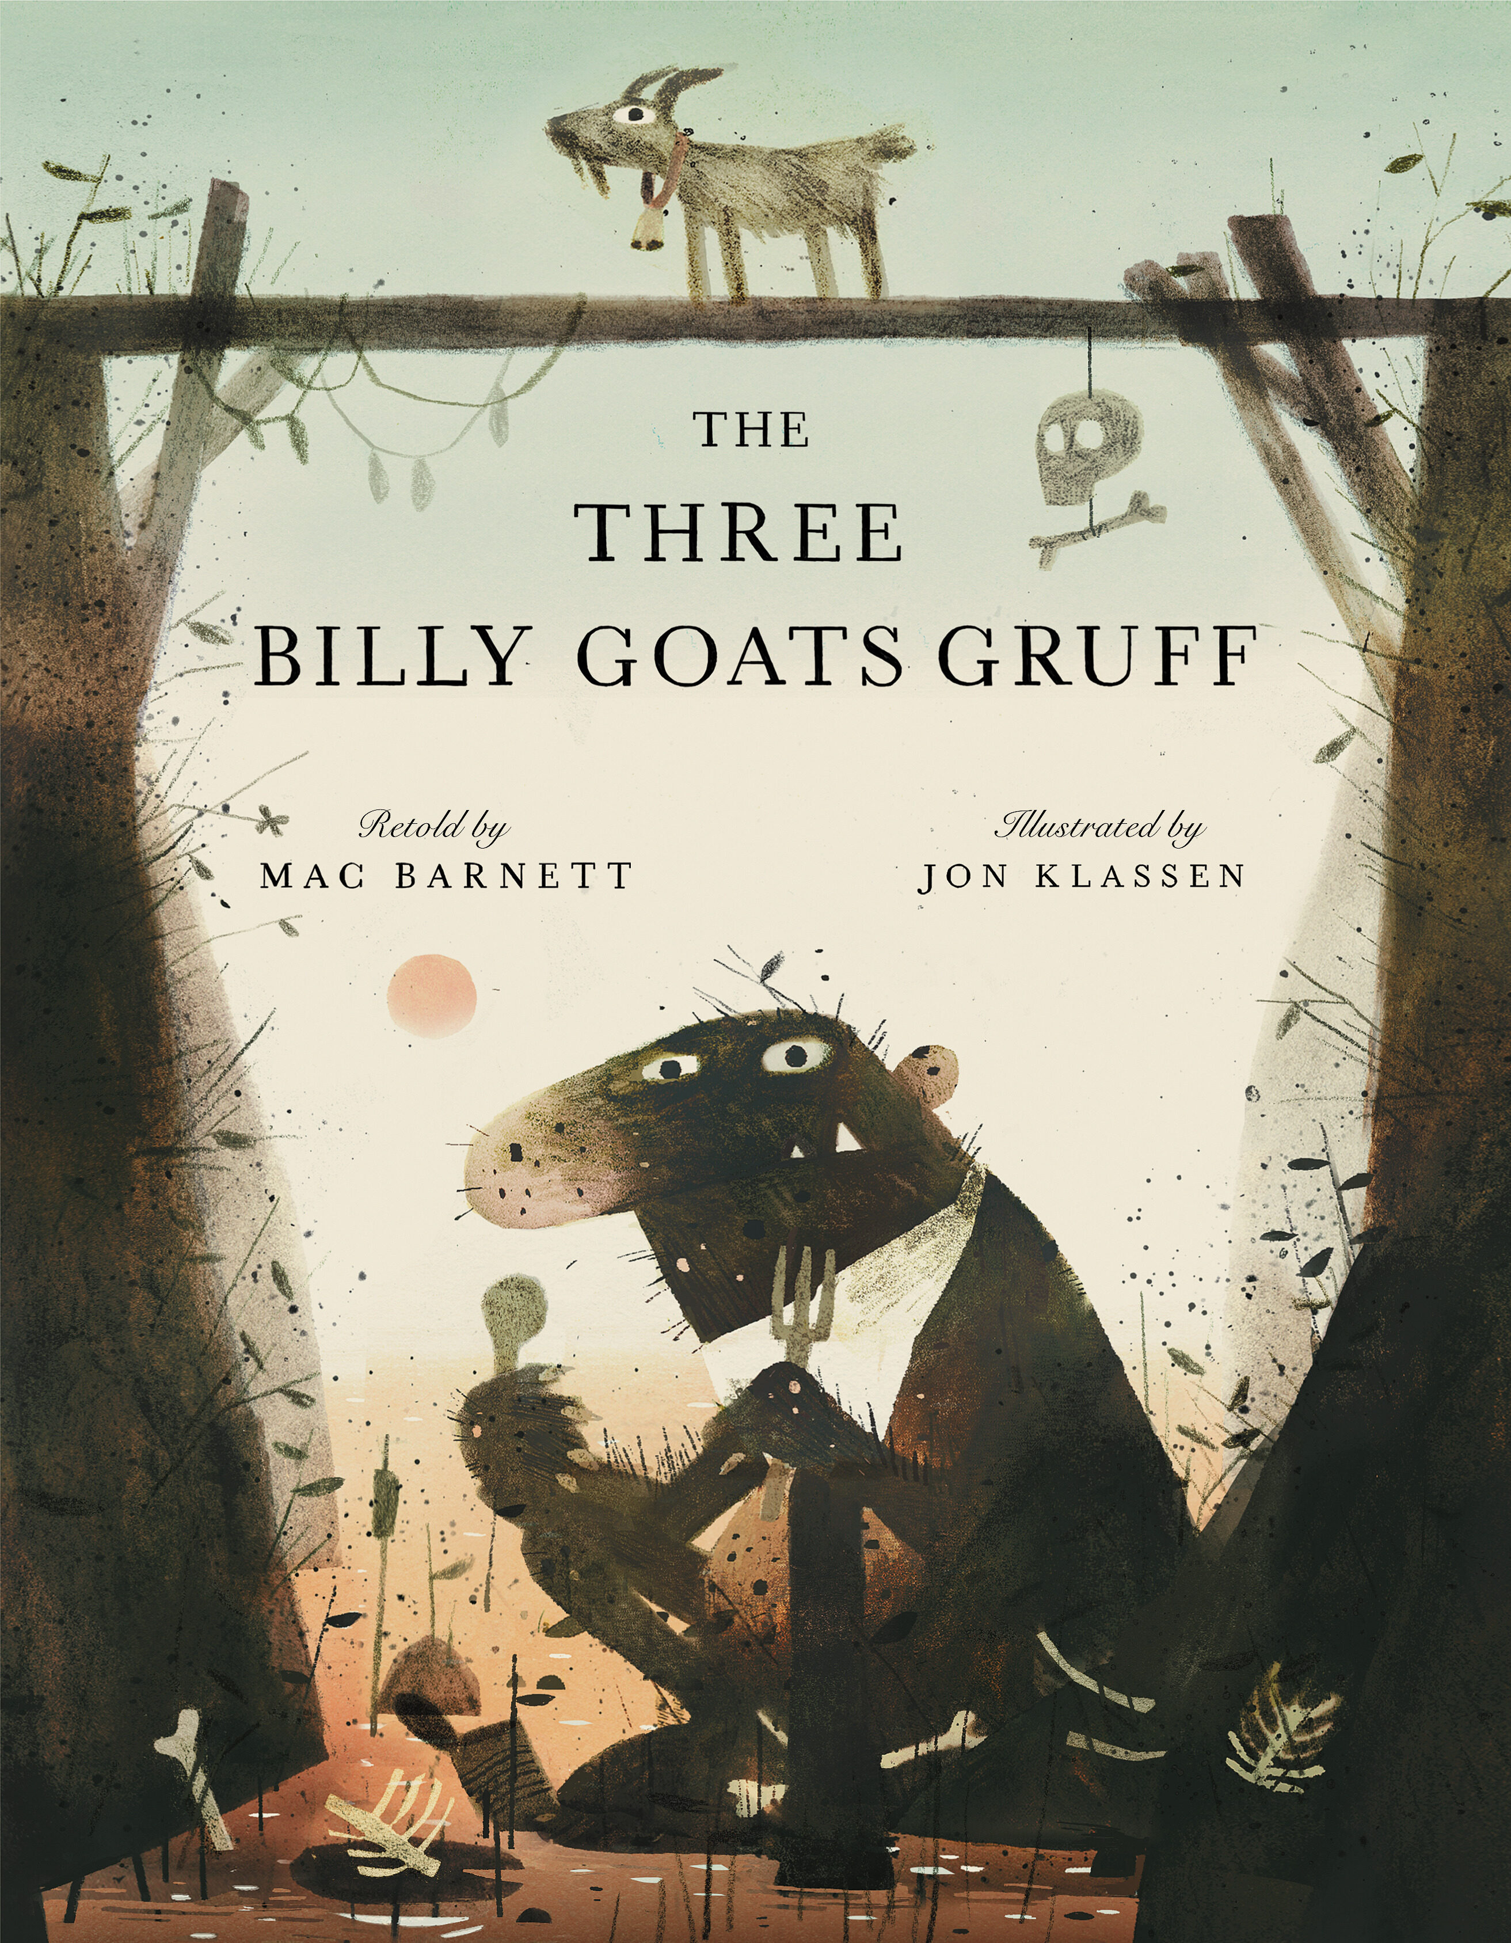
Folk Literature – Mac Barnett & Jon Klassen
10 minute Audible from Weston Woods ($2.98) Awarded a 2023 Odyssey Honor
ALA Notable Younger
1 min. intro from Scholastic
8 min. Barnes & Noble Read Aloud by authors
Oct. 18, 2022
Notes:
Three Billy Goats Gruff - New retelling of the traditional story.
"The first in a groundbreaking new collection of fractured fairy tales, this brilliantly crafted, hilarious twist on the beloved classic finds three goats putting their horns together to cleverly outsmart a hungry troll.”
Level 2.9, 560L,

Slide 7
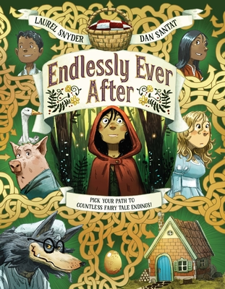
Fairy Tale Literature
Chronicle Books
ALA Notable Younger
Chronicle Produced an activity kit
When the book came out. Contact
Me for a copy. It looks like it is no
Longer available at chroniclekids.com
Notes:
Endlessly Ever After: Pick Your Path to Countless Tale Endings, April 5, 2022, 1*, RL Adult Directed, Award-winning creators Laurel Snyder and Dan Santat transform a crowd of classic tales into an ever-changing, fascinating, laugh-out-loud choose-your-path picture book, “The Three Little Pigs,” “Hansel and Gretel,” “Snow White,” “Sleeping Beauty,” “Little Red Riding Hood,” and more.

Slide 8
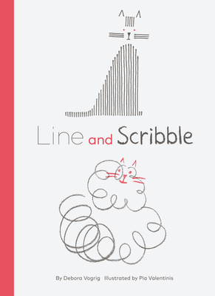
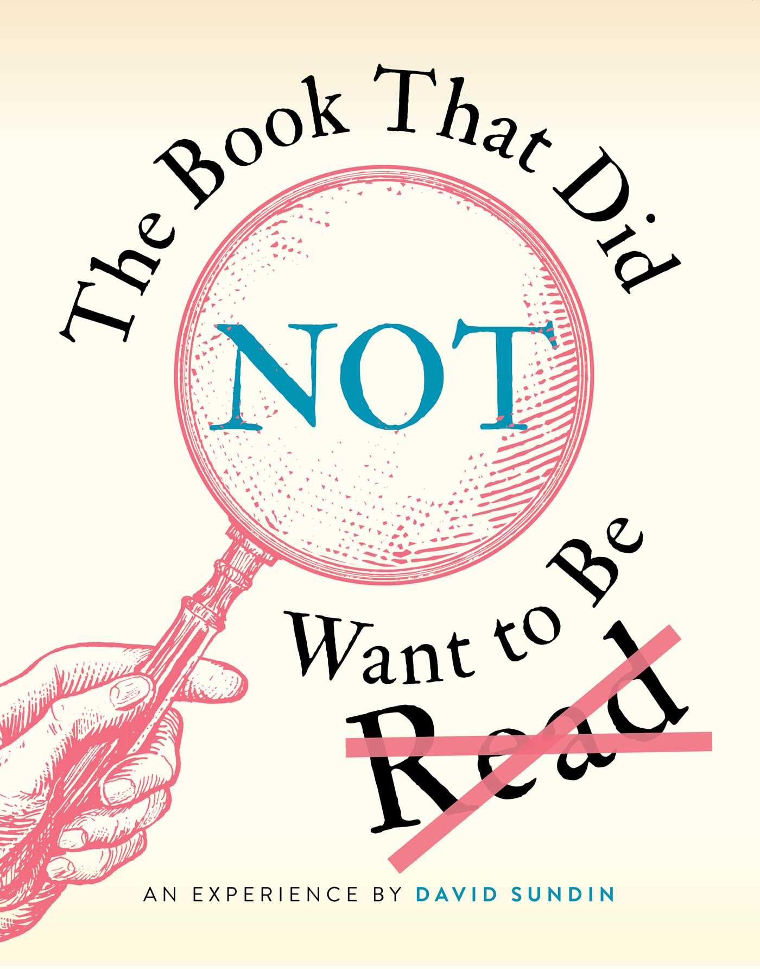
CCOLORADO LIBRARIES
FOR
EARLY LITERACY
Write
2023 shortlists
READ
WRITE
SING
TALK
PLAY
Read
Notes:
The Book That Did NOT Want to Be Read – March 1, 2022, 1* 550L but meant to be read aloud. A humorous interactive story about a book that does not want to be read and will do just about anything it can to make you give up and put it down. Swedish comedian reminiscent of BJ Novak’s The Book with No Pictures.
Line and Scribble – 1*, Line goes straight on her way, while Scribble wanders and zigzags, but they are still best friends and can work together with their individual perspectives to make art.. Can be used in many lessons – a celebration of individual ideas, creativity, and friendship

Slide 9
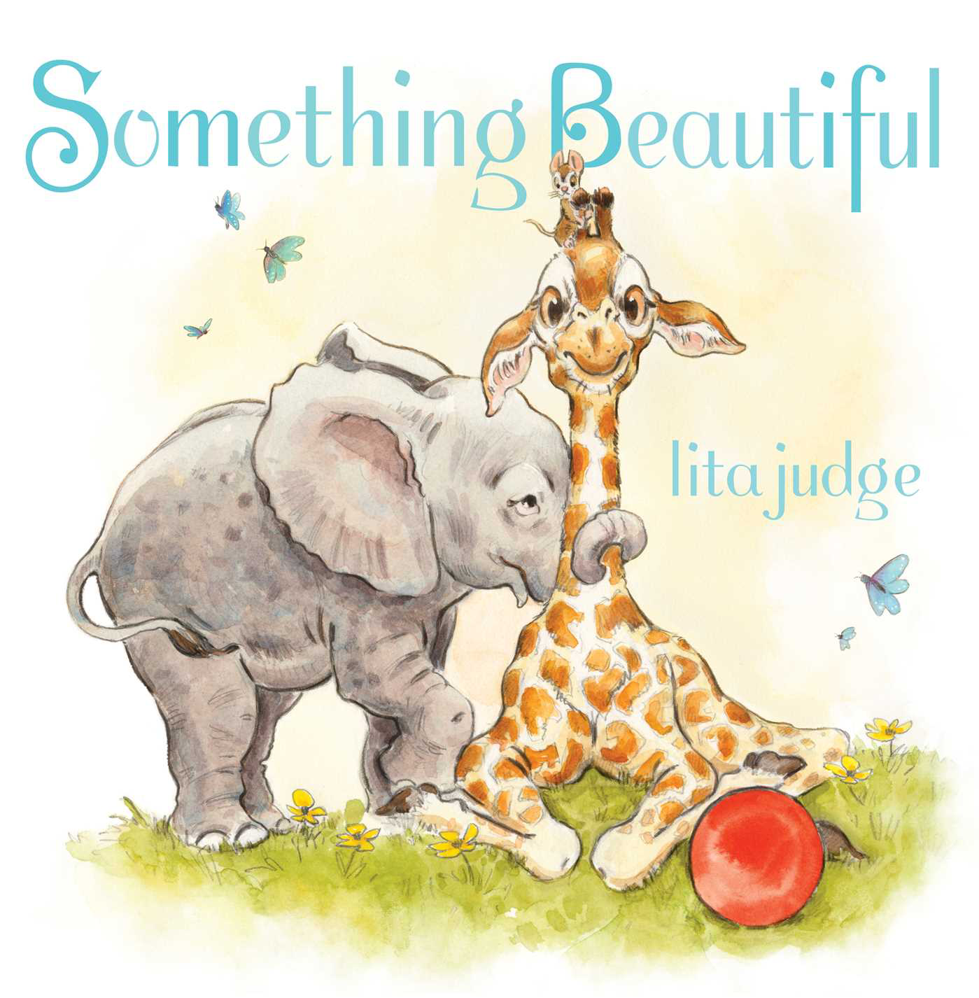
Friends
Simon and Schuster page
Simon & Schuster link with teacher's guide
5 min. Youtube read aloud by lita judfe at Simon Kids
Notes:
Something Beautiful, Lita Judge June 7, 2022 – Adult directed 550L Preschool or Kindergarten book to consider how friendships always have room for more and each friend has something unique to offer. Mouse, Elephant, and Giraffe have so much in common. They like the same games. They eat the same snacks. They don’t need anyone else! Or do they?
Walter Had a Best Friend – 2*, October 18, 2022 Sometimes best friends aren’t forever, and that’s okay. Because there might be a new pal waiting just around the corner.

Slide 10
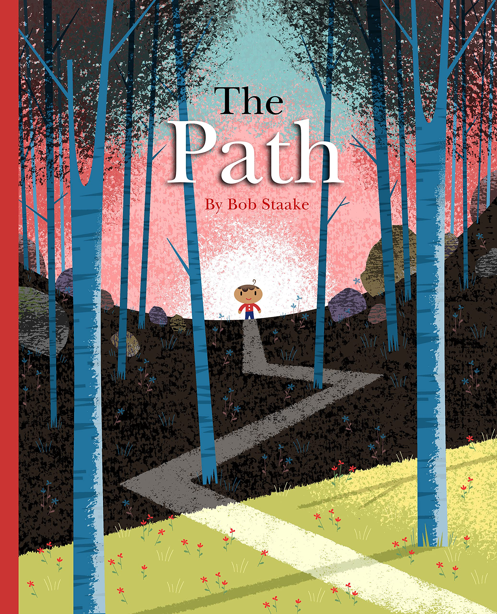
Beginning of the School Year Books
1 min. Candlewick Trailer
Penguin Random House with peek inside
resources at Astra Publishing for The Path
March 29, 2022
Notes:
This is a School – 1*, Poster on the reverse side of the jacket introduces the members of this school community. Make your own based upon the characters in your school.
The Path – Bob Staake – Adult Directed 710L A Picture Book About Finding Your Own Way - I paired it with other end of the year books and the teacher decided to use it at the beginning of next year to talk about personal choice, perseverance, resilience, and choosing your own path!

Slide 11
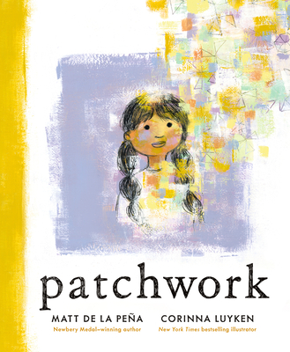
Empathy
Penguin Random House with link to teacher's guide
Publisher page with 1 min. teaser by Young Vo
March 1, 2022
Notes:
Gib-ber-ish – 3*, Challenges of learning a new language. Based upon Vo’s immigration from Viet Nam, Also gives a little bit of a feel for decoding with emoji’s at the end.
Patchwork –1*, August 30, 2022 Matt De La Pena and Corinna Luyken - In profound, uplifting verse and sumptuous artwork, beloved creators Matt de la Peña and Corinna Luyken explore the endless possibilities each child contains: A young dancer may grow into a computer coder; a basketball player might become a poet; a class clown may one day serve as an inspiring teacher; and today’s quiet empath might be tomorrow’s great leader. Here’s a profound and uplifting new classic with an empowering message for readers of all ages: Your story is still being written. NCTE Notable Poetry Book.

Slide 12
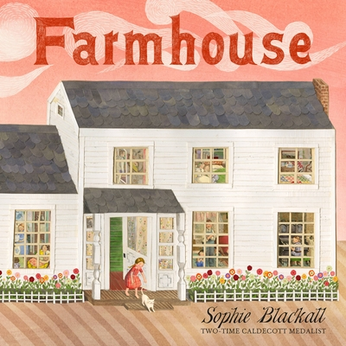
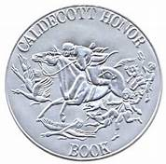
Fiction based on actual places and events set in Maine
2023 Caldecott
Honor Book
10 min. visit to Chris Van Dusen's Studio
2 min. intro to Farmhouse
30 min. author story of the story Big Truck Little Island
Picture of Sophie Blackall & Chris Van Dusin
May 3, 2022
Notes:
Farmhouse.5*, RL5.6, Sept. 21, 2022, A farmhouse where twelve children grow up holds evidence of their stories long after they are gone. The process used to make the art used pieces from the abandoned farmhouse upon which the story is based.
Big Truck, Little Island 3*, RL3.8, May 3, 2022 When a very big truck gets stuck in the road, traffic on the little island comes to a standstill. It’s a problem! Everyone needs to be someplace, but no one’s going anywhere. How will the islanders get past a twenty-ton truck and on their merry way? Based on a true event.

Slide 13
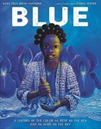
Historical/Informational
ALA Notable Younger
Blue: A History of the Color as Deep as the Sea and as Wide as the Sky
9 min. Sankofa read aloud
YouTube to @SankofaReadAloud
Suggested teaching at NEA Read Across America
Notes:
Blue: A History of the Color as Deep as the Sea and as Wide as the Sky, 1060 Lexile, 3*, Sankofa is a Youtube online African American Children’s Stories link. This picture book follows one color’s journey throughout history—from ancient Afghan painters to 1905, when a chemical blue dye was created—and around the world, as it becomes the blue we know today.

Slide 14
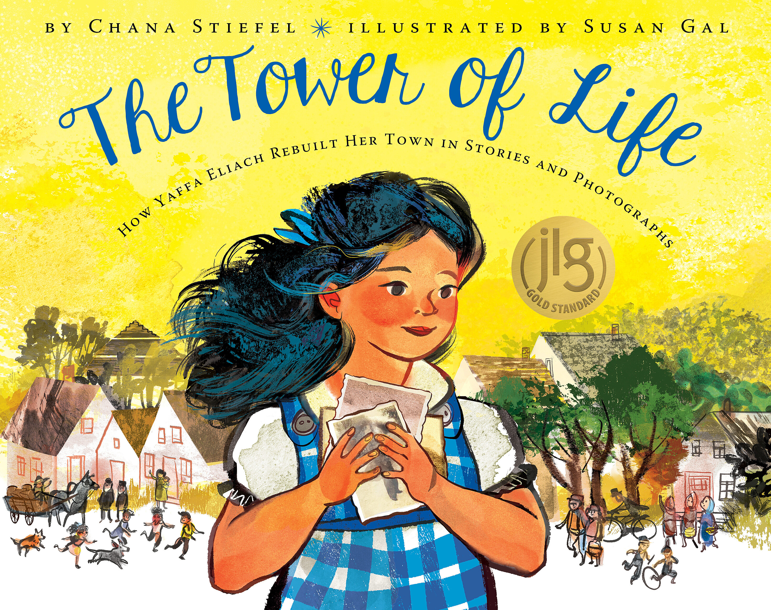
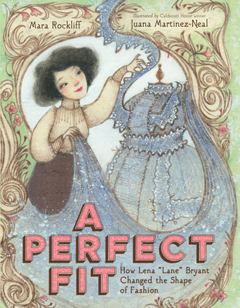
Historical/Informational/Biography
How Yaffa Eliach Rebuilt Her Town in Stories and Photographs
How Lena “Lane” Bryant Changed the Shape of Fashion
How one six-year-old girl’s march to school changed the world
2023 Siebert Honor Book
Chana Stiefel's Website
Sept. 6, 2022
Mara Rockliff's website
1 min. Scholastic Book Trailer
Notes:
A Perfect Fit: How Lena “Lane” Bryant Changed the Shape of Fashion April 12, 2022 1*, Discover how the Lane Bryant clothing brand changed the way we buy clothes forever by celebrating bodies of all shapes and sizes in this inclusive picture book biography of a Lithuanian immigrant with a brilliant eye for fashion and business. With stunning artwork from Sibert medalist Juana Martinez-Neal.
I Am Ruby Bridges, Sept 6, 2022 Ruby Bridges tells her story as never before and shares the events of the momentous day in 1960 when Ruby became the first Black child to integrate the all-white William Franz Elementary as a six year old little girl -- a personal and intimate look through a child's lens at a landmark moment in our Civil Rights history. AD 600L
The Tower of Life: How Yaffa Eliach Rebuilt Her Town in Stories and Photographs October 4, 2022 The true story behind the Tower of Life, a permanent Exhibit at the US Holocaust Memorial Museum in Washington, DC. Yaffa’s spent 17 years gathering 6000 photos. Rebuilt the town of Eishyshok (Ay-shi-shok) Lithuania by locating the photos survivors had managed to rescue.

Slide 15
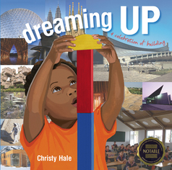
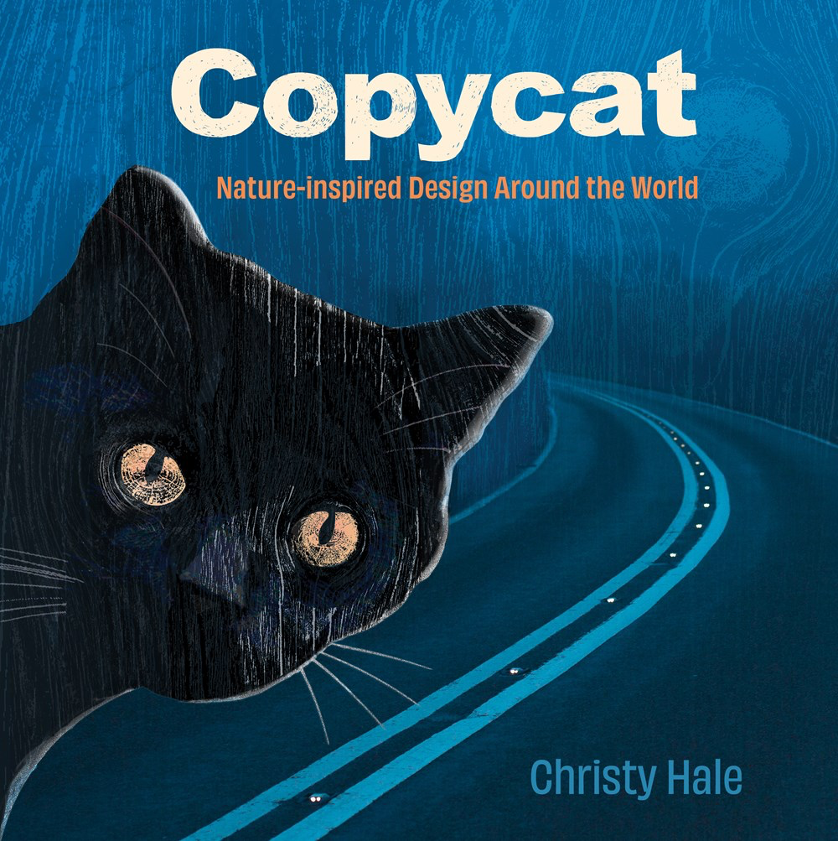
Poetry – STEM
Companion to 2012’s Dreaming Up: A Celebration of Building
Lee and Low with trailer,teachers guide and activity links
September 20, 2022
Notes:
Copycat, Sept. 20, 2022, 2*, Award-winning author-illustrator Christy Hale brings the fascinating concept of biomimicry to life in a uniquely designed book that shows how nature inspires solutions to real-world problems.
Biomimicry is…”a practice that learns from and mimics the strategies found in nature to solve human problems”. Tanka Poetry. Activites and Teacher’s Guide - Follow up to her Dreaming Up: A Celebration of Building which came out in 2012.
Illustrations of plants and animals and tanka poetry are paired with photographs of innovative inventions and designs found around the world to present captivating examples of nature-inspired design.

Slide 16
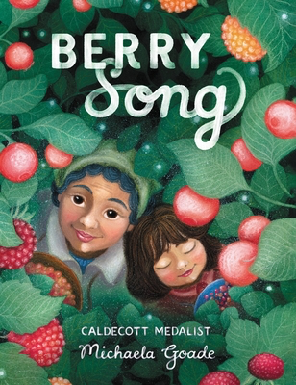
Poetry - Culture
2023 Caldecott Honor
1 min. trailer from Little Brown
Little Brown website with 12 min. intro with author
Notes:
Berry Song – 3*, As a young Tlingit girl collects wild berries over the seasons, she sings with her grandmother as she learns to speak to the land and listen when the land speaks back. Note from the Author not too long to read to older children.

Slide 17
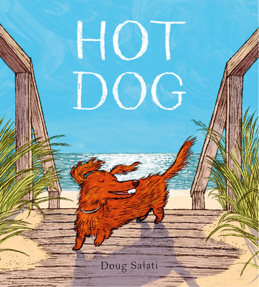
2023 Caldecott Medal
Betsy Bird review of the day with video preview by Doug Salati
2023 Caldecott Medal
Notes:
Hot Dog: 3* May 24, 2022 summer day in the city made better by trip to the beach Doug Salati. Although I’m a beginner at social media, Sophie Blackall posted a picture of the group watching the Announcement and the holding Hot Dog . dougsalati, Sophie Blackall, and sergio ruzzier (brian_Floca, ohtruth, cecifonik) watched Caldecott announcement together. Pair with – Old Woman Who Named Things by Cynthia Rylant, Madame Martine by Sara S. Brenner, and even A Ball For Daisy by Chris Raska’s.

Slide 18
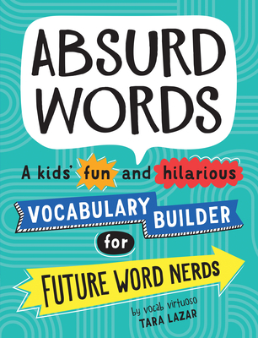
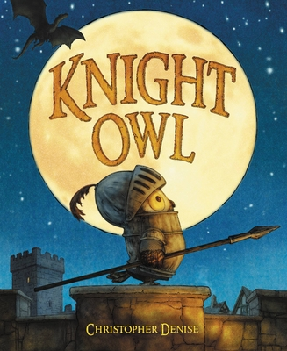
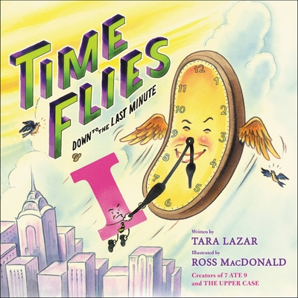
Word Play
6 min Barnes and Noble Read Aloud by Christopher Denise
1 min. Trailer on YouTube by Little Brown
Notes:
Knight Owl – March 15, 2022. Full of optimism the Owl makes a knight . Pair with Tomie DePaola’s 1980 The Night and the Dragon.
Time Flies: Down to the Last Minute – April 26, 2022. pun-filled detective noir Private I series - Just perfect for my sense of humor and teachers in 2nd-5th. Just fun. First book picked for 2023 CCIRA Session if I do it.
Private I must find out who is responsible for the disappearing clocks and watches in Capital City before they run out of time. ( Series with 7 ate 9: The Untold Story, The Upper Case: Trouble in Capital City, and other collaborations with Ross MacDonald)

Slide 19
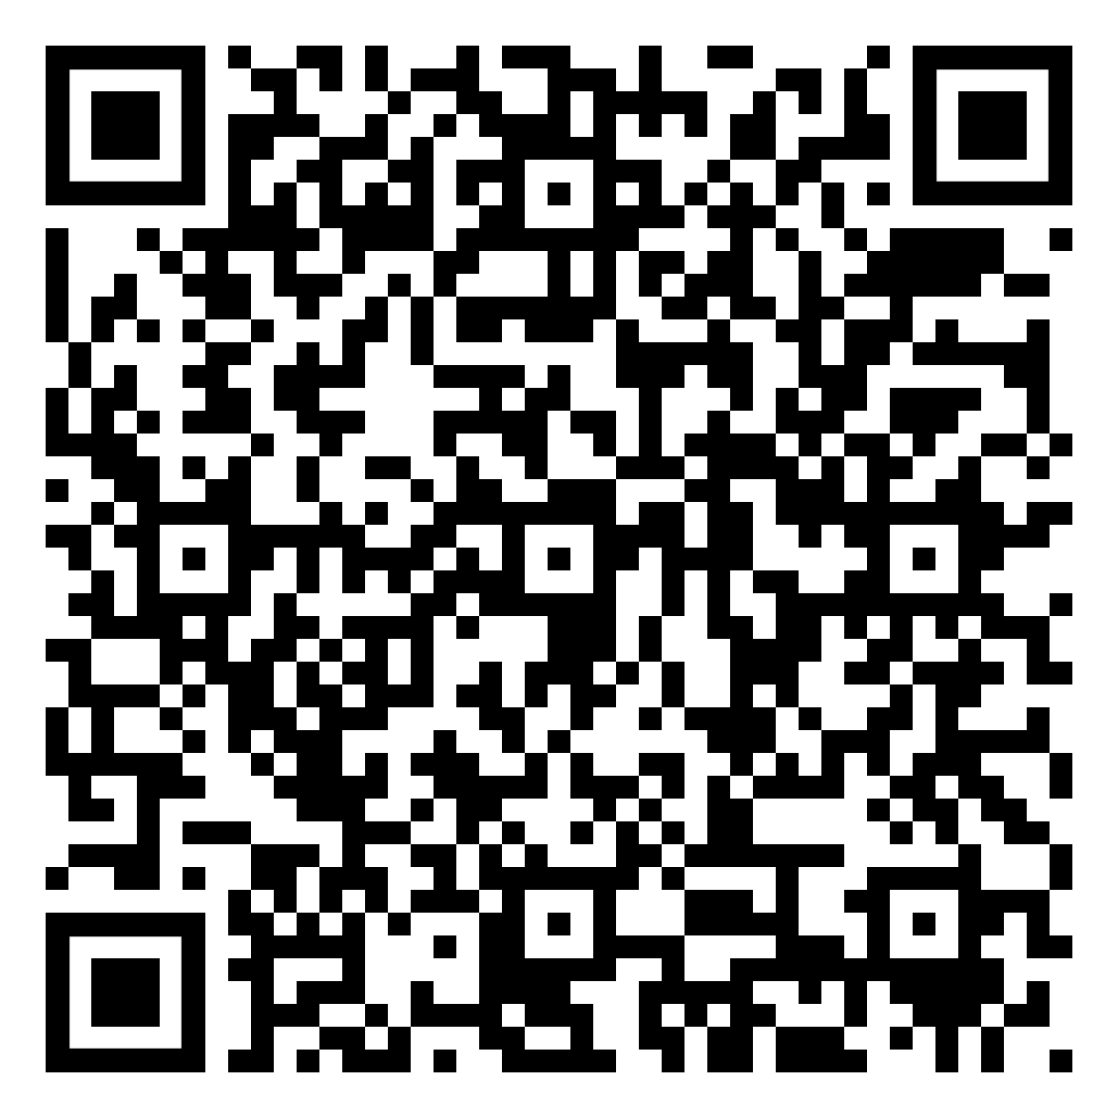
Likes and Loves: 2023 Marcie Haloin Session # 159 Thursday, Feb. 9, 2023 1:30-2:30
Notes:
Please take a moment to fill out an evaluation for this session.

Slide 20
What follows is 10 CCBA 2023 Picture Book Nominees with links to their book trailers

Slide 21
vote at CCIRA.org→Professional Learning-->Colorado Children's Book Award
Nominated books must be currently in print and published in the five years preceding the award year.
Only one title per author will be included in each year's ballot.
Last year's WINNING authors are not eligible this year.
Books previously nominated are not eligible for nomination in following years.
A book title nominated by more that one school or library will be considered more heavily for inclusion in the final list.
Books based on movies, television shows, toys, video games, or apps are not eligible for nominations unless the book preceded the movie or production.
The author of a nominated book must be a living author.
Caldecott and Newbery Award books are not eligible. Honor books are eligible.
Once a book in a series has won, all other books in that series by that author will not be eligible for nomination.
Children may vote for one picture book and one junior book provided they have read a minimum of three books in each category.
Submit the top 20 BOOK TITLES NOMINATED by children the CCBA Committee by March 1, 2023.
PLEASE be sure to put the number of students who nominated the book.

Slide 22
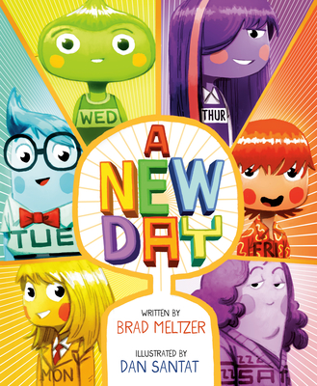
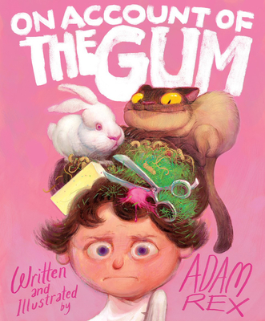
Humor
Adam Rex introduces book before it came out at Chronicle Books
Barnes & Noble Storytime read aloud with Brad Metzler
Notes:
A New Day- RL 2.5 Adult directed
"After Sunday quits being a day of the week, the other days of the week try out all sorts of candidates, until an act of kindness reminds them all that a little appreciation can go a long way."
Pair with other days of the week books. Reminiscent of Day the Crayons Quit
On Account of the Gum – RL 2.9, 560L Adult directed
Enjoy the humor of this silly romp and then let kids write their tales of Gum. Or other things that create problems.

Slide 23
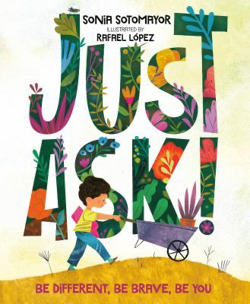
Important message
Harper Collins with link to trailer
Peek inside at Penguin/Random House
Notes:
Just Ask: Be Different, Be Brave, Be You! - 710L, RL 4.1 In this warm and inclusive story by US Supreme Court Justice Sonia Sotomayor, inspired by her own childhood diagnosis of diabetes, readers join along as differently abled kids use their strengths to work together
The Couch Potato – 550L, RL 2.8,
The Couch Potato has everything he needs within reach of his sunken couch cushion. But when the electricity goes out, Couch Potato is forced to peel himself away from the comforts of his living room and venture outside. When he does, he realizes fresh air and sunshine could be just the things he needs .

Slide 24
Unicorns
Simon & Schuster with link to trailer, discussion guide and activity sheets
1 min. Trailer from Abrams Books
Activity sheets for Itty Bitty Kitty Corn
Notes:
Itty-Bitty Kitty Corn RL2.4 490L Kitty, who looks like a kitten yet feels she is actually a unicorn, begins to doubt herself as others ridicule her, until she meets a unicorn that helps her discover and embrace who she is.
Unicorns Are the Worst! Rl 2.8, 480L "A grumpy goblin hates having unicorns as neighbors, but when dragons threaten his home and the unicorns come to the rescue, he has to admit that maybe unicorns are not so bad after all. sd

Slide 25
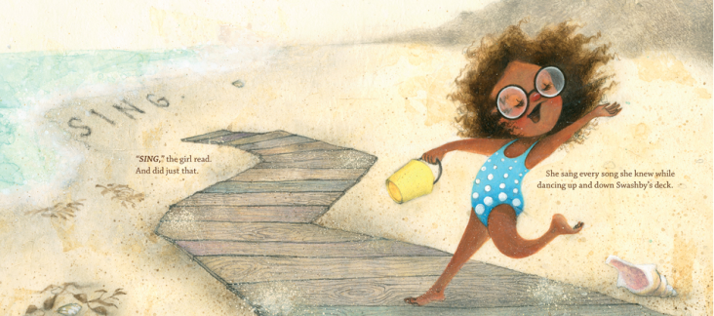
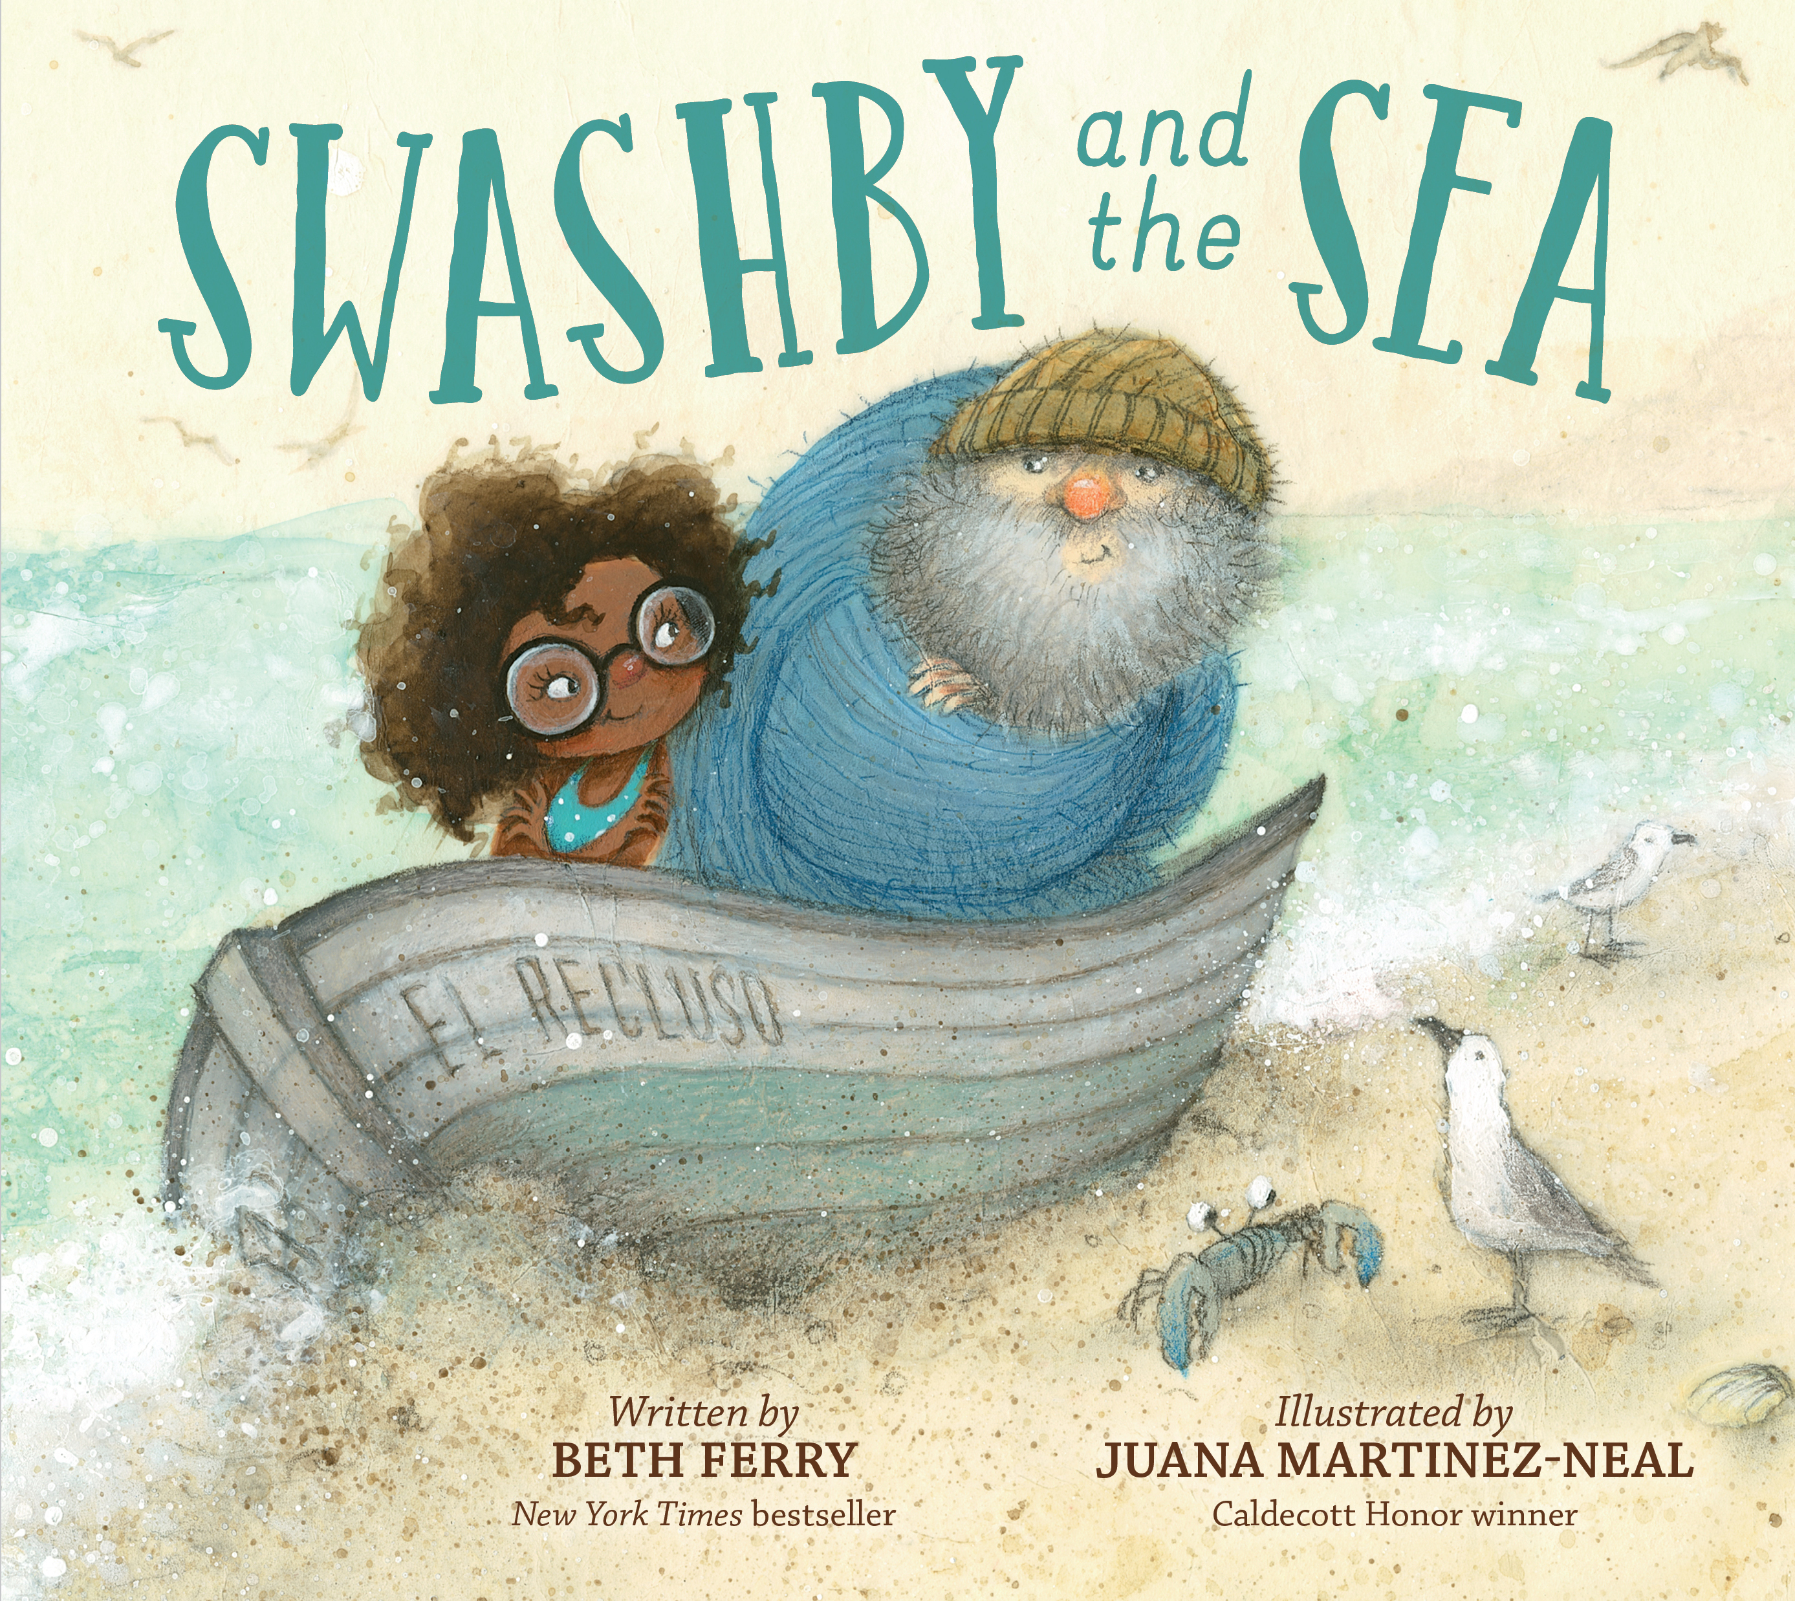
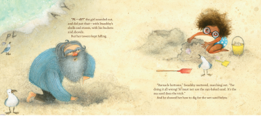
Nature
Juana Martinez Neal's website- Swashby with videos
Beth Ferry's Swashby page
6 min. read aloud by Sankofa Read Aloud
Notes:
Swashby and the Sea RL 3.4, 620L No-nonsense Captain Swashby is used to the sea meeting all of his needs and when, after his retirement, new neighbors disturb his solitary life, the sea helps in just the right way.

Slide 26
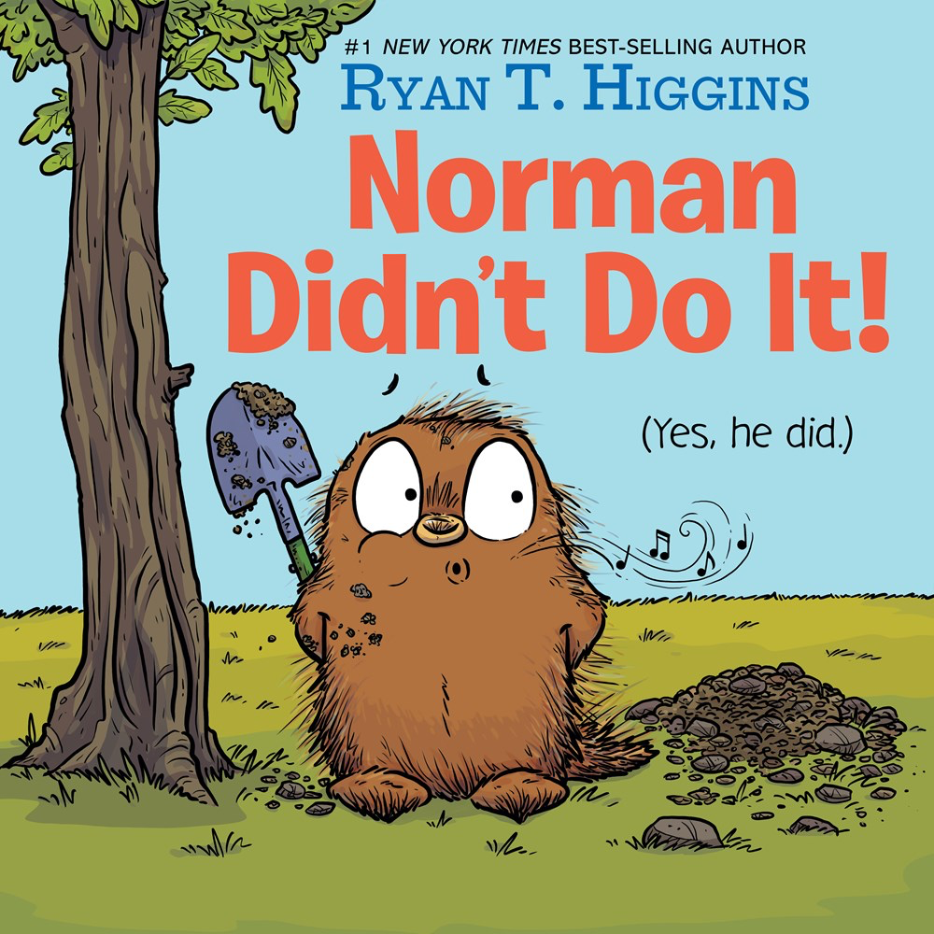
Beginning of the School Year Possibles
Barnes and Noble Storytree time 4 min. read aloud
Disney Books with activity sheets
Ryan T. Higgins pages at Disney Books
Harper collins with trailer and activity guide
Notes:
Mel Fell – 1.4 RL, Effecctive read aloud about bird that won Caldecott Honor for the illustrations.
Norman Didn’t Do It! – RL 1.9, Norman, a porcupine whose best friend is a tree named Mildred, begins to feel jealous when another tree grows close to Mildred and acts out against the new tree.

Slide 27
Colorado Author
10'42" read aloud at Where There's A. Williams, There's A Way
Susans Stevens Crummel's Website
Notes:
The Donkey Egg – RL2.5 Adult Directed, 490L
After fast-talking Fox leaves him with a large, green egg, Bear spends minutes, hours, days, and weeks lovingly caring for it with the help of his neighbor Hare.
Same Characters as Caldecott honor Tops & Bottoms.

Slide 28
2024 Nomination Guidelines
Copyright 2019 – 2023
One title per author, not last year’s winners
Book prior to any other format (production)
# of schools before # of nominations
Each school can submit up to 20 titles when they vote before March 1, 2023
Children may vote for 1 PB and 1 JB if they have read or heard at least 3 in the category

Slide 29
Likes and Loves: 2023 Marcie Haloin Session # 159 Thursday, Feb. 9, 2023 1:30-2:30
Notes:
Please take a moment to fill out an evaluation for this session.

