Slide 1
Brian Selznick
Kaleidoscope Book Birthday
September 28, 2021
Marcie Haloin for Mesa Elementary

Slide 3
FIRST PICTURE PAINTED DURING COVID

Slide 4
some of the paintings used in Kaleidoscope
Notes:
One on far right was the first painting Mr. Selznick made during covid. He found that flowers tended to help during Covid.

Slide 5
The Book of Dreams

Slide 6
THE ABANDONED HOUSE

Slide 7
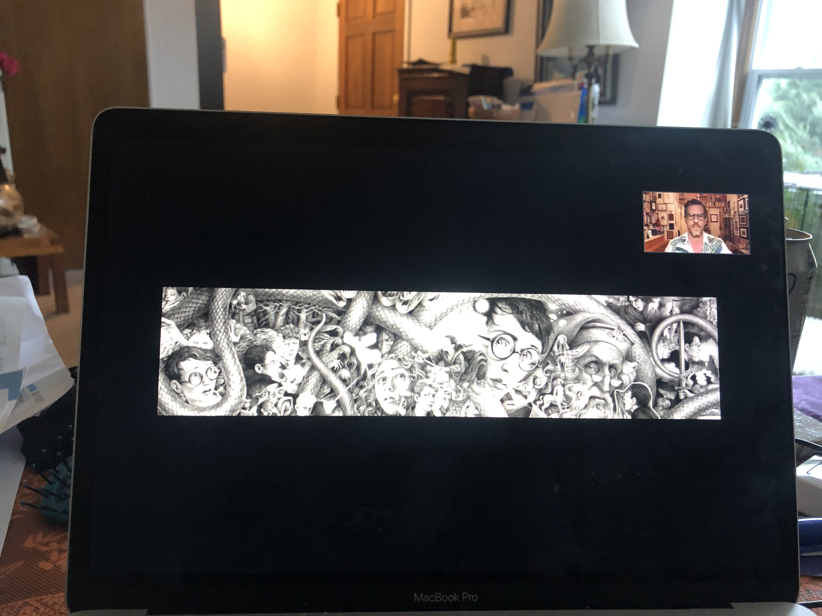
Harry Potter 20th Anniversary Covers

Slide 8
HARRY POTTER 20th Anniversary COVERS

Slide 9
One mural for all 7 covers: Tells the whole story

Slide 10
Paper cut artwork (favorite Quote)

Slide 15
IN THE DARK

Slide 16
Brian Selznick reads a story the book for 4 minutes
4 minutes chapter reading by Brian Selznick

Slide 17
Other Middle Grade Brian Selznick Authored Books

