Slide 1
Colorado Children’s Book Award 2022 winners and 2023 nominees
Download this slide show and other resources for CCBA at
www.mhaloin.com
Enjoy Reading!

Slide 2
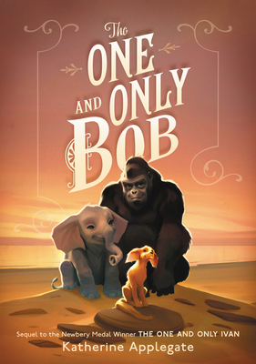
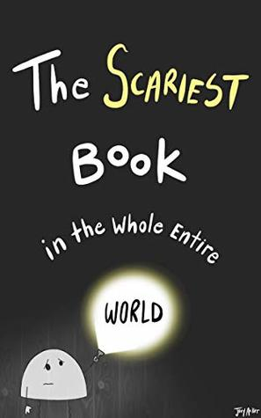
Colorado Children’s Book Awards
2022 Junior Book
Winner
Runner up
2022
Picture
Book
Winner
Runner up
Author's website - ackersbooks.com
6 min. read aloud of this second book in the series
Notes:
Ground Zero RL4.8 690L
Alternating chapters have Brandon visiting his dad on the 107th floor of the World Trade Center on September 11, 2001 when the attack comes and Reshmina gowing up in Afghanistan in the aftermath of that attack. She dreams of peace, becoming a teacher and escaping her village and the narrow role that the Taliban believes is appropriate for women. Both are struggling to survive and are changed forever by the events of 9/11.
The Cool Bean John, Jory and Pete Oswald
RL 2.5 Adult Directed Lexile 530L "Everyone knows the cool beans. They're sooooo cool. And then there's the uncool has-bean. Always on the sidelines, one bean unsuccessfully tries everything he can to fit in with the crowd--until one day the cool beans show him how it's done

Slide 3
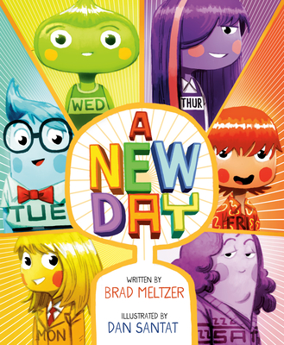
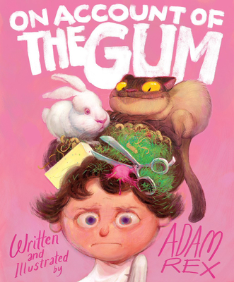
Humor
Adam Rex introduces book before it came out at Chronicle Books
Barnes & Noble Storytime read aloud with Brad Metzler
Notes:
A New Day- RL 2.5 Adult directed
"After Sunday quits being a day of the week, the other days of the week try out all sorts of candidates, until an act of kindness reminds them all that a little appreciation can go a long way."
Pair with other days of the week books. Reminiscent of Day the Crayons Quit
On Account of the Gum – RL 2.9, 560L Adult directed
Enjoy the humor of this silly romp and then let kids write their tales of Gum. Or other things that create problems.

Slide 4
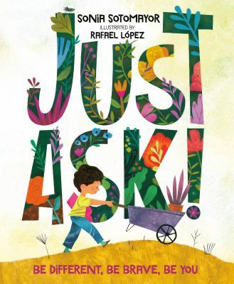
Important message
Harper Collins with link to trailer
Peek inside at Penguin/Random House
Notes:
Just Ask: Be Different, Be Brave, Be You! - 710L, RL 4.1 In this warm and inclusive story by US Supreme Court Justice Sonia Sotomayor, inspired by her own childhood diagnosis of diabetes, readers join along as differently abled kids use their strengths to work together
The Couch Potato – 550L, RL 2.8,
The Couch Potato has everything he needs within reach of his sunken couch cushion. But when the electricity goes out, Couch Potato is forced to peel himself away from the comforts of his living room and venture outside. When he does, he realizes fresh air and sunshine could be just the things he needs .

Slide 5
Unicorns
Simon & Schuster with link to trailer, discussion guide and activity sheets
1 min. Trailer from Abrams Books
Activity sheets for Itty Bitty Kitty Corn
Notes:
Itty-Bitty Kitty Corn RL2.4 490L Kitty, who looks like a kitten yet feels she is actually a unicorn, begins to doubt herself as others ridicule her, until she meets a unicorn that helps her discover and embrace who she is.
Unicorns Are the Worst! Rl 2.8, 480L "A grumpy goblin hates having unicorns as neighbors, but when dragons threaten his home and the unicorns come to the rescue, he has to admit that maybe unicorns are not so bad after all. sd

Slide 6
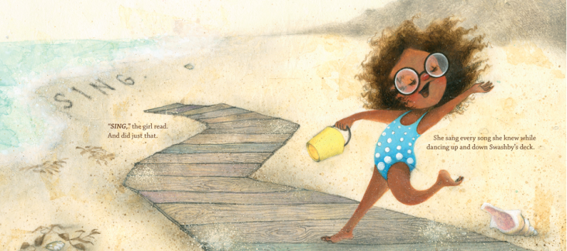
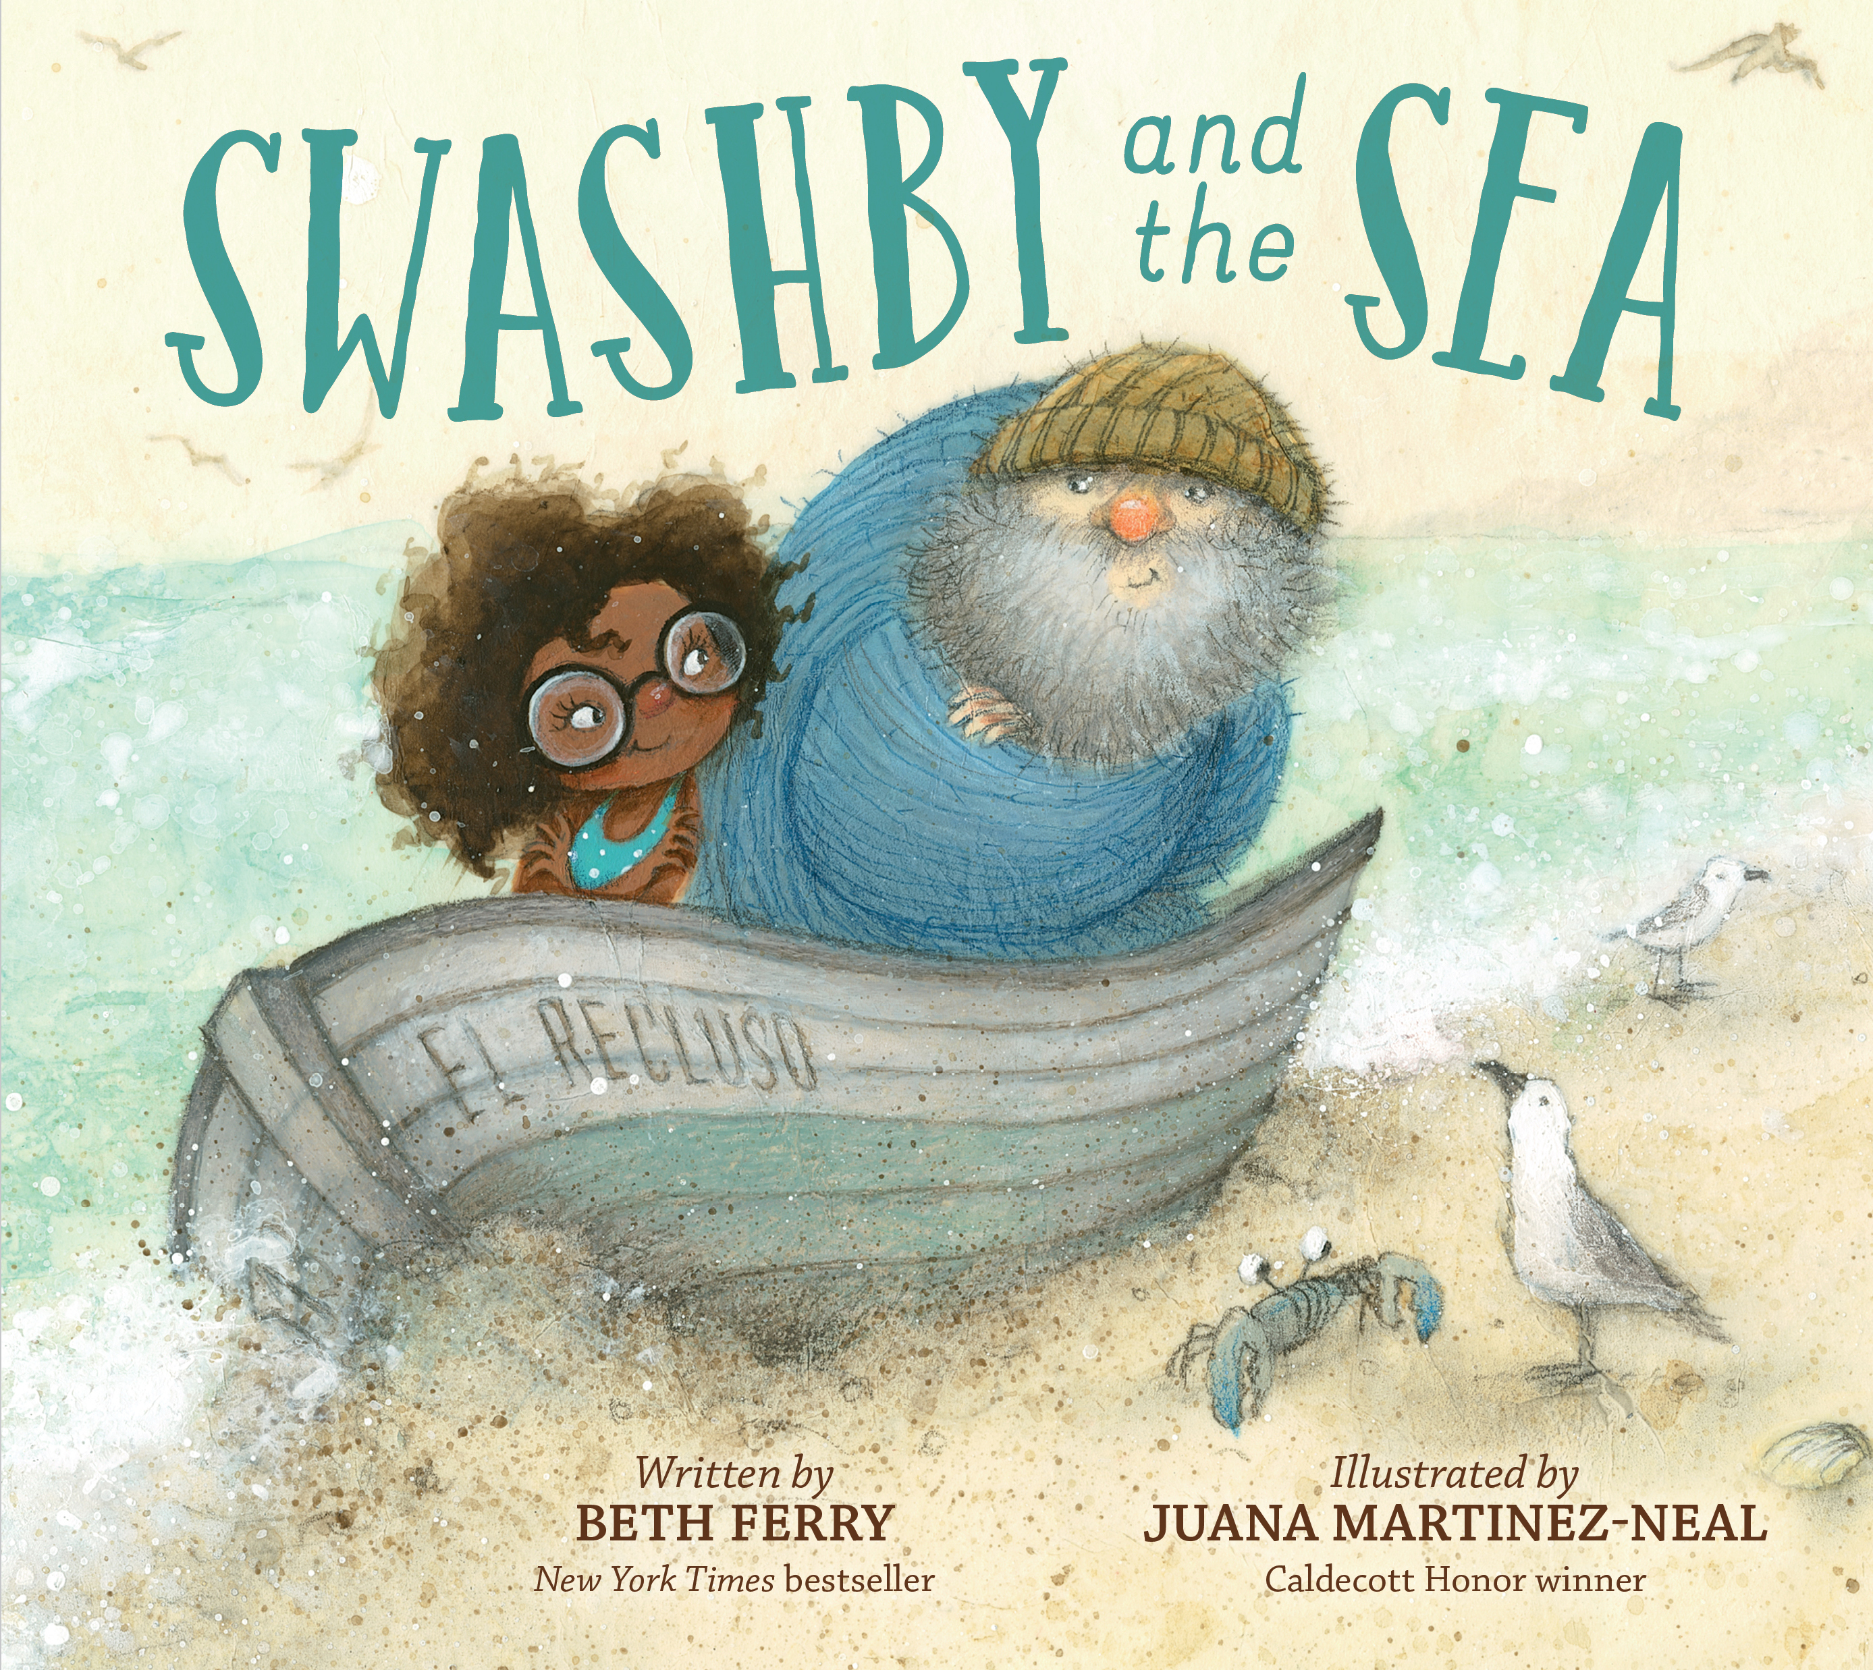
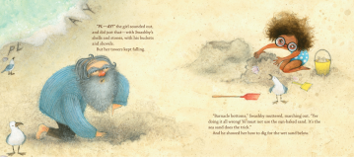
Nature
Juana Martinez Neal's website- Swashby with videos
Beth Ferry's Swashby page
6 min. read aloud by Sankofa Read Aloud
Notes:
Swashby and the Sea RL 3.4, 620L No-nonsense Captain Swashby is used to the sea meeting all of his needs and when, after his retirement, new neighbors disturb his solitary life, the sea helps in just the right way.

Slide 7
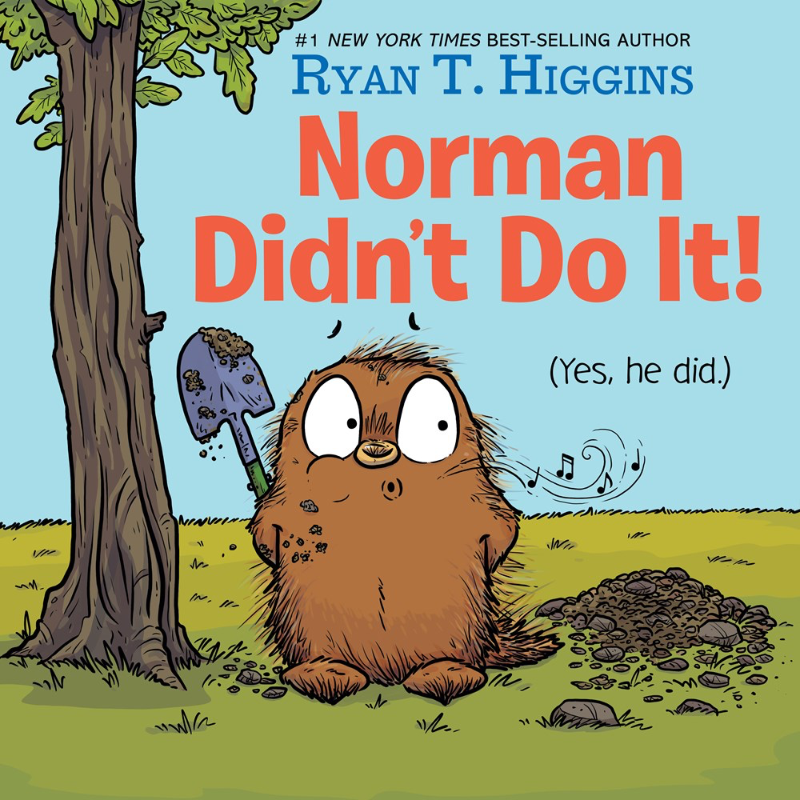
Beginning of the School Year Possibles
Barnes and Noble Storytree time 4 min. read aloud
Disney Books with activity sheets
Ryan T. Higgins pages at Disney Books
Harper collins with trailer and activity guide
Notes:
Mel Fell – 1.4 RL, Effecctive read aloud about bird that won Caldecott Honor for the illustrations.
Norman Didn’t Do It! – RL 1.9, Norman, a porcupine whose best friend is a tree named Mildred, begins to feel jealous when another tree grows close to Mildred and acts out against the new tree.

Slide 8
Colorado Author
10'42" read aloud at Where There's A. Williams, There's A Way
Susans Stevens Crummel's Website
Notes:
The Donkey Egg – RL2.5 Adult Directed, 490L
After fast-talking Fox leaves him with a large, green egg, Bear spends minutes, hours, days, and weeks lovingly caring for it with the help of his neighbor Hare.
Same Characters as Caldecott honor Tops & Bottoms.

Slide 9
2024 Nomination Guidelines
Copyright 2019 – 2022
One title per author, not last year’s winners
Book prior to any other format (production)
# of schools before # of nominations
Each school can submit up to 20 titles when they vote before March 1, 2023
Children may vote for 1 PB and 1 JB if they have read or heard at least 3 in the category

Slide 10
2022 Junior Book winner and runner up
2 min. Scholastic Trailer with Alan Gratz
One and Only Bob Trailer on YouTube
Katherine Applegate reads 4 min. excerpt on YouTube
Notes:
Ground Zero RL4.8 690L
Alternating chapters have Brandon visiting his dad on the 107th floor of the World Trade Center on September 11, 2001 when the attack comes and Reshmina gowing up in Afghanistan in the aftermath of that attack. She dreams of peace, becoming a teacher and escaping her village and the narrow role that the Taliban believes is appropriate for women. Both are struggling to survive and are changed forever by the events of 9/11.
One and Only Bob RL 3.9 570L Bob sets out on a dangerous journey in search of his long-lost sister with the help of his two best friends, Ivan and Ruby. As a hurricane approaches and time is running out, Bob finds courage he never knew he had and learns the true meaning of friendship and family.

Slide 11
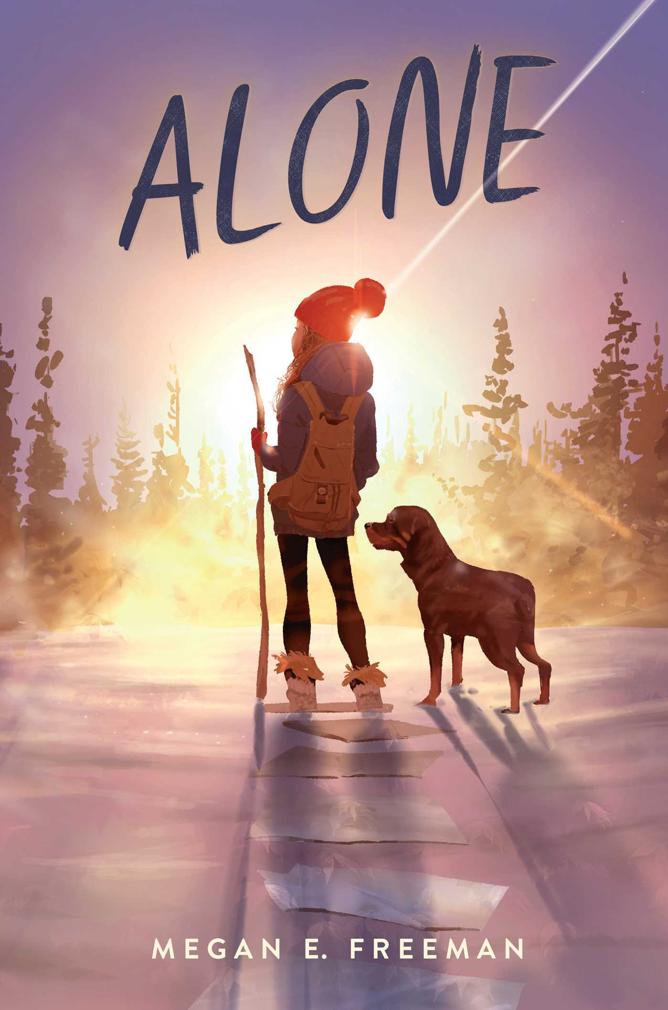
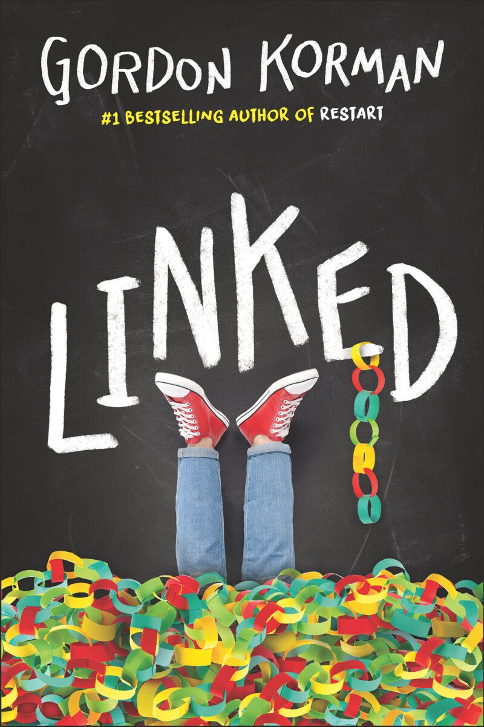
Books set in Colorado
Alone inroduction at Simon & Schuster
Gordon Korman's Website
Notes:
Alone RL 4.7 690L
When twelve-year-old Maddie hatches a scheme for a secret sleepover with her two best friends, she ends up waking up to a nightmare. She's alone--left behind in a Colorado town that has been mysteriously evacuated and abandoned. With no one to rely on, no power, and no working phone lines or internet access, Maddie slowly learns to survive on her own. Her only companions are a Rottweiler named George and all the books she can read. After a rough start, Maddie learns to trust her own ingenuity and invents clever ways to survive in a place that has been deserted and forgotten. As months pass, she escapes natural disasters, looters, and wild animals. But Maddie's most formidable enemy is the crushing loneliness she faces every day. Can Maddie's stubborn will to survive carry her through the most frightening experience of her life?
Linked RL5.3, 750L
Link, Michael, and Dana live in a quiet Colorado town. But it's woken up very quickly when someone sneaks into school and vandalizes it with a swastika. Nobody can believe it. How could such a symbol of hate end up in the middle of their school? Who would do such a thing? Because Michael was the first person to see it, he's the first suspect. Because Link is one of the most popular guys in school, everyone's looking to him to figure it out. And because Dana's the only Jewish girl in the whole town, everyone's treating her more like an outsider than ever. The mystery deepens as more swastikas begin to appear. Some students decide to fight back and start a project to bring people together instead of dividing them further. The closer Link, Michael, and Dana get to the truth, the more there is to face--not just the crimes of the present, but the crimes of the past.

Slide 12
Fictionalized Memoir
Trailer at Book Tastings
1 min intro by Rob Harrell
4 min. intro by Ernesto Cisneros
Notes:
Wink, RL3.9 580L, 3*, When twelve-year-old Ross is diagnosed with a rare form of eye cancer, he just wants things to be normal. But he soon discovers normal is overrated, and that with music, art, and the support of his true friends, he can make it through his treatments and middle school.
Efren Divided , RL 4.7. 710L
"While his father works two jobs, seventh-grader Efrén Nava must take care of his twin siblings, kindergartners Max and Mia, after their mother is deported to Mexico. Includes glossary of Spanish words”

Slide 13
Historical Fiction
Andy Marino's website
1 min. book trailer at Scholastic
Notes:
Escape from Chernobyl – RL5.6, MG+ Two young siblings flee the Chernobyl disaster with their parents, but the Communist party is on their heels. Meanwhile, the friends and family they were forced to leave behind must contend with a disinformation campaign that's determined to pretend nothing is wrong-even as deadly radiation spills into the air.

Slide 14
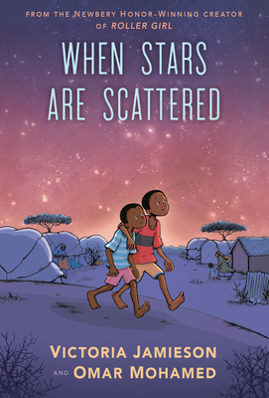
Graphic Books
20 min. read aloud by Reading Allowed Teacher
1 min. trailer at Penguin Middle School
Link to a pdfread of book is in notes full 198 pages
Penguin Random House teacher's guide
Notes:
When Stars are Scattered 3.7RL, 530L Graphic Novel
remarkable graphic novel is about growing up in a refugee camp, as told by a former Somali refugee to the Newbery Honor-winning creator of Roller Girl.’
Bad Guys # Cut to the Chase – 2.4RL, Graphic Novel, Movie not yet out when nominated
https://www.pdfread.net/ebook/the-bad-guys-in-cut-to-the-chase-aaron-blabey/
Full pdf 198 pages

Slide 15
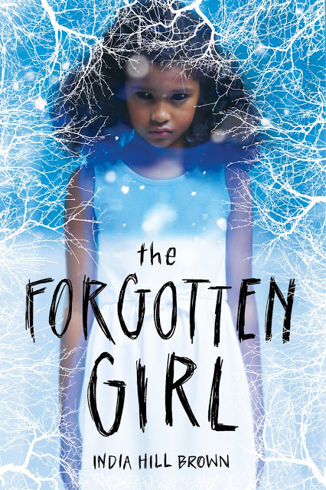
Ghost Story
Second 1 min. Scholastic Bookfair Trailer
Scholastic Bookfairs Preview 1 min.
Notes:
Forgotten Girl, RL 4.7, 670L – Daniel and Iris while investigating the local graveyards discover the neglected and forgotten Black cemetery and disturb a Avery, a jealous and demanding ghost.

Slide 16
Humor
1 min. intro by Jason Reynolds
30 second trailer Scholastic Bookfairs
Notes:
It’s the End of the World and I’m in my Bathing Suit – 5.6 RL When the electricity goes out, twelve-year-old Eddie and his friends set out to investigate what is going on when they make the startling discovery that they are the only ones left in their neighborhood--and perhaps the only people left anywhere.

Slide 17
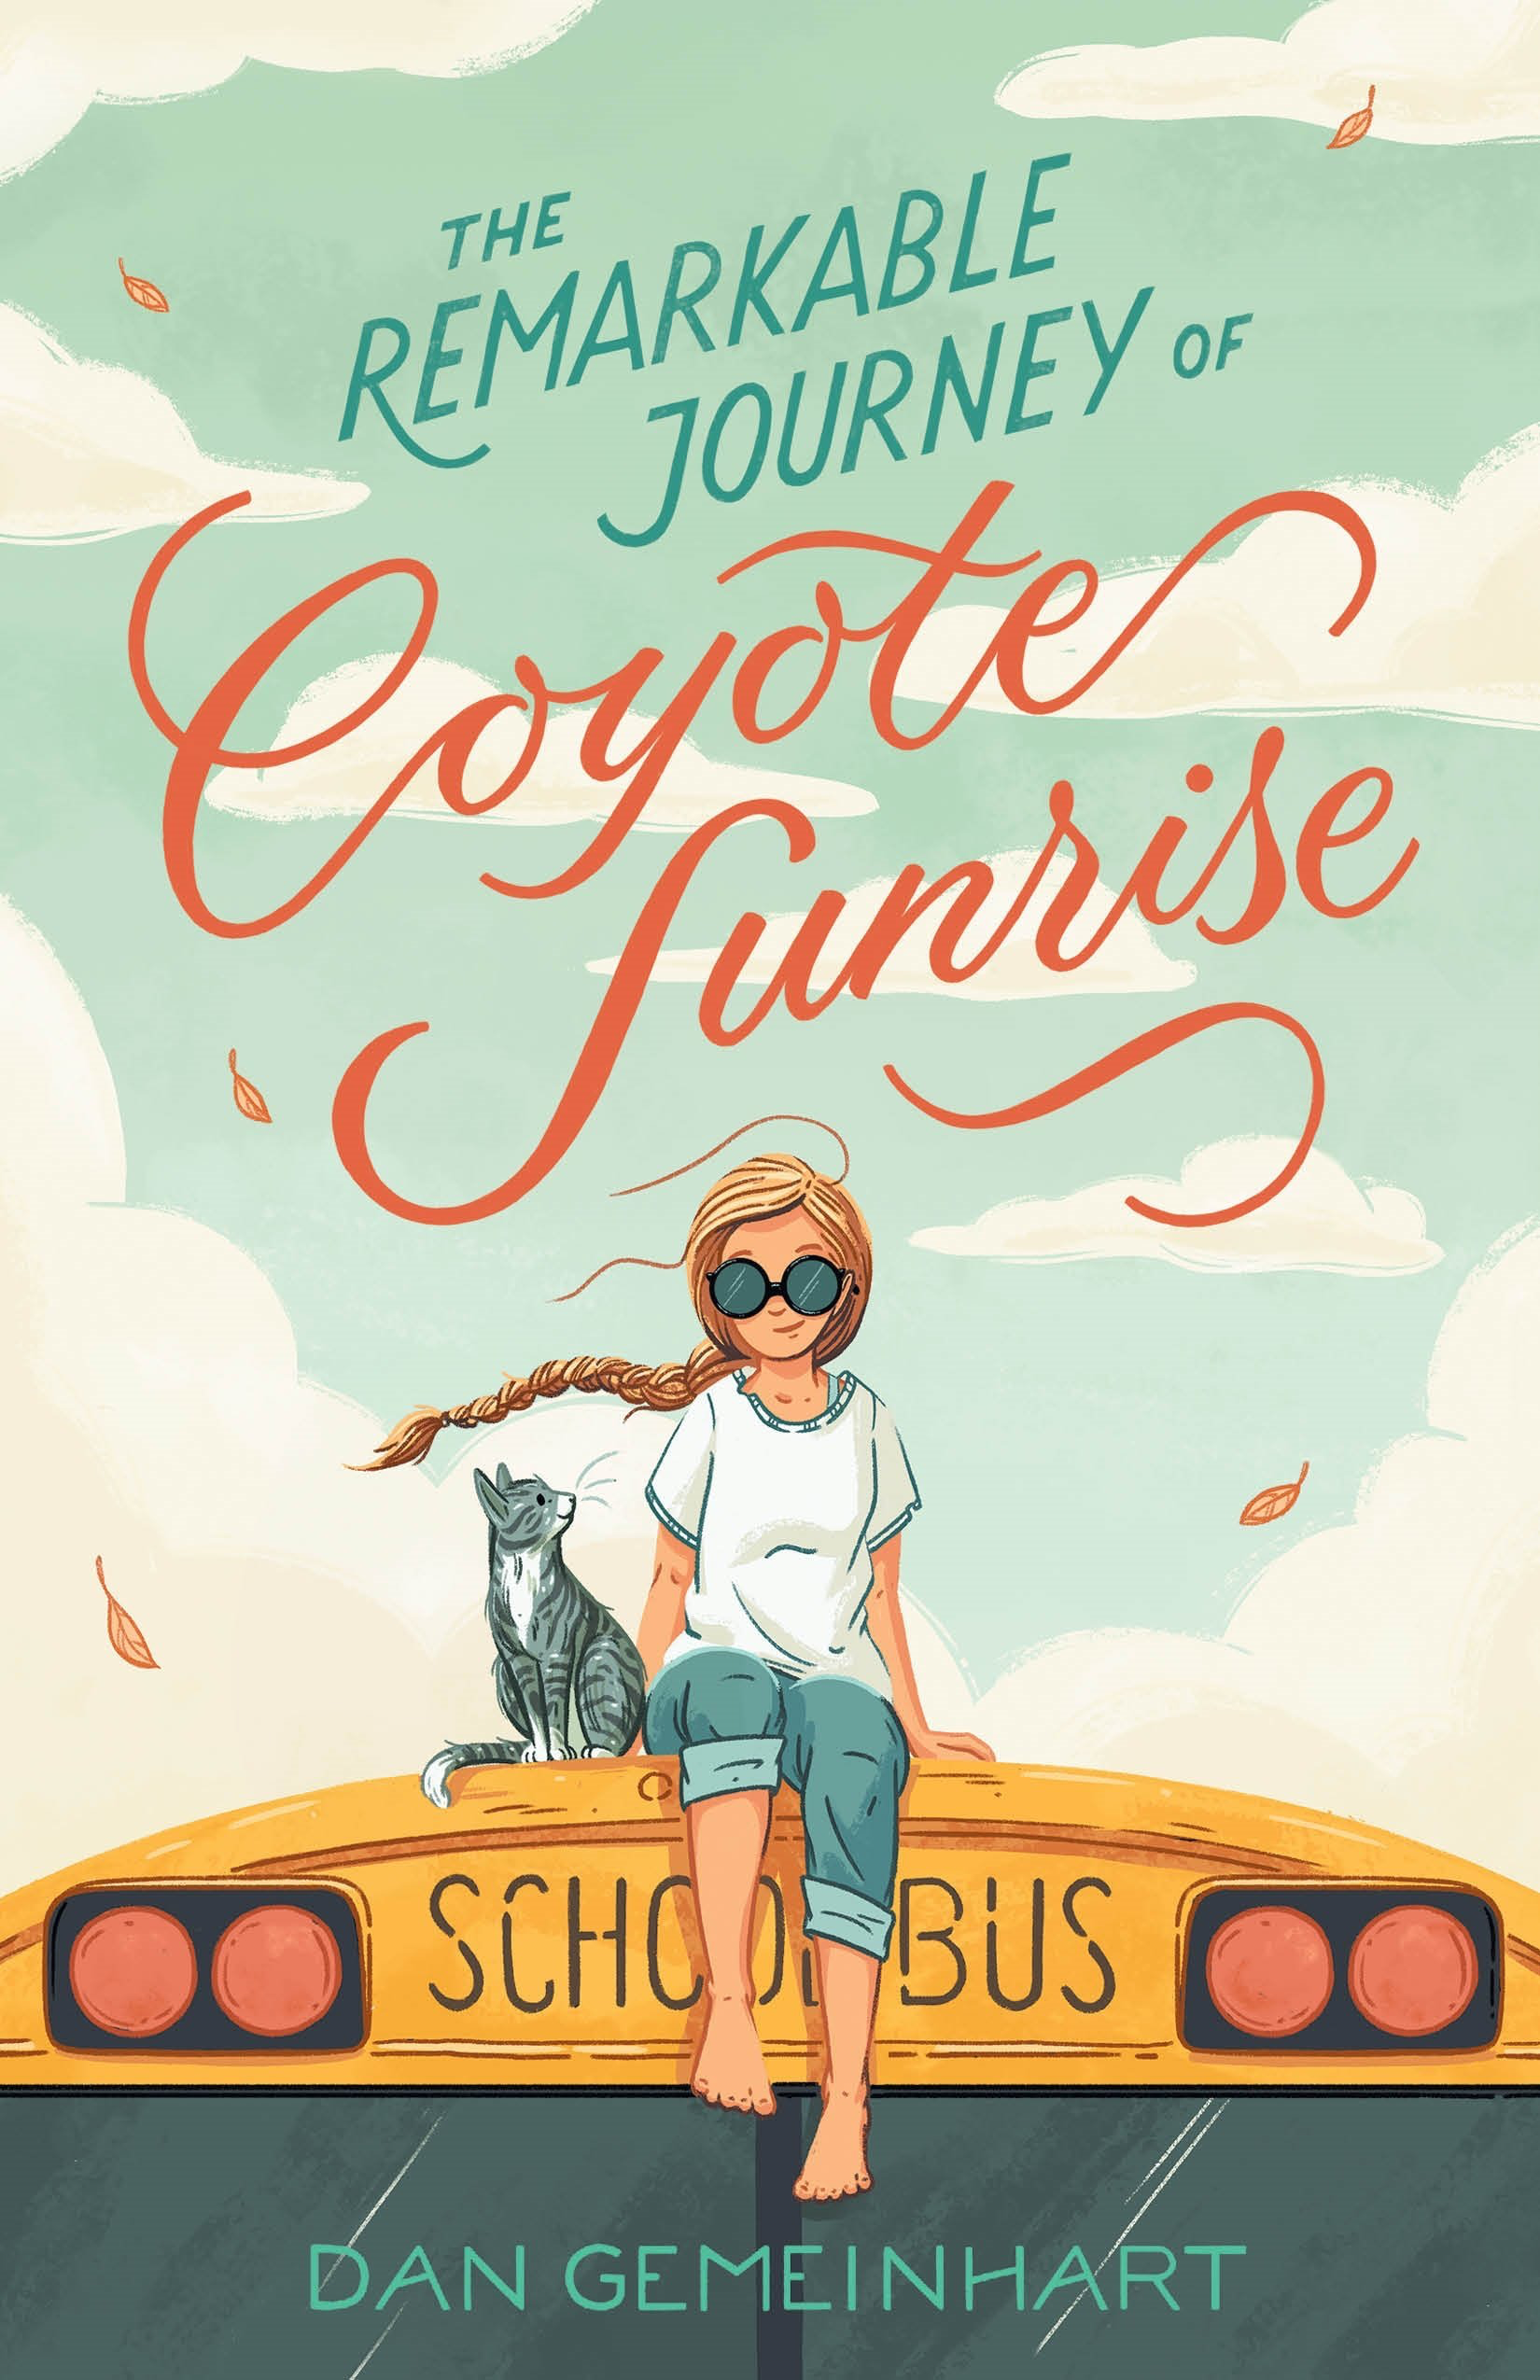
Macmillan with links to trailers and guides
Notes:
Coyote Sunrise, RL 4.7, 730L, Twelve-year-old Coyote and her father rush to Poplin Springs, Washington, in their old school bus to save a memory box buried in a park that will soon be demolished.

Slide 18
2023 Nomination Guidelines
Copyright 2018 – 2022
One title per author, not last year’s winners
Book prior to any other format (production)
# of schools before # of nominations
Each school can submit up to 20 titles when they vote before March 1, 2022
Children may vote for 1 PB and 1 JB if they have read or heard at least 3 in the category

Slide 19
vote at CCIRA.org→Professional Learning-->Colorado Children's Book Award
Nominated books must be currently in print and published in the five years preceding the award year.
Only one title per author will be included in each year's ballot.
Last year's WINNING authors are not eligible this year.
Books previously nominated are not eligible for nomination in following years.
A book title nominated by more that one school or library will be considered more heavily for inclusion in the final list.
Books based on movies, television shows, toys, video games, or apps are not eligible for nominations unless the book preceded the movie or production.
The author of a nominated book must be a living author.
Caldecott and Newbery Award books are not eligible. Honor books are eligible.
Once a book in a series has won, all other books in that series by that author will not be eligible for nomination.
Children may vote for one picture book and one junior book provided they have read a minimum of three books in each category.
Submit the top 20 BOOK TITLES NOMINATED by children the CCBA Committee by March 1, 2022.
PLEASE be sure to put the number of students who nominated each book.

Slide 20
Download this slide show and other resources for CCBA at
www.mhaloin.com
Have a great
Schoolyear!

