Slide 1
Colorado Children’s Book Award
2023 winners and 2024 nominees
Download this slide show and other resources for CCBA at
www.mhaloin.com
Enjoy Reading!

Slide 2
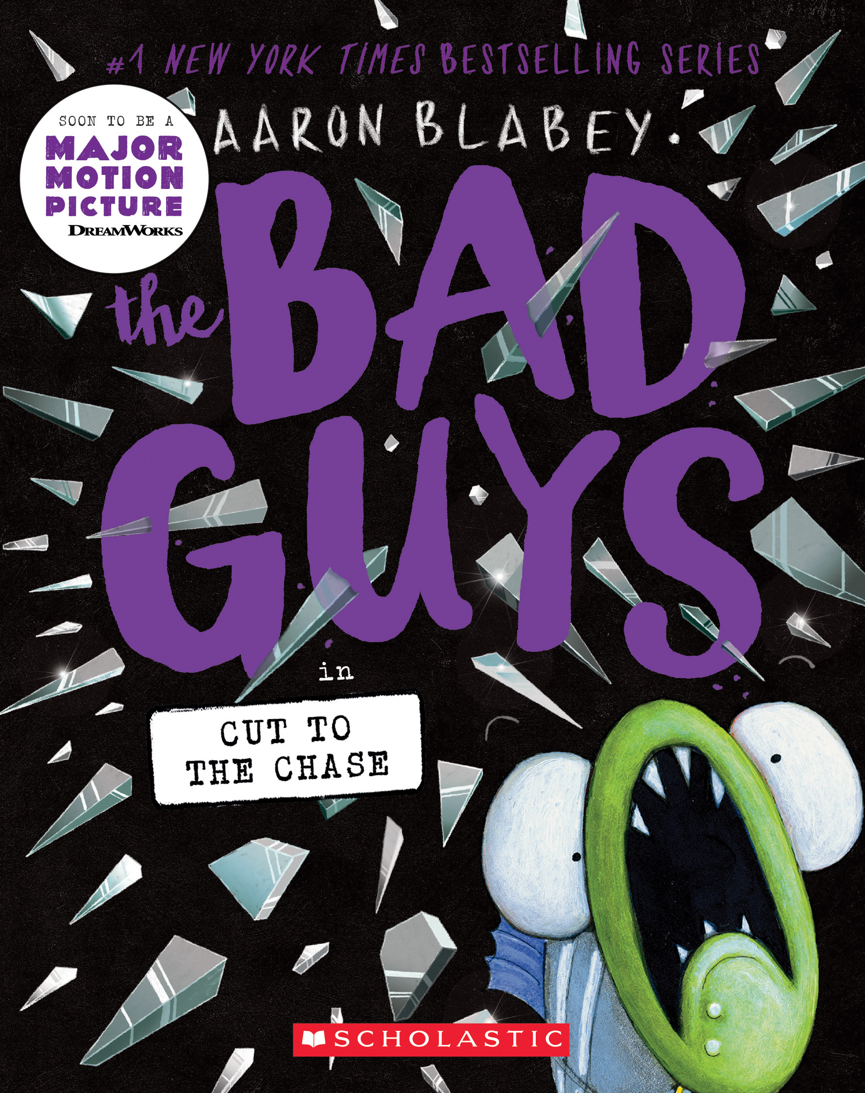


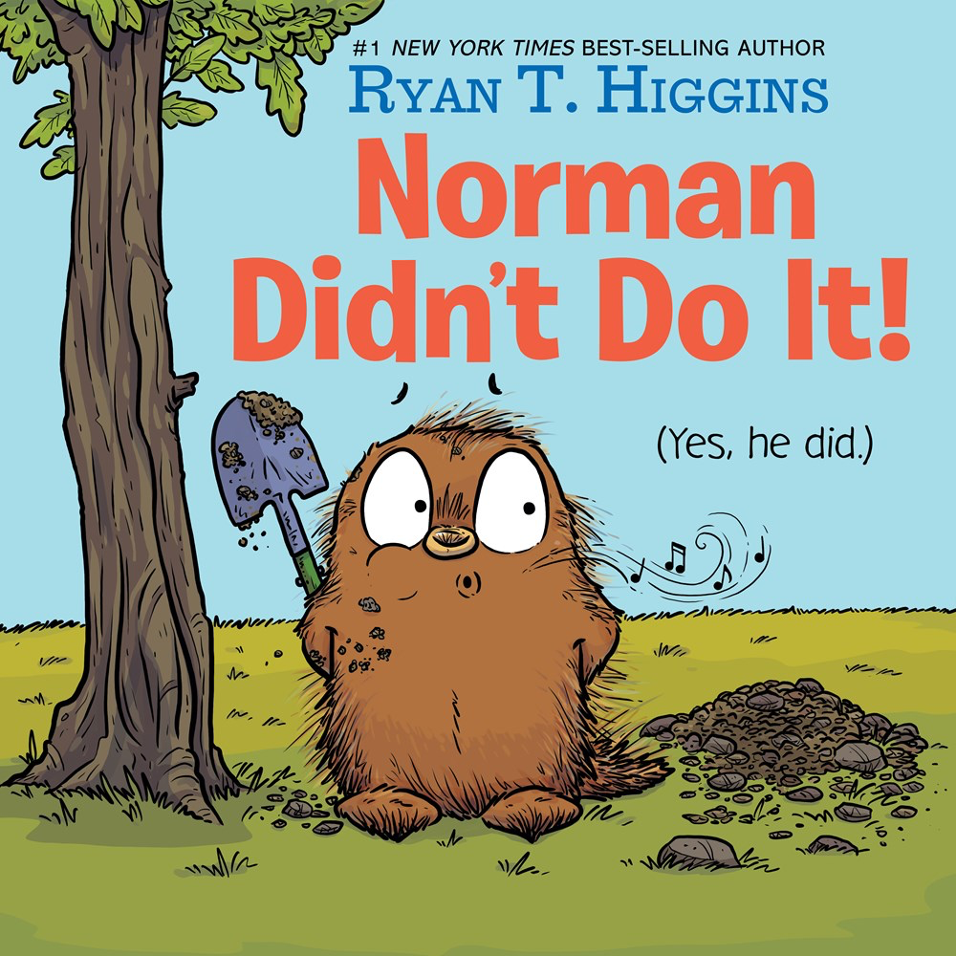
Colorado Children’s Book Awards
2023 Junior Book
Winner
Runner up
2023
Picture
Book
Winner
Runner up
Notes:
The Couch Potato – 550L, RL 2.8,
The Couch Potato has everything he needs within reach of his sunken couch cushion. But when the electricity goes out, Couch Potato is forced to peel himself away from the comforts of his living room and venture outside. When he does, he realizes fresh air and sunshine could be just the things he needs
Norman Didn’t Do It! – RL 1.9, Norman, a porcupine whose best friend is a tree named Mildred, begins to feel jealous when another tree grows close to Mildred and acts out against the new tree.
Bad Guys # Cut to the Chase – 2.4RL, Graphic Novel, Movie not yet out when nominated
https://www.pdfread.net/ebook/the-bad-guys-in-cut-to-the-chase-aaron-blabey/
Full pdf 198 pages
Escape from Chernobyl – RL5.6, MG+ Two young siblings flee the Chernobyl disaster with their parents, but the Communist party is on their heels. Meanwhile, the friends and family they were forced to leave behind must contend with a disinformation campaign that's determined to pretend nothing is wrong-even as deadly radiation spills into the air.

Slide 3
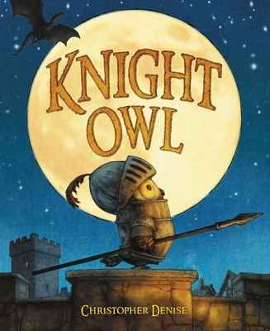
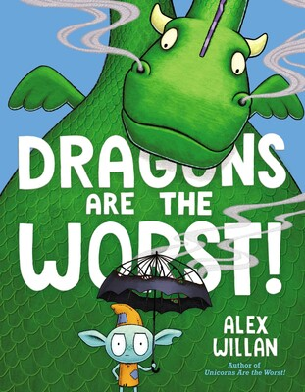
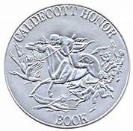
Fantasy Characters
Teaching Guide at Simon & Schuster
6 min Barnes and Noble Read Aloud by Christopher Denise
13 min visit with Alex Willan on Facebook at Schuler Books
Notes:
Sequel to last years nominee Unicorns Are the Worst! Rl 2.8, 480L
Dragons are the Worst! RL 3.3 660L
Disgruntled Gilbert the goblin argues that dragons are terrible and not nearly as frightening as he is, but perspectives change when knights arrive to capture a dragon.
Knight Owl – RL 2.6, March 15, 2022. Full of optimism the Owl makes a knight . Pair with Tomie DePaola’s 1980 The Night and the Dragon.
"Since the day he hatched, Owl dreamed of becoming a real knight. He may not be the biggest or the strongest, but his sharp nocturnal instincts can help protect the castle, especially since many knights have recently gone missing. While holding guard during Knight Night Watch, Owl is faced with the ultimate trial—a frightening intruder. It’s a daunting duel by any measure. But what Owl lacks in size, he makes up for in good ideas. Full of wordplay..

Slide 4
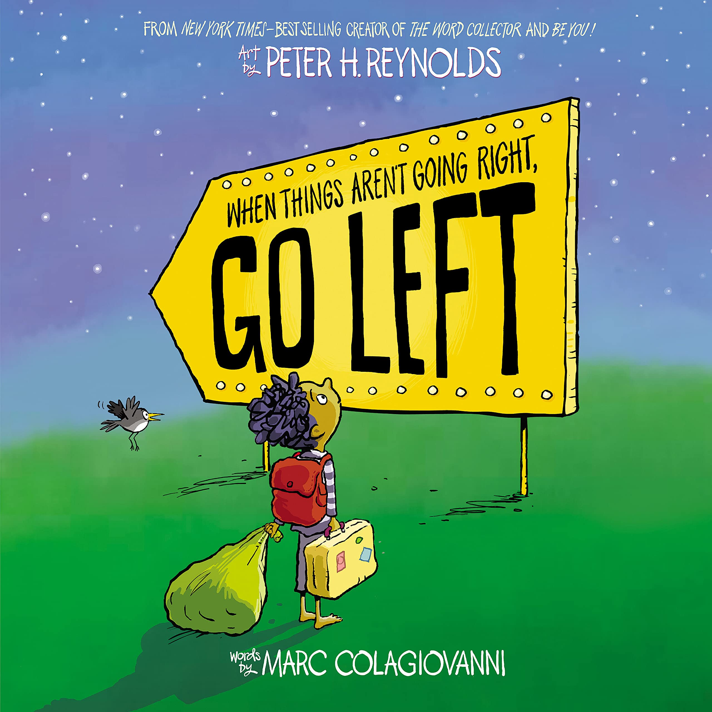
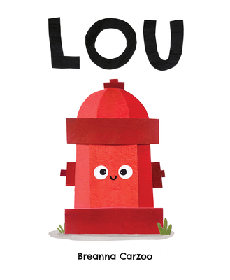
Important messages
2 min. Lou Storytime read aloud with puppets and sound effects
1 min. intro with Peter H. Reynold
1 min. cut paper "Lou" with Breanna Carzoo
Peter H.Reynolds Themes Poster word docx
Notes:
When Things Aren’t Going Right, Go Left, 500L
This picture book reminds readers of their own agency and the power they have to direct their own path – One book for all ages of the importance of and value of worries, doubts, fears, and frustrations but only by making sure they aren’t too big.
Lou
"Meet Lou. Lou has an important job . . . as the neighborhood toilet for dogs on their walks. Useful as he may be, he gets the feeling that deep down inside, there might be more to him than that. He just doesn't seem to know exactly what yet. When disaster strikes, will Lou find out what he's made of and save the day?

Slide 5
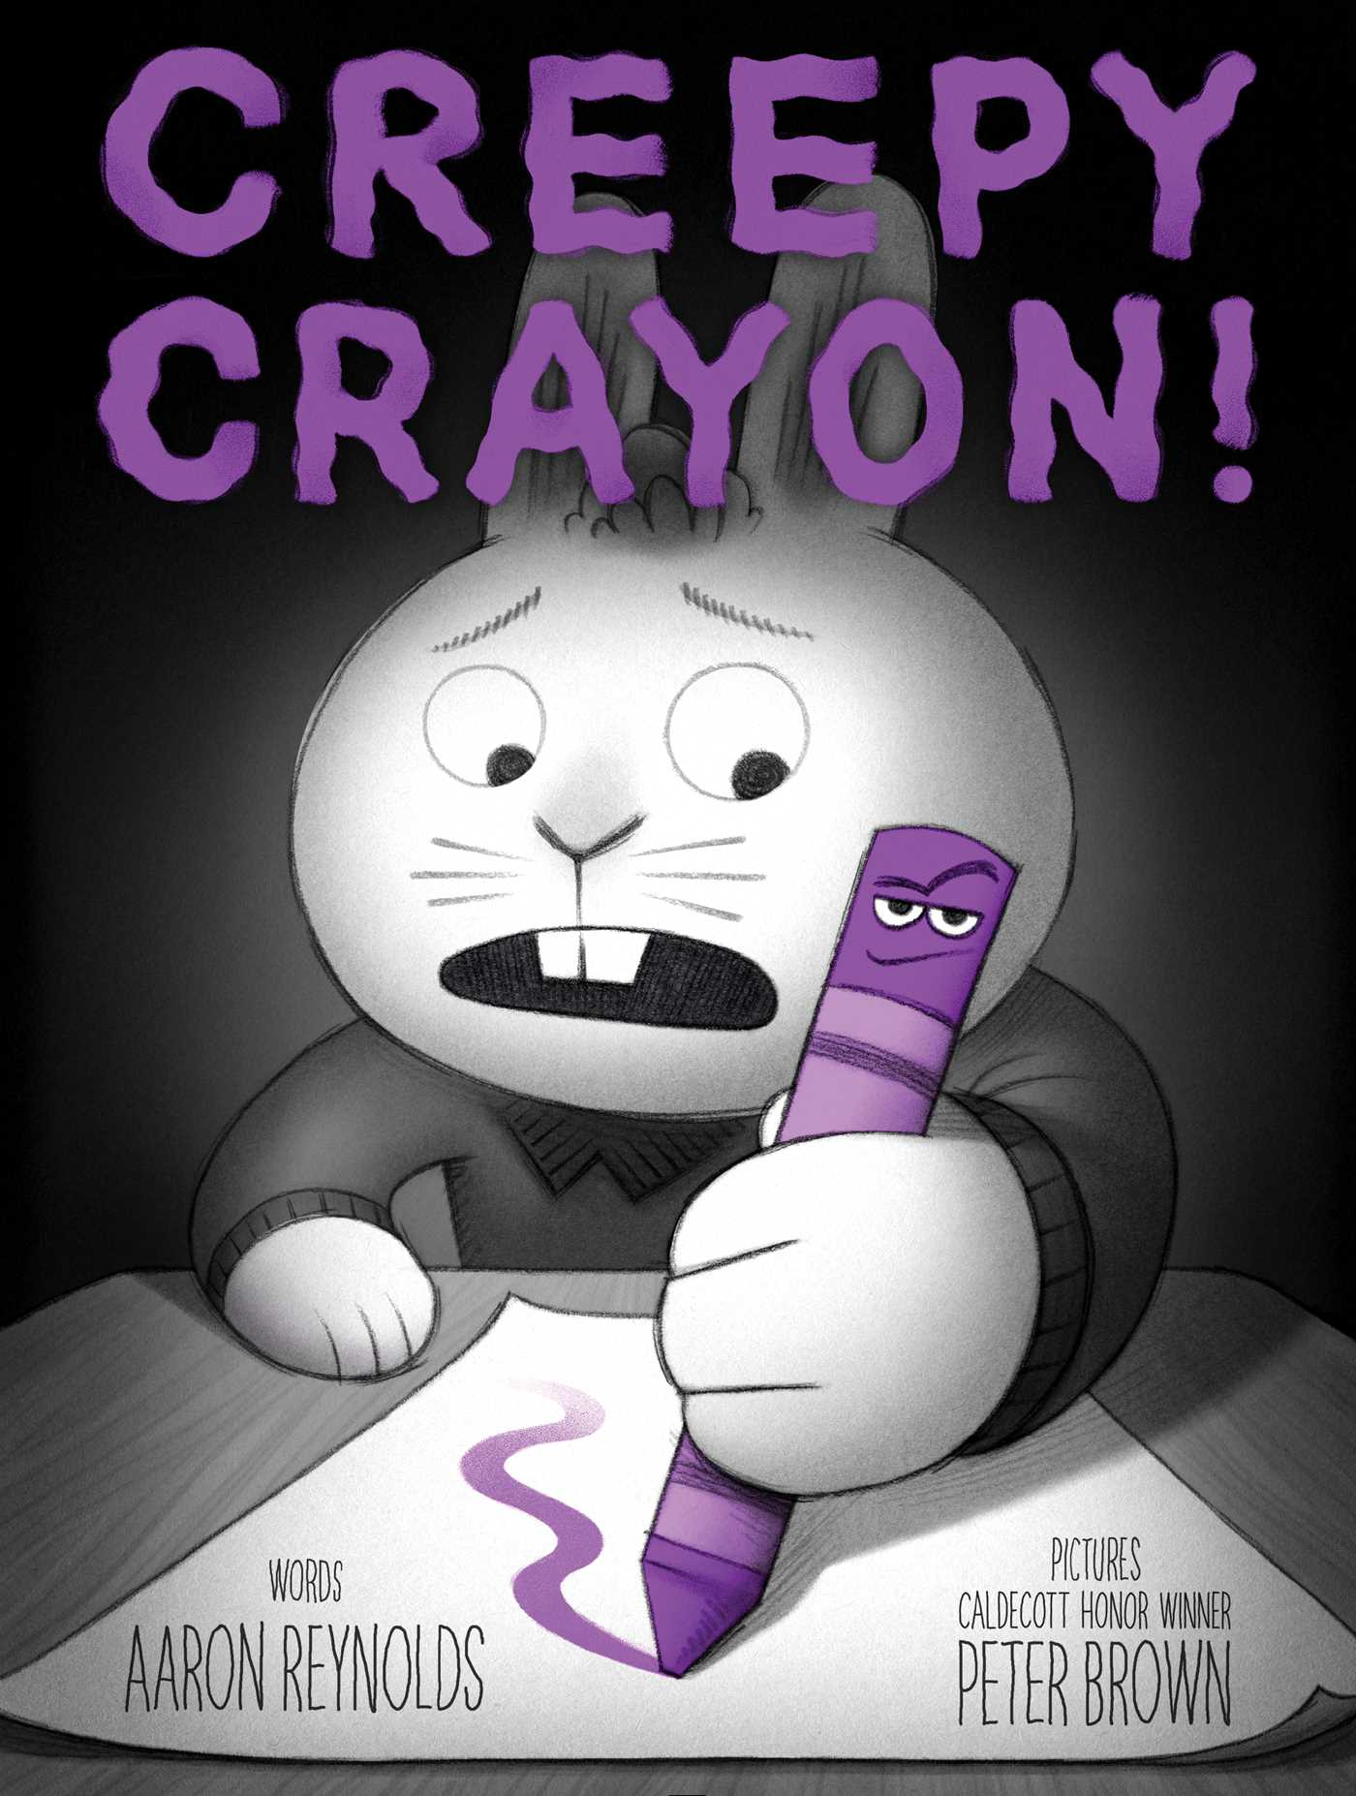
Scary Series
1 min. trailer at Simon Kids
11 min. read aloud by Aaron Reynolds at Simon. Kids
Notes:
Creepy Crayon! – RL 2.7, 500L
Jasper Rabbit has a problem: he is NOT doing well in school. His spelling tests? Disasters. His math quizzes? Frightening to behold. But one day, he finds a crayon lying in the gutter. Purple. Pointy. Perfect. Somehow . . . it looked happy to see him. And it wants to help. At first, Jasper is excited. Everything is going great. His spelling is fantastic. His math is stupendous. And best of all, he doesn’t have to do ANY work! But then the crayon starts acting weird. It’s everywhere, and it wants to do everything. And Jasper must find a way to get rid of it before it takes over his life. The only problem? The creepy crayon will not leave.

Slide 6
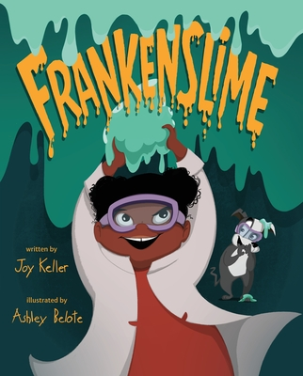
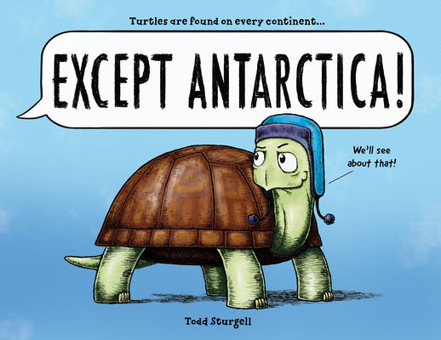
STEM
9 minute read-aloud at Read Aloud Children's Books and Fun Stuff
4 min. Read Aloud on YouTube
Notes:
Except Antarctica! RL4.0, 540L
"Turtles are found on every continent EXCEPT Antarctica. But not for long! When a David Attenborough-esque narrator explains that turtles are found everywhere except Antarctica, one determined turtle sets out to prove him wrong. After recruiting other non-Antarctic animals along the way-much to the narrator's dismay-the turtle and his adventurous friends travel through fields, forests, and cross an entire ocean to reach their goal. But what exactly
Frankenslime – RL 4 690L
Victoria and her assistant, her dog Igor, set out to make amazing slime, but one night their creation unexpectedly comes to life.

Slide 7
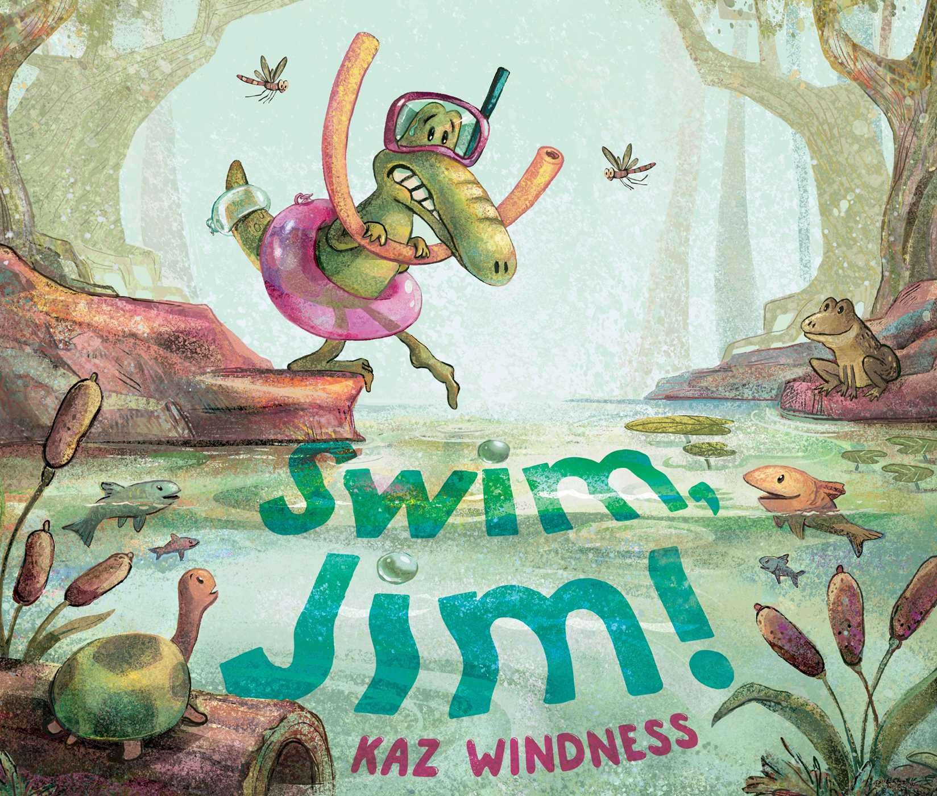
Colorado Author
Swim, Jim! Activity sheets
8 min. read aloud on YouTube
Kaz Windness shares 2 minutes of Swim Jim
Notes:
Swim, Jim! By Kaz Windness 420L,
Don’t miss the Case cover. Lovely! Great end of school year for kids off to hopefully learn to swim in the summer or beginning of school year to encourage trying something they fear or are apprehensive to try.

Slide 8
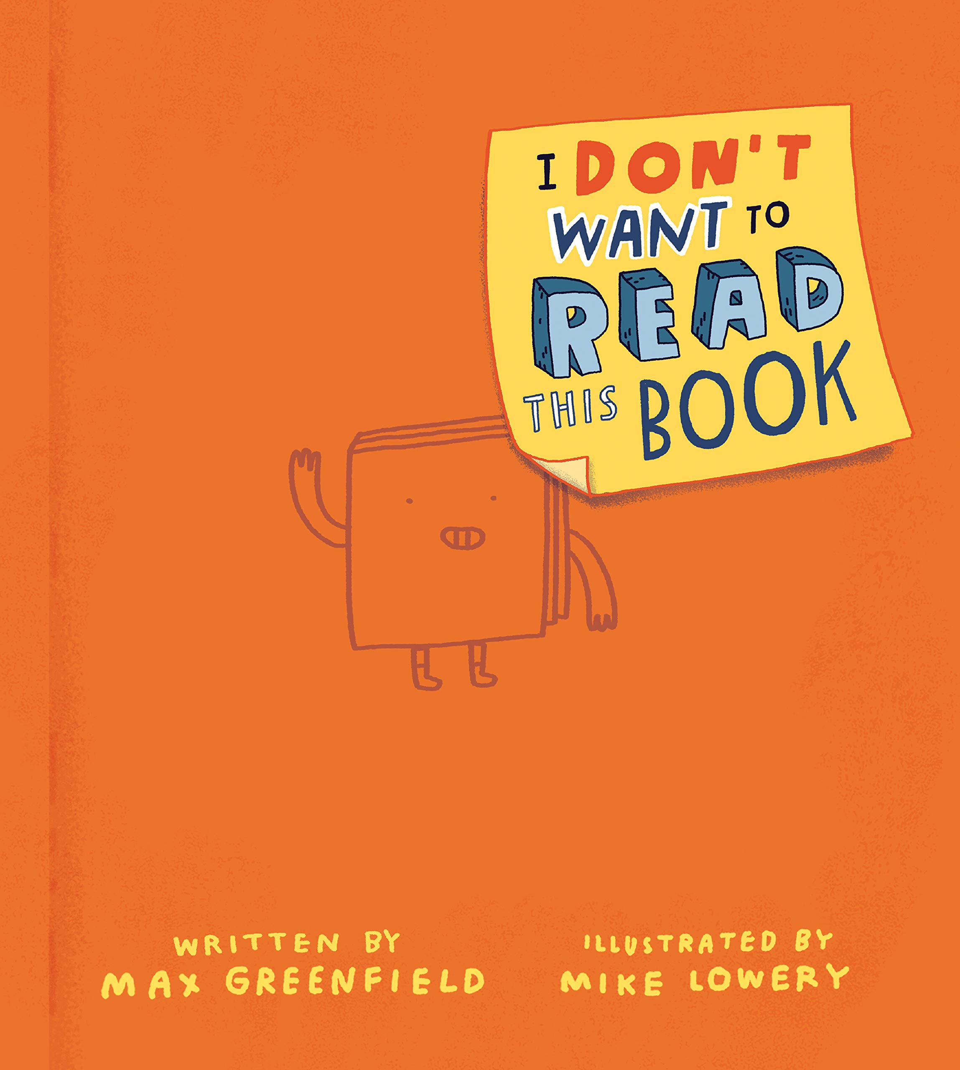
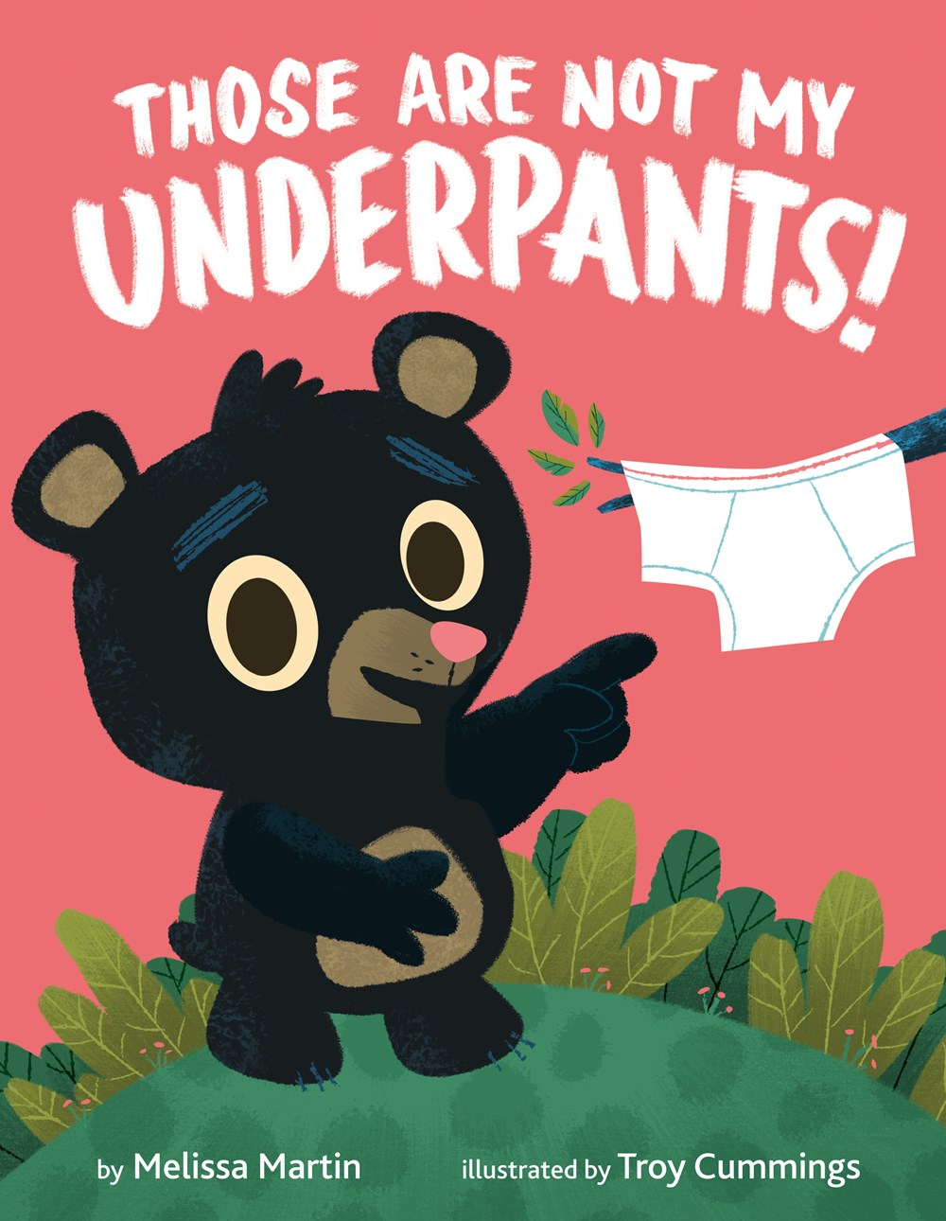
Humor
5 min. Barnes & Noble Read Aloud by Max Greenfield
5 min. read aloud with Coucilman Goode Plainfield PL
Notes:
I Don’t Want to Read this Book- GL 3.2, 700L
Words, sentences, and even worse, paragraphs fill up books. Ugh! So what's a reluctant reader to do? Actor Max Greenfield and illustrator Mike Lowery bring the energy and laugh-out-loud fun out for every child (and parent) who thinks they don’t want to read a book. This clever and playful read-aloud breaks the fourth wall and will have all readers coming back for laughs again and again!
Those are Not My Underpants!
Bear Cub spies a pair of underpants hanging from a tree branch and sets out to find their owner, but they belong to none of his forest friends.

Slide 9
2025 Nomination Guidelines
Copyright 2020 – 2023
One title per author, not last year’s winners
Book prior to any other format (production)
# of schools before # of nominations
Each school can submit up to 20 titles when they vote before March 1, 2024
Children may vote for 1 PB and 1 JB if they have read or heard at least 3 in the category

Slide 10
2023 Junior Book winner and runner up
20 min. read aloud by Reading Allowed Teacher
1 min. book trailer at Scholastic
Link to a pdfread of book is in notes full 198 pages
Andy Marino's website
Notes:
Escape from Chernobyl – RL5.6, MG+ Two young siblings flee the Chernobyl disaster with their parents, but the Communist party is on their heels. Meanwhile, the friends and family they were forced to leave behind must contend with a disinformation campaign that's determined to pretend nothing is wrong-even as deadly radiation spills into the air.
Bad Guys # Cut to the Chase – 2.4RL, Graphic Novel, Movie not yet out when nominated
https://www.pdfread.net/ebook/the-bad-guys-in-cut-to-the-chase-aaron-blabey/
Full pdf 198 pages

Slide 11

Novel in Verse
Peek inside at Penguin/Random House with Teacher's Guide
Notes:
Starfish – RL 4.1, 630L
Novel in Verse. Bullied and shamed her whole life for being fat, twelve-year-old Ellie finally gains the confidence to stand up for herself, with the help of some wonderful new allies.

Slide 12
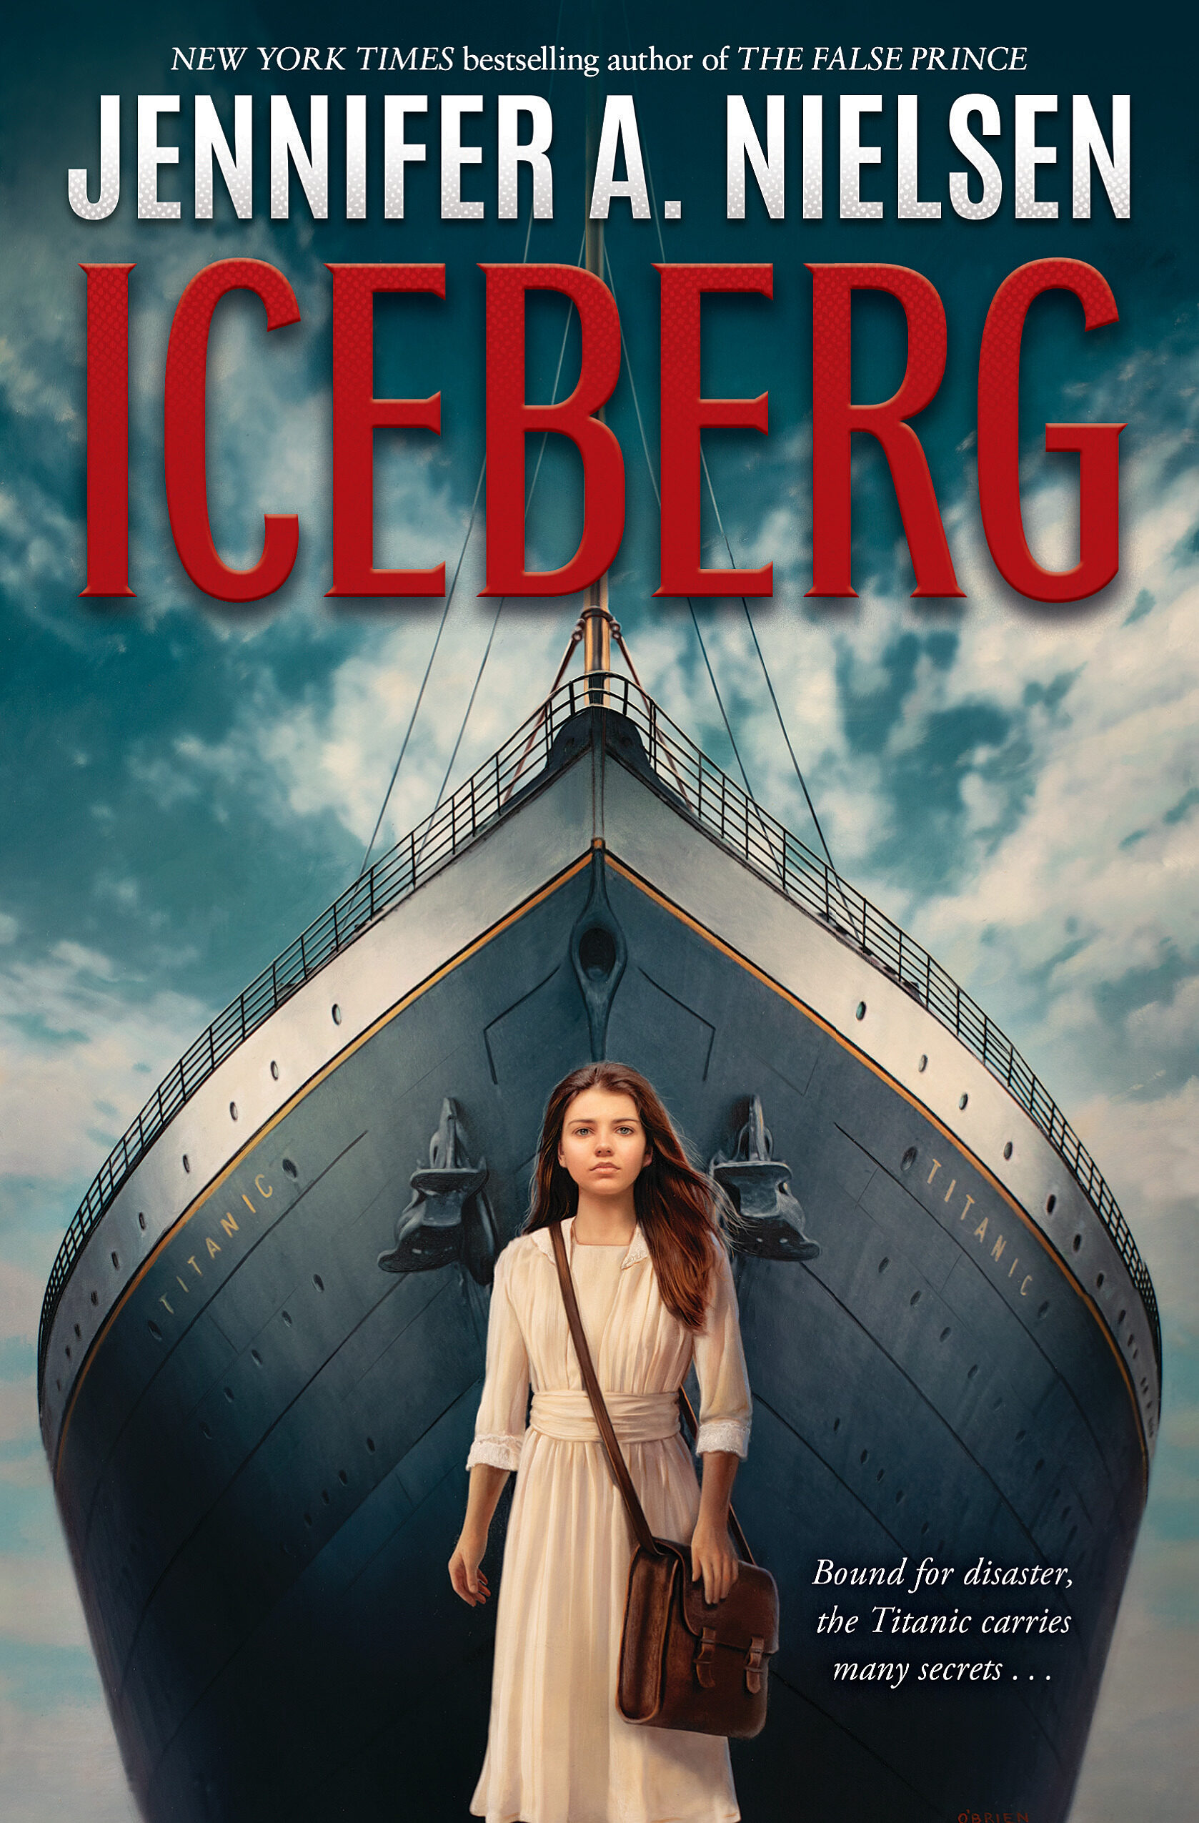
Historical Fiction
1 min. trailer at Scholastic Bookfairs
Notes:
Iceberg March 7, 2023, 730L,
Twelve-year-old Hazel Rothbury stows away aboard the Titanic and, with the help of a porter named Charlie and a first-class passenger named Sylvia, she sets out to explore the great ship, uncovering a haunting mystery--until the ship hits an iceberg and she must fight to save herself and her friends Pair with I Survived the Sinking 39L

Slide 13
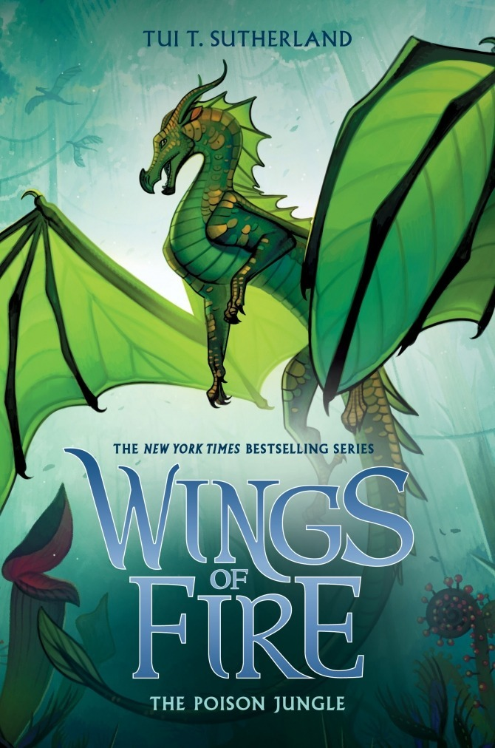
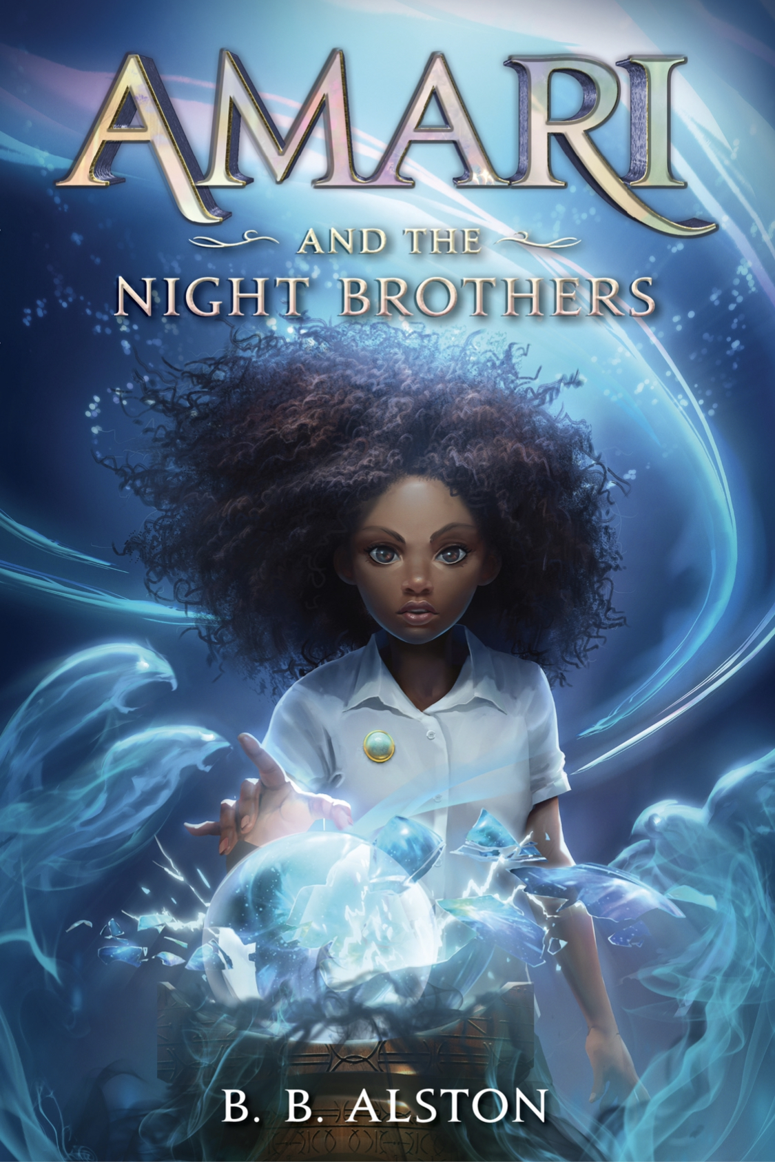
Fantasy
1 min. book Trailer and teacher's guide at HarperCollins
Series Website by Scholastic
Tui T. Sutherland Website
Notes:
Amari and the Night Brothers – RL 4.9, 700L
"Amari, a Black girl with limited means, confronts privilege and prejudice even while delving into a world of wonder, humor, and adventure”. 1st in Supernatural Investigators Series
Wings of Fire: The Poisen Jungle -RL 5.4, 750L Original Series Volume 13 - Sundew and most of the other LeafWings are nursing a deep hatred for the HiveWings, who have ripped every tree from the surface of Pantala. Every tree except those in Poison Jungle where the surviving LeafWings have been hiding, waiting for a dragon clever and powerful enough to exact their revenge--and now they are searching for the jungle's oldest and darkest mystery, one that could destroy them all.

Slide 14
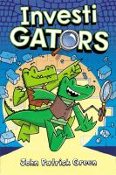
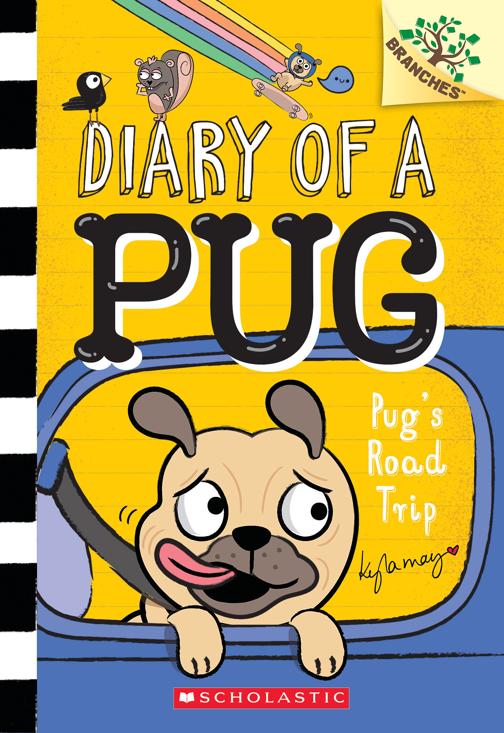
Series
Series Website by Macmillan Group
Series Website at Scholastic
Notes:
InvestiGATORS – RL 3.3 390L Graphic Novel
Mango and Brash are 2 investigator alligators.
With their Very Exciting Spy Technology and their tried-and-true, toilet-based travel techniques, the InvestiGators are undercover and on the case! And on their first mission together, they have not one but two mysteries to solve! Can Mango and Brash uncover the clues, crack their cases, and corral the crooks--or will the criminals wriggle out of their grasp?
Diary of a Pug – Pug’s Road Trip RL2.8. 500L
When their friend Jack cannot join them, Bub the pug and his human, Bella, vow to bring him souvenirs from their road trip, and despite some bumps along the way, Bub calls their trip a big success. Australian Illustrator and animator.

Slide 15
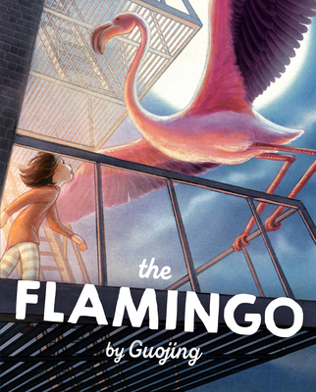
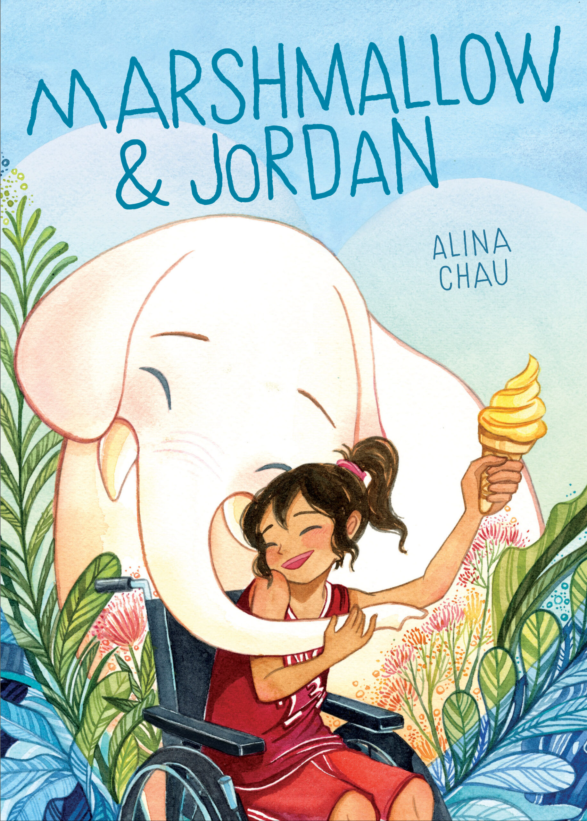
Graphic Beginning Reader
Book intro at Macmillan
Peek inside at penguin random house
One minute trailer
1 min book buzz at BaltimorePL
Notes:
The Flamingo by Guojing 430L
A little girl arrives, excited for a beachy vacation with her Lao Lao. The girl and her grandmother search for shells, chase crabs, and play in the sea, but when the girl finds an exquisite flamingo feather in her grandmother's living room, her vacation turns into something fantastical.
Marshmallow & Jordan 340L, RL2.9
Jordan's days as star player for her school's basketball team ended when an accident left her paralyzed from the waist down. Now, she's still the team captain, but her competition days seem to be behind her...until an encounter with a mysterious elephant, who she names Marshmallow, helps Jordan discover a brand new sport. Will water polo be the way for Jordan to continue her athletic dreams—or will it just come between Jordan and her best friends

Slide 16
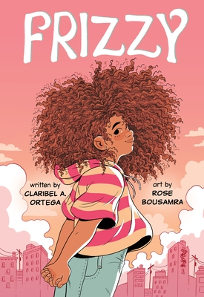
Graphic Novel
Clarabel Ortega booktalks Whitchlings & Frizzy
Notes:
Frizzy – RL3. Graphic
"Frizzy is an intimate mother-daughter drama that sensitively explores the concept of so-called “good hair”. Marlene, a young Dominican girl whose greatest enemy is the hair salon! Through her struggles and triumphs, this heartwarming and gorgeous middle-grade graphic novel shows the radical power of accepting yourself as you are,

Slide 17
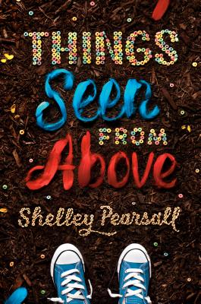
School Stories
2 minute trailer by BPLibraryKids
Shelley Pearsell Website
Notes:
Things Seen From Above – RL 5.2 750L
"April is looking for an escape from the sixth-grade lunch hour, which has become a social-scene nightmare, so she signs up to be a "buddy bench monitor" for the fourth graders' recess. Joey Byrd is a boy on the fringes, who wanders the playground alone, dragging his foot through the dirt. But over time, April realizes that Joey isn't just making random circles. When you look at his designs from above, a story emerges... Joey's "bird's eye" drawings reveal what he observes and thinks about every day. Told in alternating viewpoints--April's in text and Joey's mostly in art--the story gives the "whole picture" of what happens as these two outsiders find their rightful places

Slide 18
2025 Nomination Guidelines
Copyright 2020 – 2024
One title per author, not last year’s winners
Book prior to any other format (production)
# of schools before # of nominations
Each school can submit up to 20 titles when they vote before March 1, 2024
Children may vote for 1 PB and 1 JB if they have read or heard at least 3 in the category

Slide 19
vote at CCIRA.org→Professional Learning-->Colorado Children's Book Award
Nominated books must be currently in print and published in the five years preceding the award year.
Only one title per author will be included in each year's ballot.
Last year's WINNING authors are not eligible this year.
Books previously nominated are not eligible for nomination in following years.
A book title nominated by more that one school or library will be considered more heavily for inclusion in the final list.
Books based on movies, television shows, toys, video games, or apps are not eligible for nominations unless the book preceded the movie or production.
Caldecott and Newbery Award books are not eligible. Honor books are eligible.
Once a book in a series has won, all other books in that series by that author will not be eligible for nomination.
Children may vote for one picture book and one junior book provided they have read a minimum of three books in each category.
Submit the top 20 BOOK TITLES NOMINATED by children the CCBA Committee by March 1, 2024.
PLEASE be sure to put the number of students who nominated each book.

Slide 20
Download this slide show and other resources for CCBA at
www.mhaloin.com
Have a great
Schoolyear!

