Slide 1
Likes and Loves from the Literary Lists – 2015 Edition Part 1
Marcie Haloin
http://www.mhaloin.com/
Goodreads
marciehaloin@gmail.com

Slide 2
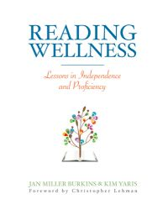
Professional Books

Slide 3
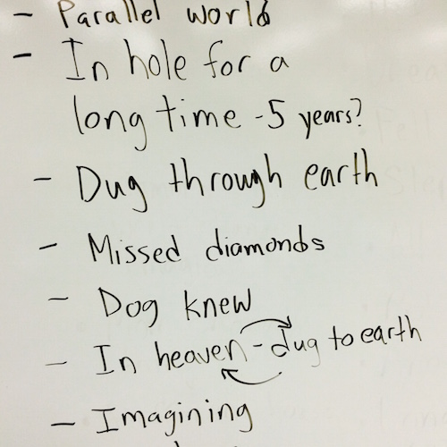

Slide 6
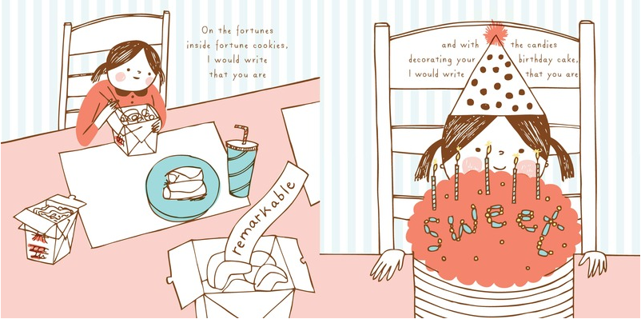
Picture Book Read Alouds
CLEL Bell Awards 2015 Shortlists
http://www.clel.org/#!previous-nominations/c1l46

Slide 8
