Slide 1
2020 ALA (American Library Association)
YM (Youth Media) Award

Slide 2
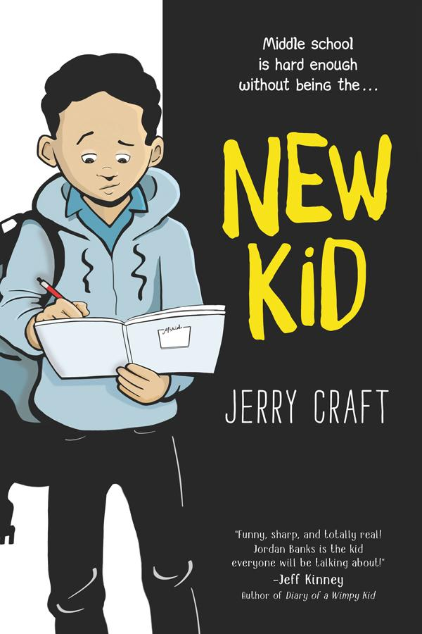
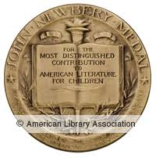
Newbery Medal
New Kid at The Classroom Bookshelf
5 min. blindfolded drawing challenge
1 min trailer New Kid
5 min. for adults with Jerry Craft
2020 Coretta Scott King Author Medal
2020 Newbery Medal
Notes:
New Kid -IL 5-8; RL: 3.6
Seventh grader Jordan Banks stars in an honest graphic novel about starting over at a new school where diversity is low and the struggle to fit in is real.
Not just for kids as a teacher this made me reflect in good ways. Calling students by their names. Set in New York. Humor -
.

Slide 3
2020 Newbery Honor Books
2 min. author interview at teaching books.net

Slide 4
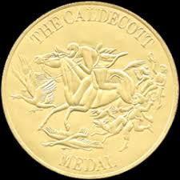
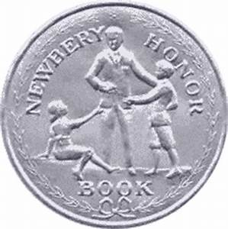
Poetry
2020 Caldecott Medal, 2020 Newbery Honor, 2020 Coretta Scott King Book Award
How to pronounce Kwame Alexander at TeachingBooks.net
Audio clip download from hmhbooks
Using code in book
Notes:
The Undefeated – Black History all year round IL: K-3; RL: 2.5
Originally performed for ESPN's The Undefeated, this poem is a love letter to black life in the United States

Slide 5
2020 Caldecott Honor Books
8 minutes bookchat with the illustrator at Little Brown Books for Adults
2020 Newbery Medal
Notes:
As Bear Meets the woodland creatures they join him taking an adventure down the river together.
I loved Sheep 101 a couple of years ago. Author's note "This story says, "Take a chance! "Hop on Board", "Work Together" Trust Each Other" "Share the adventure"Endpapers are map of the story. Story of unity not tribalism. Building Community.

Slide 6
2020 Coretta Scott King Author Honor Books

Slide 7
CSK/John Steptoe New Talent Award

Slide 8
Pura Belpre Award – Portray Affirm and Celebrate Latino Experience
5 min with Rick Riordan and Carlos Hernandez

Slide 9
Pura Belpre Illustrator Award

Slide 10
Pura Belpre Illustrator Honor Books
Lesson plans from the classroom bookshelf blog
Notes:
IL: K-3; RL: 2.8
When Daisy Ramona zooms around her neighborhood with her papi on his motorcycle, she sees the people and places she's always known. She also sees a community that is rapidly changing around her.
Vamos
IL: K-3; RL: 2.1
Follow Little Lobo and his dog Bernabe as they deliver supplies to a variety of vendors, selling everything from sweets to sombreros, portraits to pinatas, carved masks to comic books!English and Spanish words interspersed!

Slide 11
Pura Bel pre Author Honor Books

Slide 12
Seibert Medal Informational
publishersweekly print interview with author and illustrator
Macmillan peek inside
meet the author 5 min. recording at teaching books.net
Notes:
K-3 amazing endpapers list Indiginous tribes - Refer to Indian No More

Slide 13
Siebert Honor Books for Informational Books
Notes:
Other Words for Home RL 5.3 930L
Jude must leave Syria to eventually make her home in Cincinatti
The Promise of Change: One Girl’s Story of the Fight for School Equity

Slide 14
Schneider Family Picture Book Award – Disability Experience
Interview with Justice Sotomayor on Today Show
Notes:
IL: K-3; RL: 2.9 In Just Ask, United States Supreme Court Justice Sonia Sotomayor celebrates the different abilities kids (and people of all ages) have. Using her own experience as a child who was diagnosed with diabetes, Justice Sotomayor writes about children with all sorts of challenges--and looks at the special powers those kids have as well. As the kids work together to build a community garden, asking questions of each other along the way, this book encourages readers to do the same: When we come across someone who is different from us but we're not sure why, all we have to do is Just Ask
IL: 3-6; RL: 4.1 free-verse narrative perfectly captures the tension leading up to the writing the speech as each adviser urged his own ideas while remaining a supportive community.

Slide 15
Stonewall Book Award
Honor Book (other honor books were YA)

Slide 16
Schneider Family Book Award
Honor Book
Each Tiny Spark Teacher's Guide at Random House
Notes:
.
Each Tiny Spark 680L,
Own Voices Story where author has a child with some of the traits of the main character. Covers a lot of how students can do research and follow their own interests. Also follows a theme of parents in the military. Sixth-grader Emilia Torres struggles with ADHD, her controlling abuela, her mother's work commitments, her father's distance after returning from deployment, evolving friendships, and a conflict over school redistricting.
Shouting at the Rain
This one also hones in on how we can change our perspective to understand that things aren't usually as bad as we think they are. Several memorable moments: - For teachers who need examples of Beers/Probst signposts, there is a perfect Words of the Wiser scene on pp. 199-201. - The precious moment between Delsie and Grammy at the end of chapter 40 - reminds me of the scene in Inside Out (might be my favorite Pixar movie) among Sadness, Bing Bong, and Joy about Riley. - The anagrams! - Mullaly's beautiful Dear Reader letter and Acknowledgements
Song for a Whale IL: 3-6; RL: 5.6
From fixing the class computer to repairing old radios, twelve-year-old Iris is a tech genius. But she's the only deaf person in her school, so people often treat her like she's not very smart. Deaf Culture. Author is a sign language interpreter.

Slide 17
Geisel Medal

Slide 18
Geisel Honor Books – Beginning Reader
30 min. Cece Bell at 2019 National Book Festival
Notes:
Chick & Brain – replacements for Dick & Jane – Silly, funny, two friends with both visual and verbal humor.
Monkey & Cake Series – 330L - Schrödinger's cat meets 'Piggy & Elephant’
Fox & Chick Quiet Boat Ride 400L– 3 chapters with humorous stories understanding personalities and friendships.

Slide 19
Asian Pacific Award/Picture Books
Honor Book

Slide 20
Asian Pacific Children’s Literture
Peek Inside at Macmillan
Honor Book
Notes:
Guts
Stargazing –
Story of Moon and Christine unlikely best friends in Chinese American Community
Jen Wang draws on her childhood to paint a deeply personal yet wholly relatable friendship story that’s at turns joyful, heart-wrenching, and full of hope.
Best Friends - IL: 3-6; RL: 4.6
Sixth grade is supposed to be perfect, but Shannon has difficulty understanding the rules.
Guts -IL: 3-6; RL: 3.6
TC and Pop Culture Classroom brought her to CO and it was the largest author visit I’ve attended in Denver.

Slide 21
Sydney Taylor Book Award Picture Books
Honor Books

Slide 22
Sydney Taylor Book Award
Honor Books

Slide 23
American Indian Youth Literature Award

Slide 24
American Indian Youth Middle Grade Book
classroom bookshelf blog for indian-no-more/
Honor Books
teachers guide at Lee and Low

Slide 25
This presentation does not include any Young Adult Books

