Slide 1

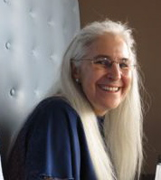
Colorado Children’s
Book Award
A Quick History Updated by
Marcie Haloin February 2022

Slide 2
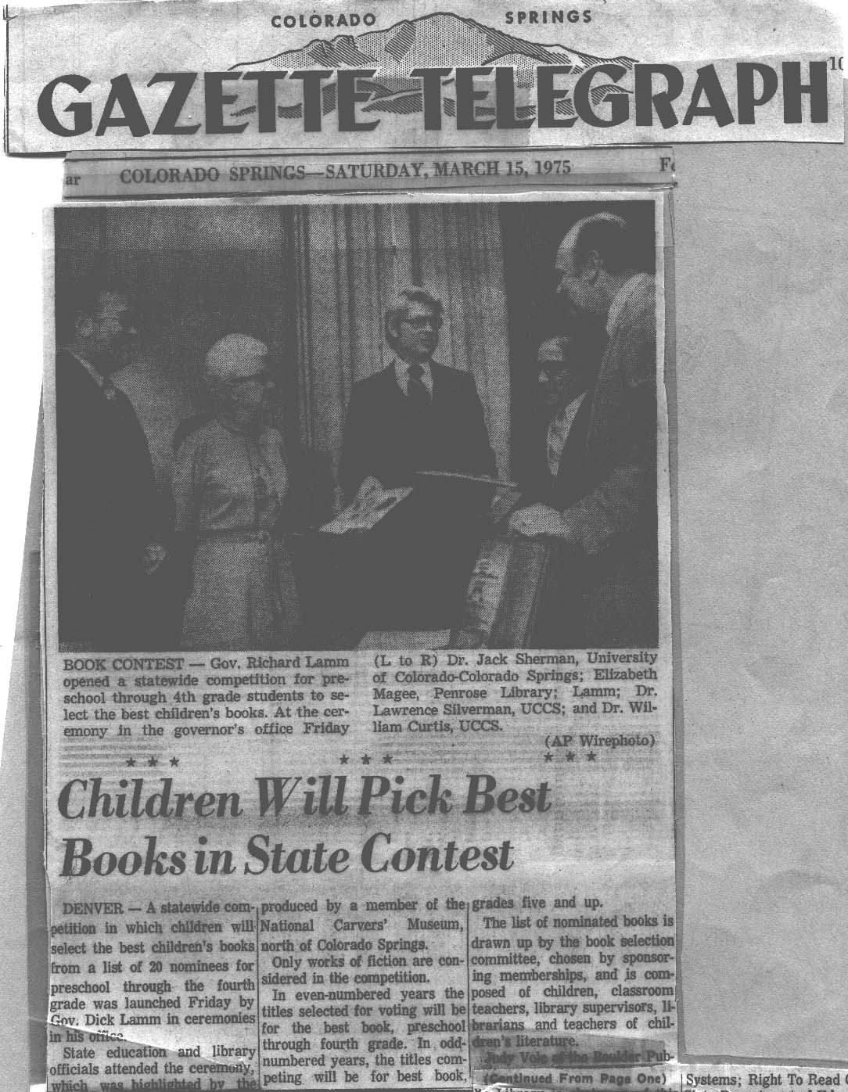

Colorado Children’s Book Award was established by the late Dr. Bill Curtis in 1975 to encourage children’s active involvement with books and reading.
  Since then, more than 1,000,000 students in kindergarten through 8th grade have been nominating, voting for, and selecting CCBA winners.

Slide 3
  Colorado Children nominate 10 picture and 10 junior books each year.
  They then vote for favorite books at their schools or libraries, when they have read, or heard read, a minimum of three books in that category
  If possible the school or library should own 10 of the nominated books
  Ballots must be submitted by March 1.

Slide 4
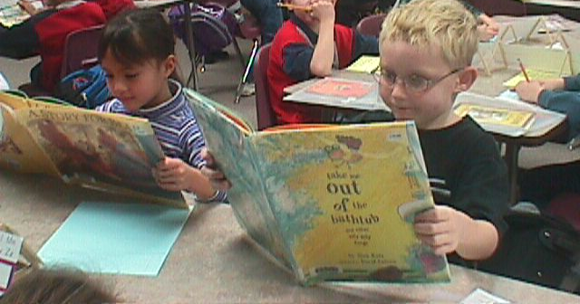
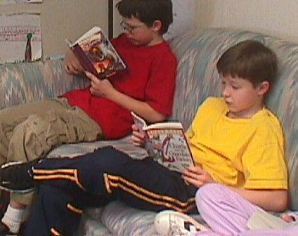
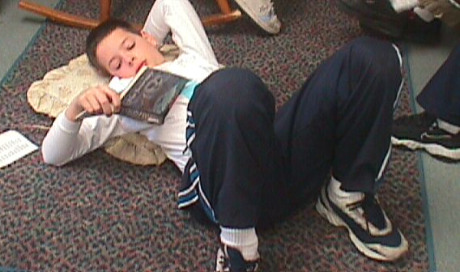
Teachers and students throughout the state read as many of the books as they can.
The votes are tallied by the Colorado Children’s Book Award Committee the first week in March.

Slide 5
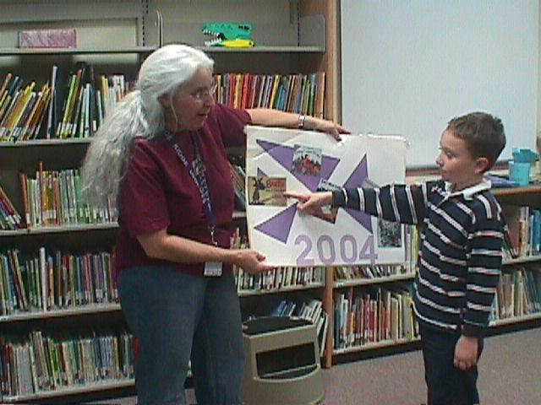
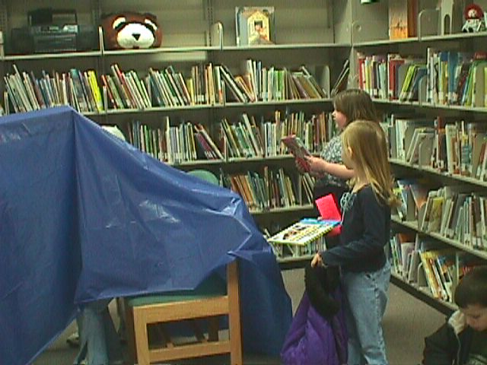
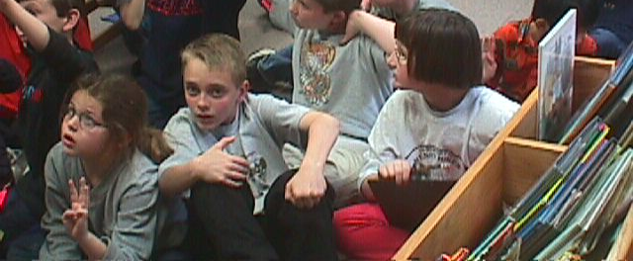
Many different methods are used by schools and
libraries for voting.

Slide 6



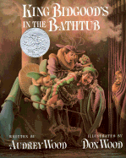

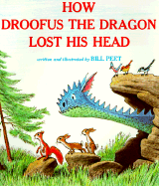
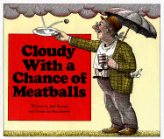
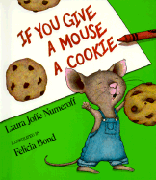
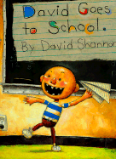

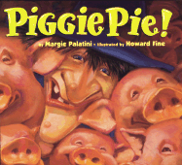
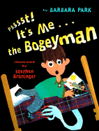

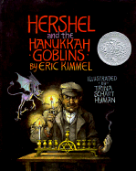


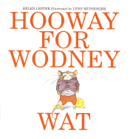
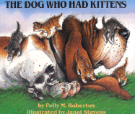
These are some of the 41 picture books that have won the CCBA since 1976

Slide 7




CCBA Winners for 2021
Junior book
winner
Picture book
winner
Guts
by Raina Telgemeier
Llama Destroys the World
by Jonathan Stutzman and Heather Fox
Junior book
runner up
Picture book
runner up
Wildfire by Rodman Philbrick
Gaston by Rachel Bright and Jim Field

Slide 8

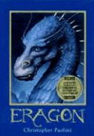
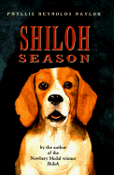

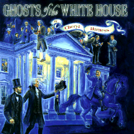
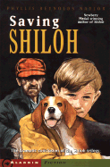
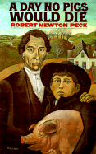
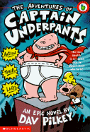
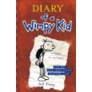


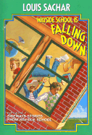
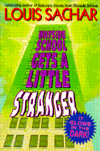
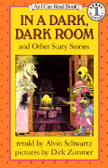
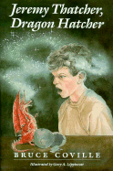



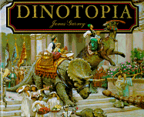
Beginning in 1992 two awards have been presented. One for a picture book and one for a junior book. These are some of the 25 junior book winners.

Slide 9
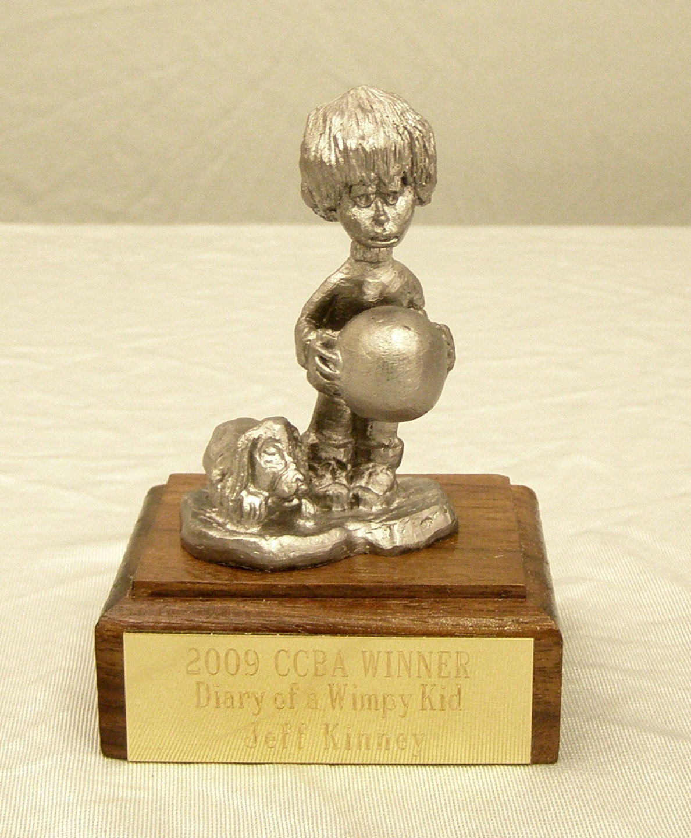
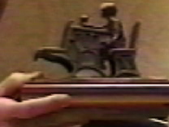
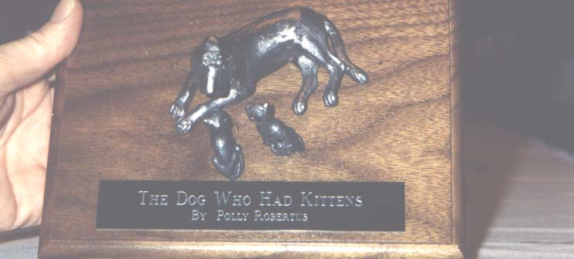
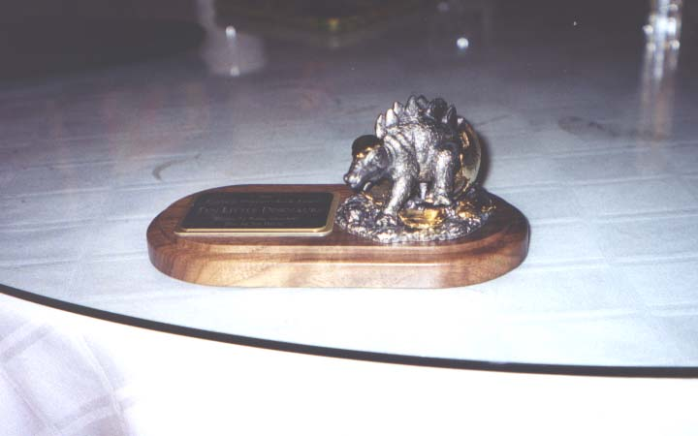
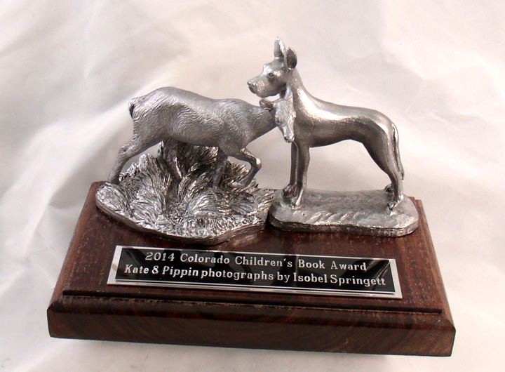
Winning authors are invited to receive their award, and a unique Michael Ricker statue at each year’s CCIRA Children’s Book Award Luncheon.

Slide 10
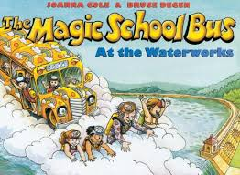
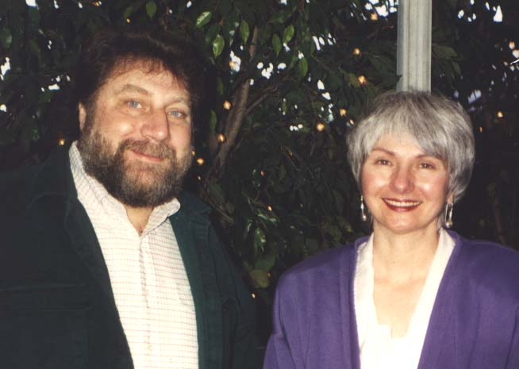
Some authors who have come in the past are:
Bruce Degen and JoAnna Cole - For Magic Schoolbus at the Waterworks in 1989

Slide 11
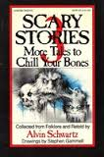
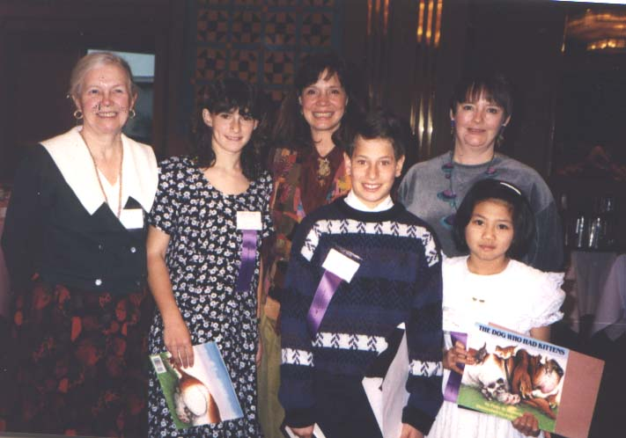
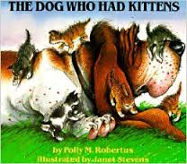
Mrs. Alvin Schwartz for Scary Stories 3 by Alvin Schwartz and
Janet Stevens and Paula Robertson for The Dog Who Had Kittens in 1995

Slide 12
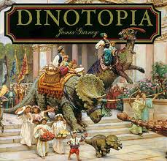
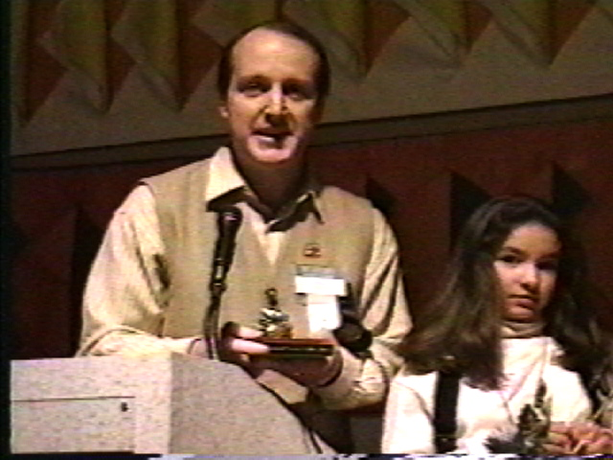
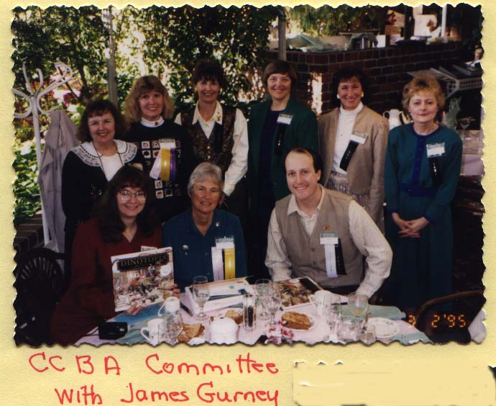
James Gurney for
Dinotopia in 1994

Slide 13
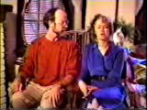
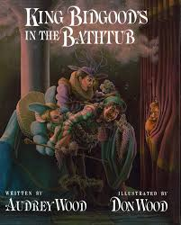

In 1987 when King Bidgood in the Bathtub won, Audrey and Don Wood sent a videotape to say thanks!

Slide 14
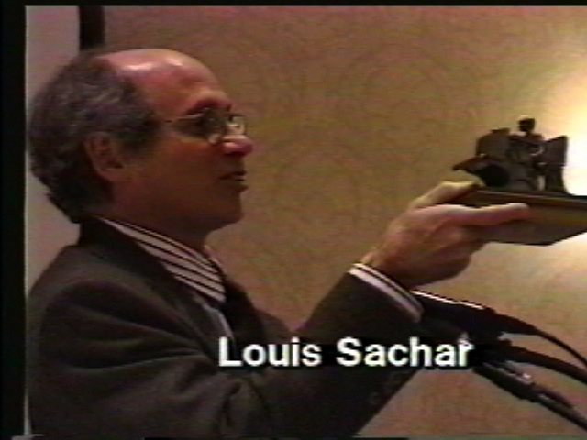
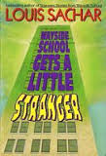
Wayside School Gets a Little Stranger in 1997

Slide 15
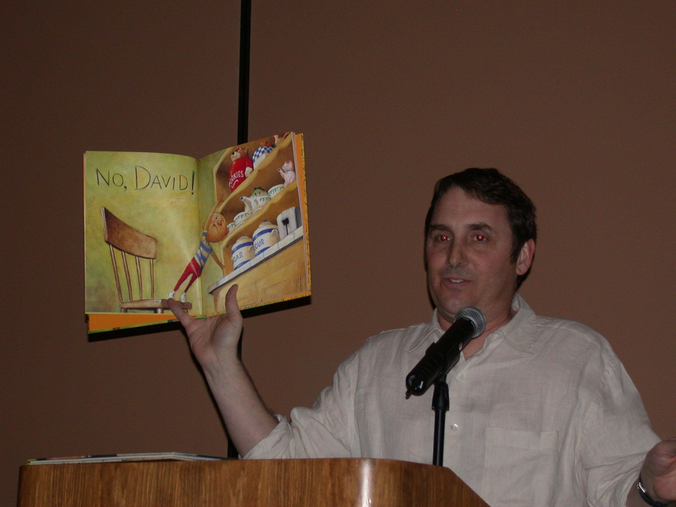
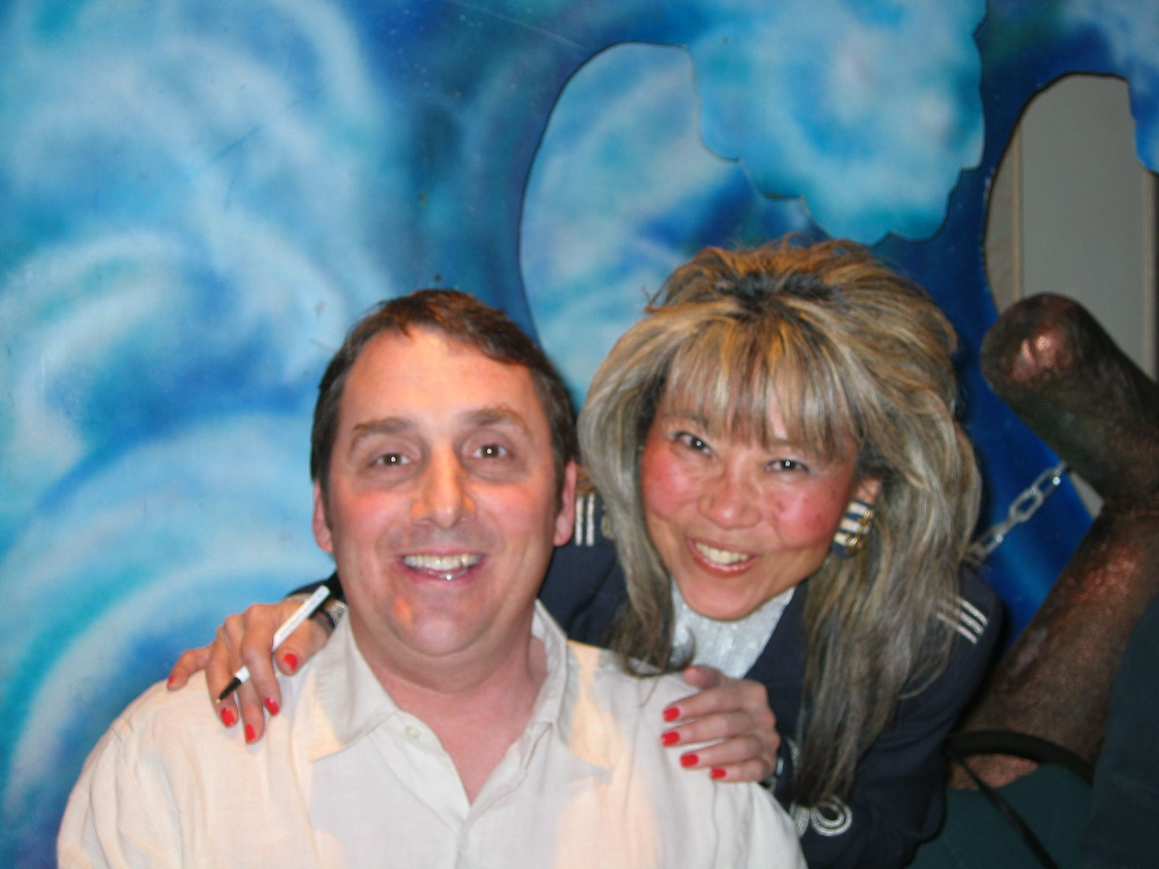
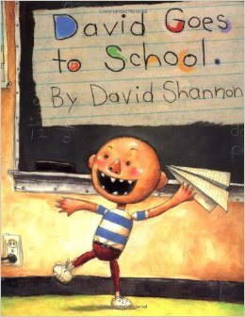
David Shannon for David Goes to School
in 2002

Slide 16

Cheryl Harness for Ghosts of the White House
in 2002

Slide 17






Alan Katz and David Catrow in 2004 for Take Me Out of the Bathtub
Judy Blume who was unable to come sent a DVD to thank the Children

Slide 18




Ridley Pearson and Judy Schachner in 2006

Slide 19




Janet Stevens and Susan Stevens Crummel in 2008

Slide 20



Laurie Keller for Arnie the Doughnut in 2009
Pictures from www.lauriekeller.com

Slide 21



Jeff Kinney in 2010 for
Diary of a Wimpy Kid

Slide 22




Kevin O’Malley and Mary Downing Hawn in 2011.

Slide 23




Mary Nethery in snowy 2012

Slide 24



Chris Barton in 2013

Slide 25



In 2015 Martin Springett and Isobel Springett came from Canada for Kate and Pippin

Slide 26


Gordon Korman on February 6, 2016

Slide 27


Bridget Heos in 2018 for Mustache Baby

Slide 28

Other activities of the committee include:
Notify winners and nominees and their publishers;
Encourage and increase participation by the children of Colorado;

Slide 29

Count ballots and certify winners;
Announce and publicize the award;

Slide 30



Circulate traveling box of the nominated books to CCIRA Councils throughout the year;
Thanks to Mackin, and some years Bound to Stay Bound, Follett, and Scholastic Book Fairs
for donations of these sets of books and posters as well.

Slide 31
Starting in 2013-2019 Student Reporters from the Denver Post have written and published reviews of the books.
Since 2016 it has
Been in ColoradoKids! At ColoradoNIE.com

Slide 32




The committee and volunteers produced large fabric banners to display the winners and nominees during the conference until 2020

Slide 33








Some 2005, 2006 and 2007 nominee banners

Slide 34
Every year flyer as a .pdf is made available to schools and libraries throughout the state. Voting is done online at the CCIRA website.
www.ccira.org-->Professional Learning-->Colorado Children's Book Award→ VOTE FOR CCBA 2022 AND NOMINATE FOR 2023!

Slide 35

Current CCBA Committee:
Marcie Haloin, chairperson
Julianne Guyer
Kyle Kimmal
Christine Cervera
Hollyanna Bates
Cindi Bryant
Heather Walker
Susan Gorrell
Marybel Schimberg
Carol Wilcox

Slide 36




Materials for this presentation were taken from the CCBA Archives
Voices: Kelsey Clark,
Morgan Golightly, and Riana Roy, Marcie Haloin
Images from Scrapbooks created by many CCBA chairpersons and volunteers.

Slide 37



















These are the 20 nominated books for 2022. Please encourage your students and children to vote . Also, nominate books for 2023.

Slide 38
Nominations Nominated Books must be currently in print and published in the five years preceding the award year.
Only one title per author will be included in each year’s ballot
Last year’s WINNING authors are not eligible this year.
Books previously nominated are not eligible for nomination in following years.
A book title nominated by more than one school will be considered more heavily for inclusion in the final list.
Books based on movies, toys, Apps, etc. are not eligible.
Author must be a living author.
Caldecott and Newbery Award winners are not eligible.
Once a book in a series has won, all other books in that series by that author will not be eligible for nomination.

Slide 39
c2018, c2019, c2020, c2021, c2022
Only one title per author will be included in each year’s ballot
Last year’s WINNING authors are not eligible this year.
Books get only one chance to win
Number of Schools tallied first.
No movies, TV shows, Toys
Author Lives in USA
ALA winners NO Honor Books YES
Once a book in a series has won, all other books in that series by that author will not be eligible for nomination.

